Slide 1
Chapter 6 Fundamentals of Stochastic Calculus

Slide 2
Stochastic Calculus: Introduction
Although stochastic and ordinary calculus share many common properties, there are fundamental differences. The probabilistic nature of stochastic processes distinguishes them from the deterministic functions associated with ordinary calculus. Since stochastic differential equations so frequently involve Brownian motion, second order terms in the Taylor series expansion of functions become important, in contrast to ordinary calculus where they can be ignored.

Slide 3
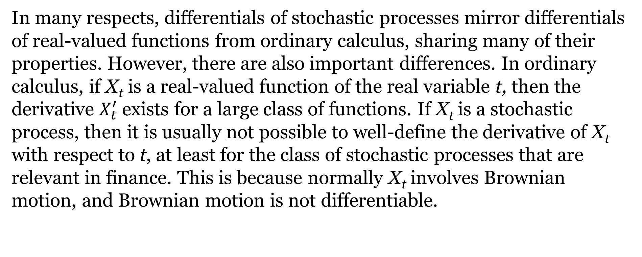
Differentials Of Stochastic Processes
In many respects, differentials of stochastic processes mirror differentials of real-valued functions from ordinary calculus, sharing many of their properties. However, there are also important differences. In ordinary calculus, if X_{t} is a real-valued function of the real variable t, then the derivative $X_{t}^{′}$exists for a large class of functions. If X_{t} is a stochastic process, then it is usually not possible to well-define the derivative of X_{t} with respect to t, at least for the class of stochastic processes that are relevant in finance. This is because normally X_{t} involves Brownian motion, and Brownian motion is not differentiable.

Slide 4
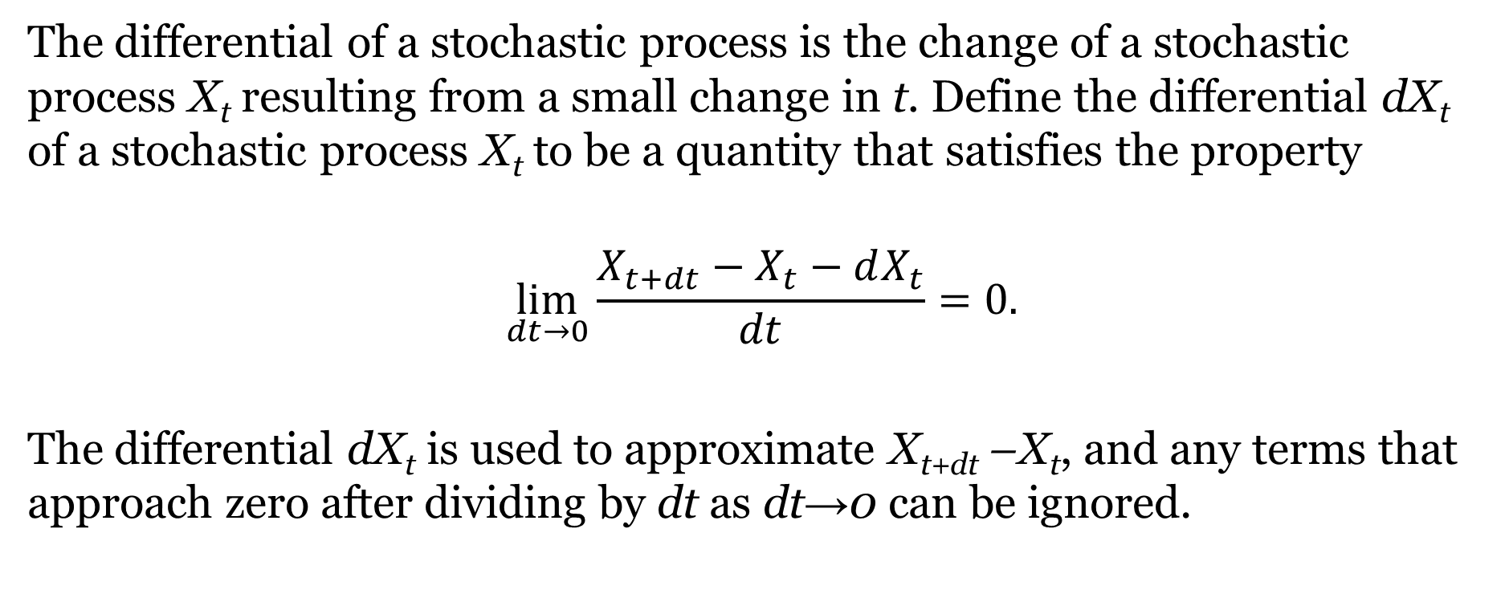
Differentials Of Stochastic Processes (Continued)
The differential of a stochastic process is the change of a stochastic process X_{t} resulting from a small change in t. Define the differential dX_{t} of a stochastic process X_{t} to be a quantity that satisfies the property
$$\lim_{dt→0}{\frac{X_{t+dt}−X_{t}−dX_{t}}{dt}}=0.$$
The differential dX_{t} is used to approximate X_{t+dt} –X_{t}, and any terms that approach zero after dividing by dt as dt→0 can be ignored.

Slide 5
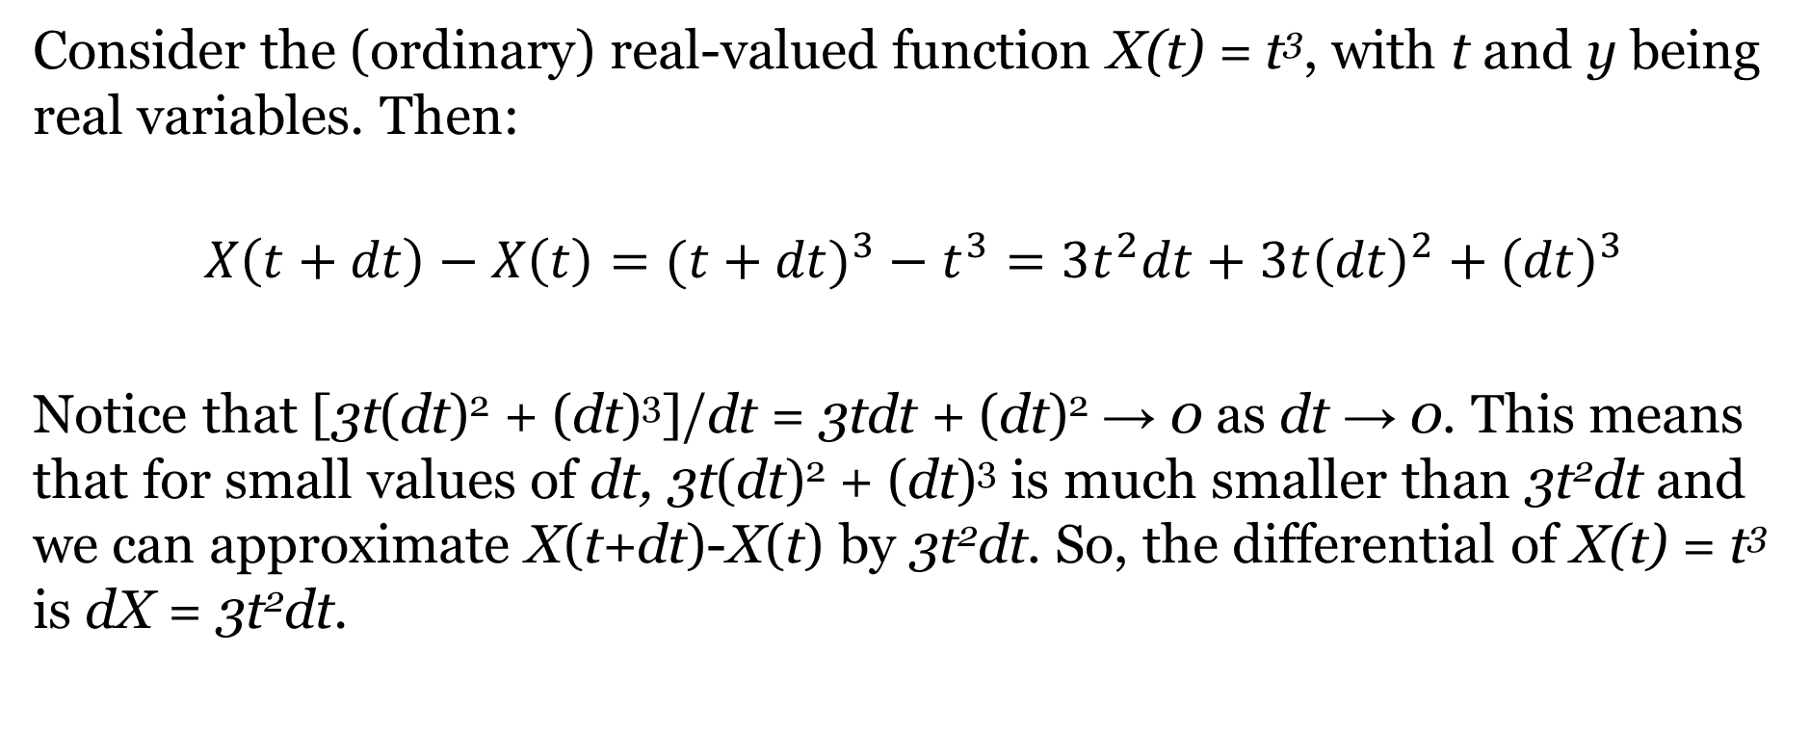
An Example Of A Real-Valued Differential From Ordinary Calculus
Consider the (ordinary) real-valued function X(t) = t³, with t and y being real variables. Then:
$${X\left(t+dt\right)−X\left(t\right)=(t+dt)}^{3}−t^{3}=3t^{2}dt+3t{\left(dt\right)}^{2}+{\left(dt\right)}^{3}$$
Notice that [3t(dt)² + (dt)³]/dt = 3tdt + (dt)² → 0 as dt → 0. This means that for small values of dt, 3t(dt)² + (dt)³ is much smaller than 3t²dt and we can approximate X(t+dt)-X(t) by 3t²dt. So, the differential of X(t) = t³ is dX = 3t²dt.

Slide 6
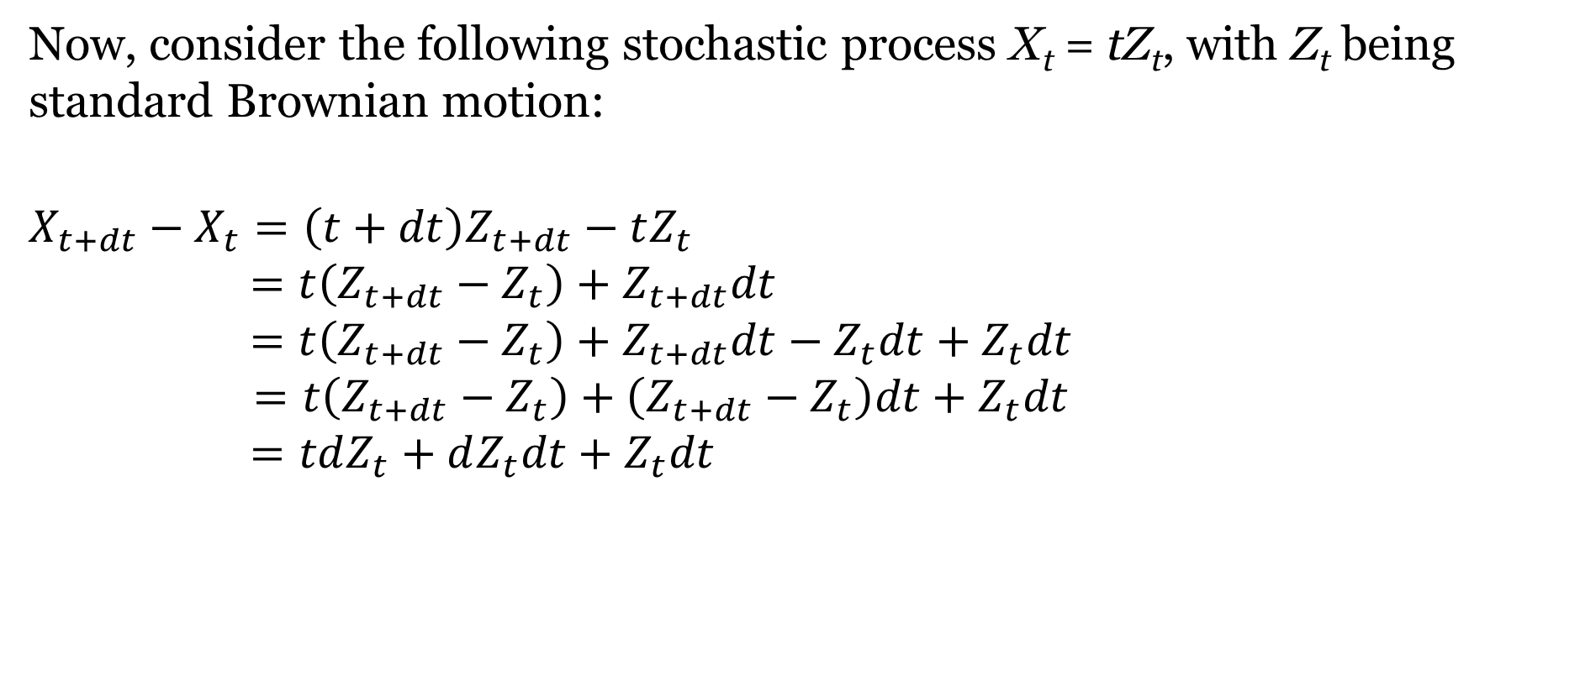
An Example Of A Stochastic Differential
Now, consider the following stochastic process X_{t} = tZ_{t}, with Z_{t} being standard Brownian motion:
$$X_{t+dt}−X_{t}=\left(t+dt\right)Z_{t+dt}−tZ_{t}$$
$$=t\left(Z_{t+dt}−Z_{t}\right)+Z_{t+dt}dt$$
$$=t\left(Z_{t+dt}−Z_{t}\right)+Z_{t+dt}dt−Z_{t}dt+Z_{t}dt$$
$$=t\left(Z_{t+dt}−Z_{t}\right)+\left(Z_{t+dt}−Z_{t}\right)dt+Z_{t}dt$$
$$=tdZ_{t}+dZ_{t}dt+Z_{t}dt$$

Slide 7
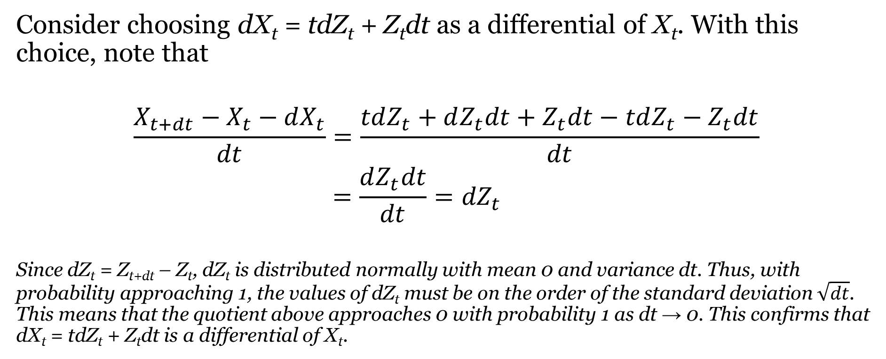
An Example Of A Stochastic Differential (Continued)
Consider choosing dX_{t} = tdZ_{t} + Z_{t}dt as a differential of X_{t}. With this choice, note that
$$\frac{X_{t+dt}−X_{t}−dX_{t}}{dt}=\frac{tdZ_{t}+dZ_{t}dt+Z_{t}dt−tdZ_{t}−Z_{t}dt}{dt}$$
$$=\frac{dZ_{t}dt}{dt}={dZ}_{t}$$
Since dZ_{t} = Z_{t+dt} – Z_{t}, dZ_{t} is distributed normally with mean 0 and variance dt. Thus, with probability approaching 1, the values of dZ_{t} must be on the order of the standard deviation $\sqrt{dt}$. This means that the quotient above approaches 0 with probability 1 as dt → 0. This confirms that dX_{t} = tdZ_{t} + Z_{t}dt is a differential of X_{t}.

Slide 8
Properties Of The Differential
Linearity: If X_{t} and Y_{t} are stochastic processes, and a and b are constants, then d(aX_{t} +bY_{t}) = adX_{t} +bdY_{t}.
General Product Rule: If X_{t} and Y_{t} are stochastic processes, then d(X_{t}Y_{t}) = X_{t}dYt + Y_{t}dX_{t} +dX_{t}dY_{t}.
Special Product Rule: Suppose that dX_{t} = μ_{t}dt + σ_{t}dZ_{t} and dY_{t} =ρ_{t}dt where σ_{t}, μ_{t}, and ρ_{t} are stochastic processes, then d(X_{t}Y_{t}) = X_{t}dYt + Y_{t}dX_{t}.

Slide 9
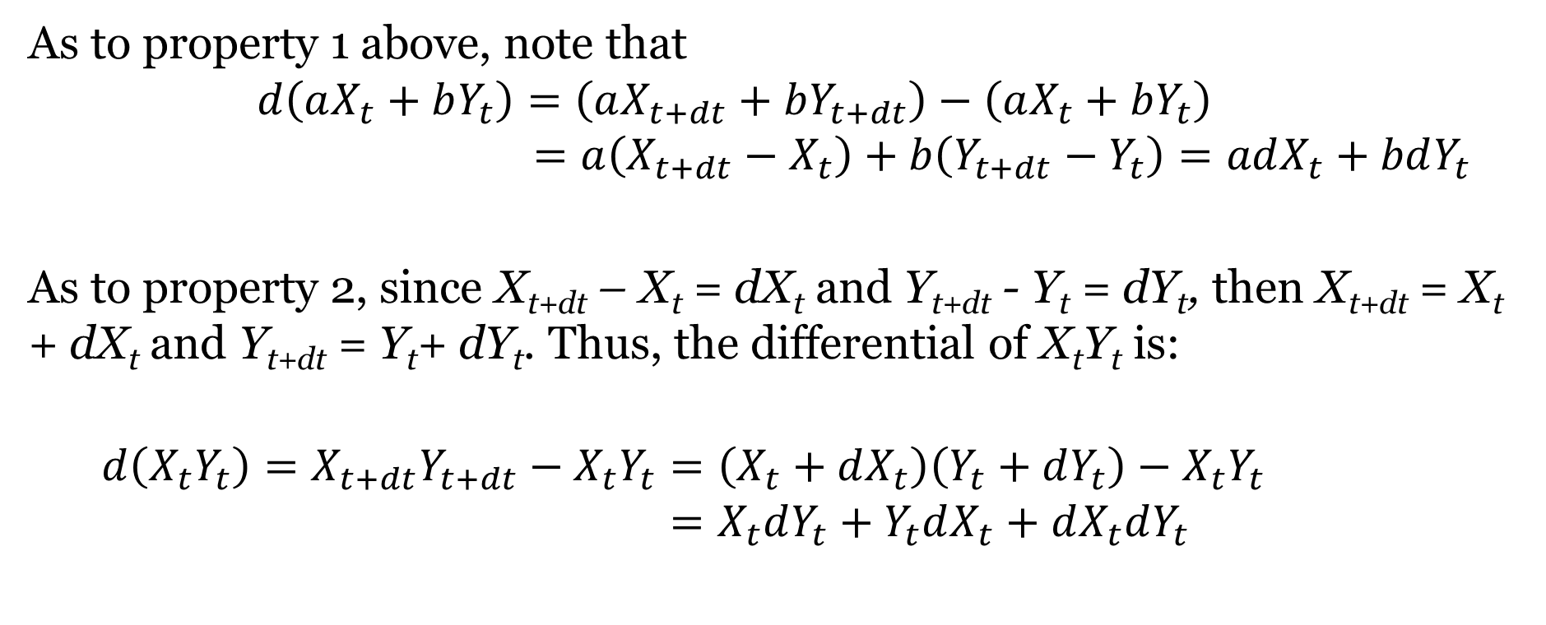
Proofs Of Properties Of The Differential
As to property 1 above, note that
$$d\left(aX_{t}+bY_{t}\right)=\left(aX_{t+dt}+bY_{t+dt}\right)−\left(aX_{t}+bY_{t}\right)$$
$$=a\left(X_{t+dt}−X_{t}\right)+b\left(Y_{t+dt}−Y_{t}\right)=adX_{t}+bdY_{t}$$
As to property 2, since X_{t+dt} – X_{t} = dX_{t} and Y_{t+dt} - Y_{t} = dY_{t}, then X_{t+dt} = X_{t} + dX_{t} and Y_{t+dt} = Y_{t}+ dY_{t}. Thus, the differential of X_{t}Y_{t} is:
$$d\left(X_{t}Y_{t}\right)=X_{t+dt}Y_{t+dt}−X_{t}Y_{t}=\left(X_{t}+dX_{t}\right)\left(Y_{t}+dY_{t}\right)−X_{t}Y_{t }$$
$$=X_{t}dY_{t}+Y_{t}dX_{t}+dX_{t}dY_{t}$$

Slide 10
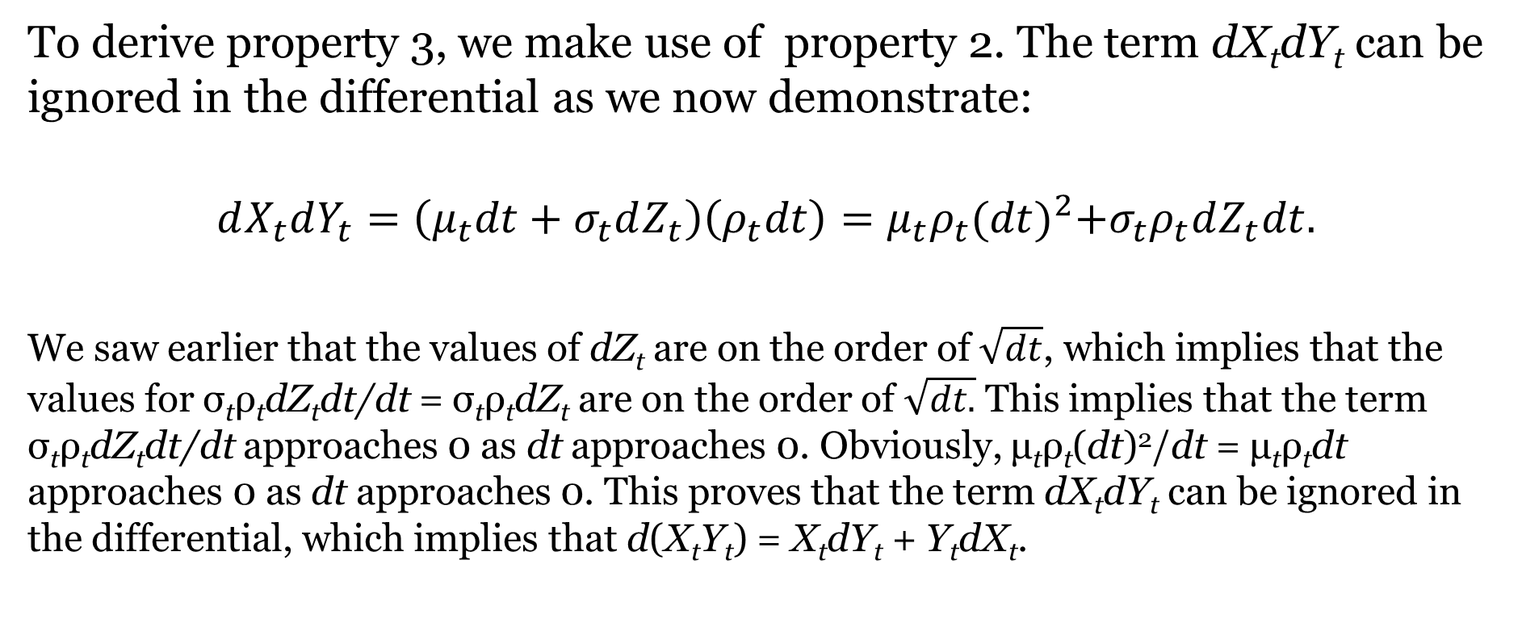
Proofs Of Properties Of The Differential (Continued)
To derive property 3, we make use of property 2. The term dX_{t}dY_{t} can be ignored in the differential as we now demonstrate:
$$dX_{t}dY_{t}=\left(μ_{t}dt+σ_{t}dZ_{t}\right)\left(ρ_{t}dt\right)=μ_{t}ρ_{t}{(dt)}^{2}+σ_{t}ρ_{t}dZ_{t}dt.$$
We saw earlier that the values of dZ_{t} are on the order of $\sqrt{dt}$, which implies that the values for σ_{t}ρ_{t}dZ_{t}dt/dt = σ_{t}ρ_{t}dZ_{t} are on the order of $\sqrt{dt.}$ This implies that the term σ_{t}ρ_{t}dZ_{t}dt/dt approaches 0 as dt approaches 0. Obviously, μ_{t}ρ_{t}(dt)²/dt = μ_{t}ρ_{t}dt approaches 0 as dt approaches 0. This proves that the term dX_{t}dY_{t} can be ignored in the differential, which implies that d(X_{t}Y_{t}) = X_{t}dY_{t} + Y_{t}dX_{t}.

Slide 11
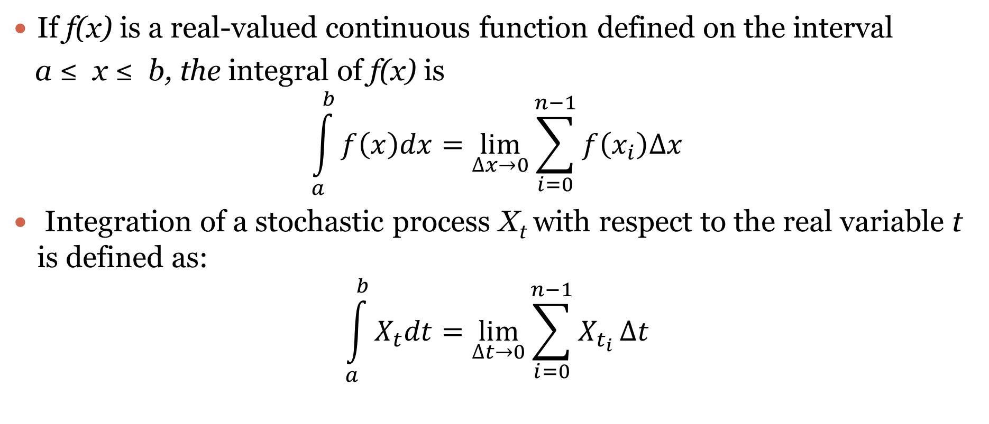
Stochastic Integration
If f(x) is a real-valued continuous function defined on the interval
a ≤ x ≤ b, the integral of f(x) is
$$\int_{a}^{b}{f\left(x\right)dx}=\lim_{∆x→0}{\sum_{i=0}^{n−1}{f\left(x_{i}\right)∆x}}$$
Integration of a stochastic process X_{t} with respect to the real variable t is defined as:
$$\int_{a}^{b}{X_{t}dt}=\lim_{∆t→0}{\sum_{i=0}^{n−1}{X_{t_{i}}}}∆t$$
Where Δt = (b – a)/n and t_{i} = a + iΔt for i = 0,1,…,n

Slide 12
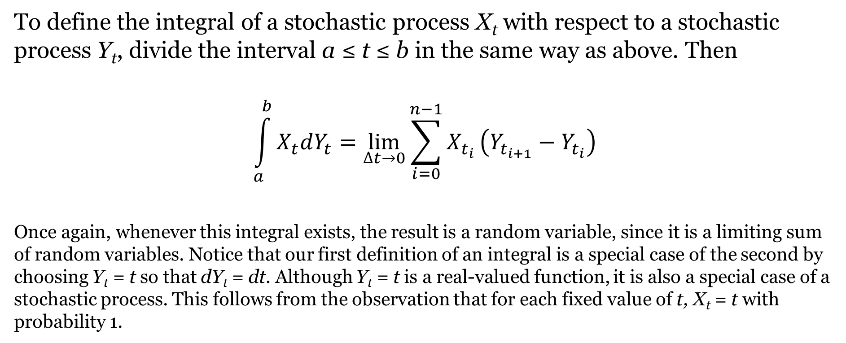
Stochastic Integration (Continued)
To define the integral of a stochastic process X_{t} with respect to a stochastic process Y_{t}, divide the interval a ≤ t ≤ b in the same way as above. Then
$$\int_{a}^{b}{X_{t}dY_{t}}=\lim_{∆t→0}{\sum_{i=0}^{n−1}{X_{t_{i}}}}\left(Y_{t_{i+1}}−Y_{t_{i}}\right)$$
Once again, whenever this integral exists, the result is a random variable, since it is a limiting sum of random variables. Notice that our first definition of an integral is a special case of the second by choosing Y_{t} = t so that dY_{t} = dt. Although Y_{t} = t is a real-valued function, it is also a special case of a stochastic process. This follows from the observation that for each fixed value of t, X_{t} = t with probability 1.

Slide 13
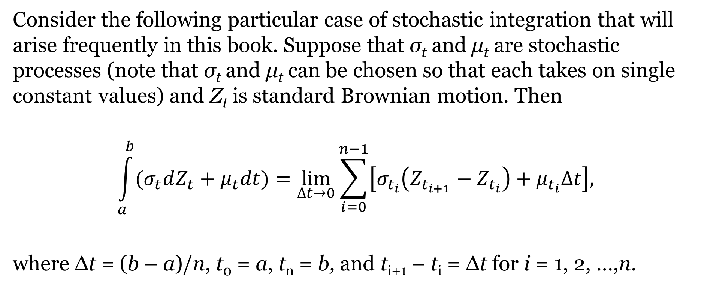
Stochastic Integration (Continued)
Consider the following particular case of stochastic integration that will arise frequently in this book. Suppose that σ_{t} and μ_{t} are stochastic processes (note that σ_{t} and μ_{t} can be chosen so that each takes on single constant values) and Z_{t} is standard Brownian motion. Then
$$\int_{a}^{b}{(σ_{t}dZ_{t}+μ_{t}dt)}=\lim_{∆t→0}{\sum_{i=0}^{n−1}{\left[σ_{t_{i}}\left(Z_{t_{i+1}}−Z_{t_{i}}\right)+μ_{t_{i}}∆t\right],}}$$
where Δt = (b – a)/n, t₀ = a, t_{n} = b, and t_{i+1} – t_{i} = Δt for i = 1, 2, …,n.

Slide 14
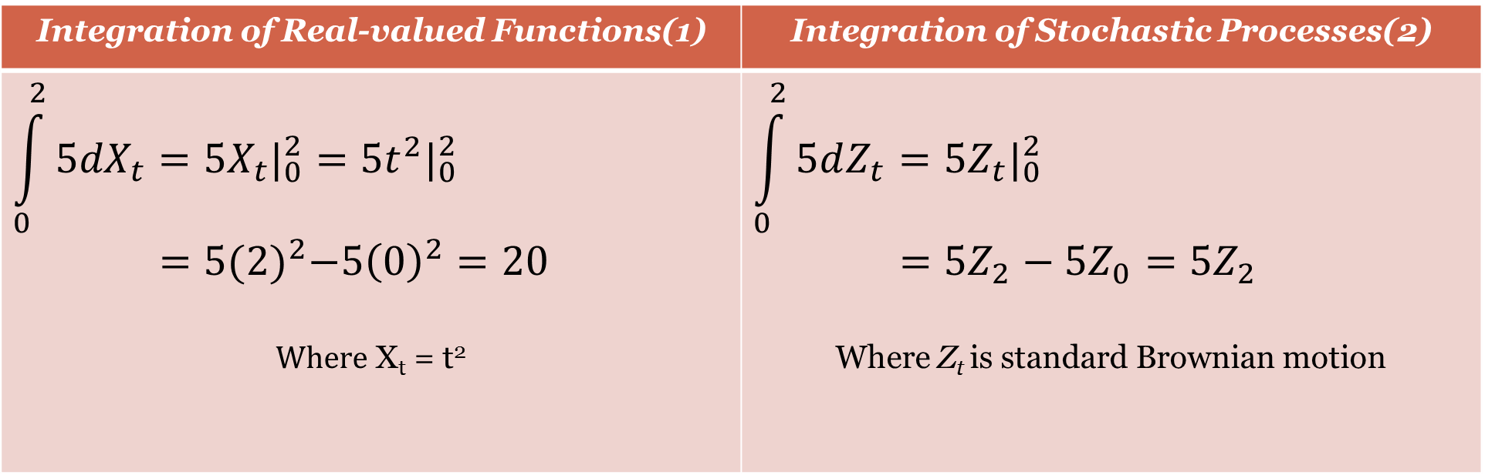
Contrasting Integration of Real-valued Functions with Integration of Stochastic Processes
Integration of Real-valued Functions(1) | Integration of Stochastic Processes(2)
$$\int_{0}^{2}{{5dX}_{t}}=5X_{t}|_{0}^{2}=5t^{2}|_{0}^{2}$$ $=5{(2)}^{2}−5{\left(0\right)}^{2}=20$ $Where$ X_{t} = t² | $$\int_{0}^{2}{5dZ_{t}=5Z_{t}|_{0}^{2}}$$ $=5Z_{2}−5Z_{0}=5Z_{2}$ Where Z_{t} is standard Brownian motion
The solution in the first illustration is a number. The solution in the second illustration is a random variable since Z₂ is a normally distributed random variable, with mean 0 and variance 2. Thus, 5Z₂ is a normally distributed random variable with mean 0 and variance (5)²(2) = 50.

Slide 15
Elementary Properties of Stochastic Integrals
Integral of a Stochastic Differential
Linearity

Slide 16
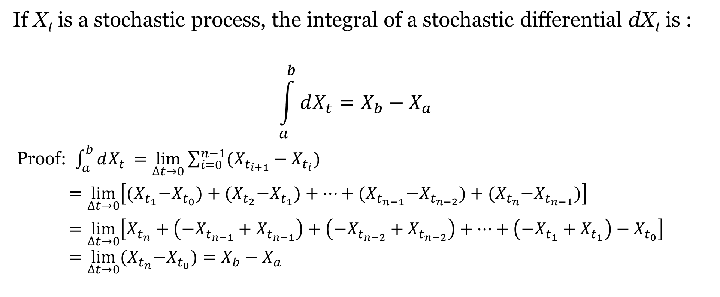
Integral of a Stochastic Differential
If X_{t} is a stochastic process, the integral of a stochastic differential dX_{t} is :
$$\int_{a}^{b}{dX_{t}}=X_{b}−X_{a}$$
Proof: $\int_{a}^{b}{dX_{t}}$ $=\lim_{∆t→0}{\sum_{i=0}^{n−1}{{(X}_{t_{i+1}}}−X_{t_{i}})}$
$=\lim_{∆t→0}\left[{(X}_{t_{1}}−X_{t_{0}})+{(X}_{t_{2}}−X_{t_{1}})+…+{(X}_{t_{n−1}}−X_{t_{n−2}})+{(X}_{t_{n}}−X_{t_{n−1}})\right]$
$=\lim_{∆t→0}\left[X_{t_{n}}+\left(−X_{t_{n−1}}+X_{t_{n−1}}\right)+\left(−X_{t_{n−2}}+X_{t_{n−2}}\right)+…+\left(−X_{t_{1}}+X_{t_{1}}\right)−X_{t_{0}}\right]$ $=\lim_{∆t→0}{(X}_{t_{n}}−X_{t_{0}})=X_{b}−X_{a}$

Slide 17
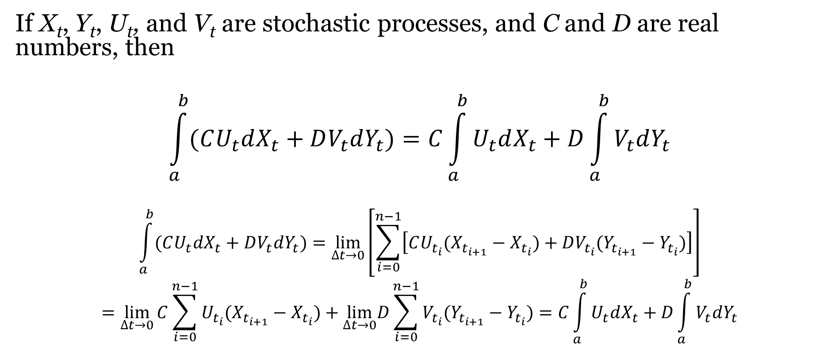
Linearity
If X_{t}, Y_{t}, U_{t}, and V_{t} are stochastic processes, and C and D are real numbers, then
$$\int_{a}^{b}{(CU_{t}dX_{t}+DV_{t}dY_{t})=C\int_{a}^{b}{U_{t}dX_{t}}}+D\int_{a}^{b}{V_{t}dY_{t}}$$
$$\int_{a}^{b}{(CU_{t}dX_{t}+DV_{t}dY_{t})}=\lim_{∆t→0}\left[\sum_{i=0}^{n−1}{\left[{CU_{t_{i}}(X}_{t_{i+1}}−X_{t_{i}})+DV_{t_{i}}(Y_{t_{i+1}}−Y_{t_{i}})\right]}\right]$$
$$=\lim_{∆t→0}{C\sum_{i=0}^{n−1}{U_{t_{i}}{(X}_{t_{i+1}}}}−X_{t_{i}})+\lim_{∆t→0}D\sum_{i=0}^{n−1}{V_{t_{i}}(Y_{t_{i+1}}−Y_{t_{i}}})=C\int_{a}^{b}{U_{t}dX_{t}}+D\int_{a}^{b}{V_{t}dY_{t}}$$
Proof:

Slide 18
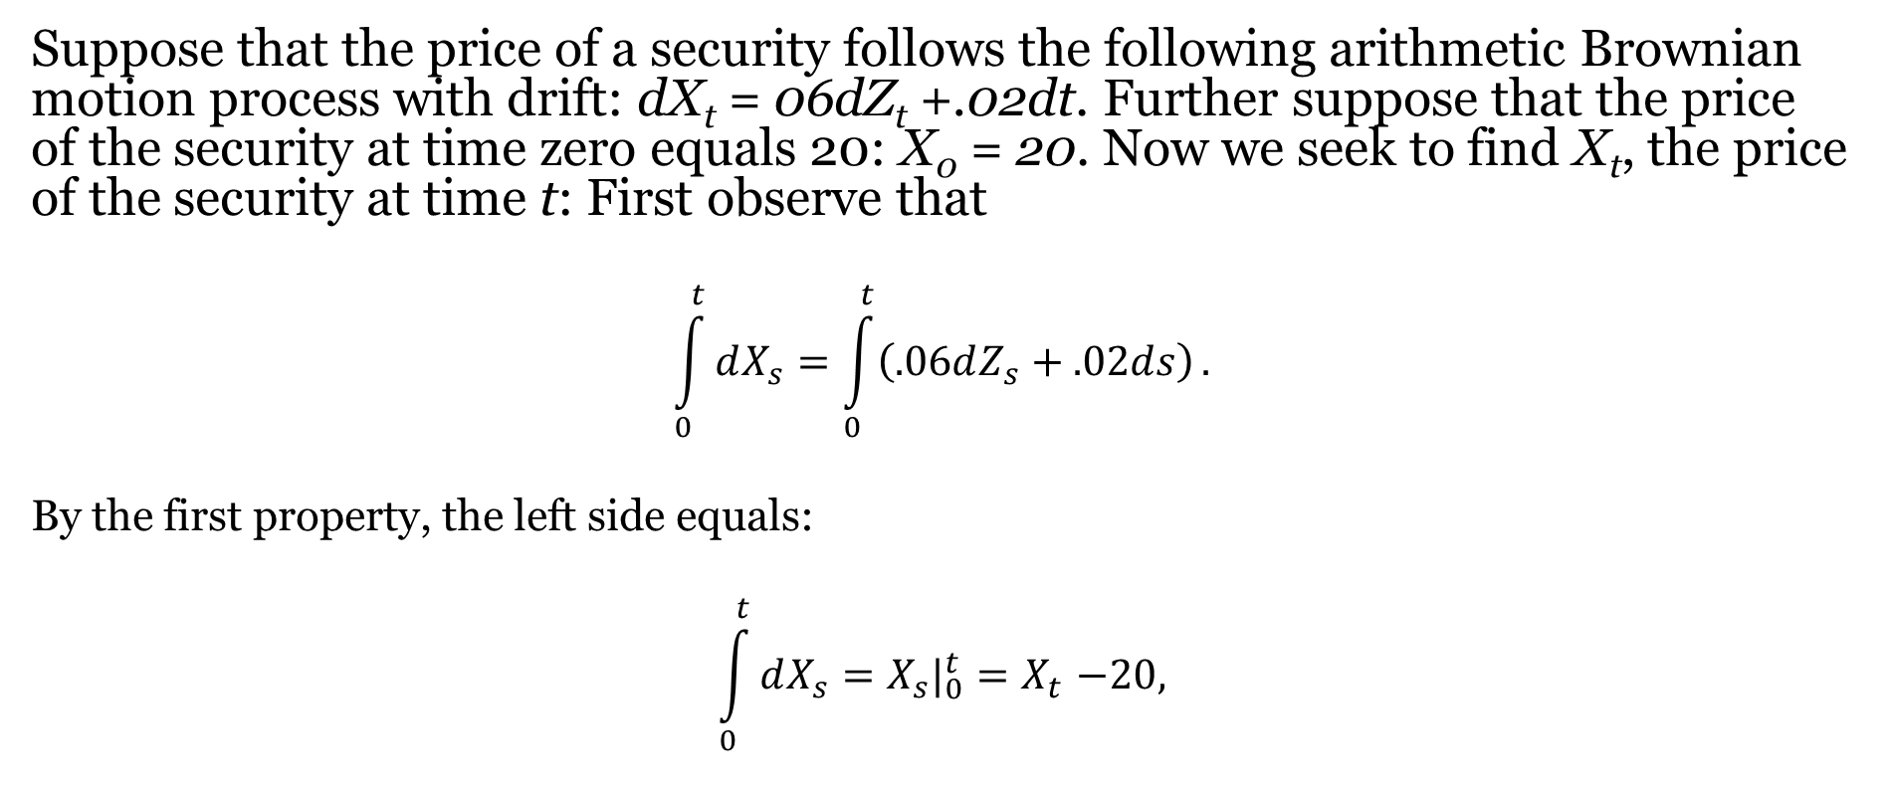
Illustration
Suppose that the price of a security follows the following arithmetic Brownian motion process with drift: dX_{t} = 06dZ_{t} +.02dt. Further suppose that the price of the security at time zero equals 20: X₀ = 20. Now we seek to find X_{t}, the price of the security at time t: First observe that
$$\int_{0}^{t}{dX_{s}}=\int_{0}^{t}{\left(.06dZ_{s}+.02ds\right)}.$$
By the first property, the left side equals:
$$\int_{0}^{t}{dX_{s}}=X_{s}|_{0}^{t}{=X}_{t}−20,$$

Slide 19
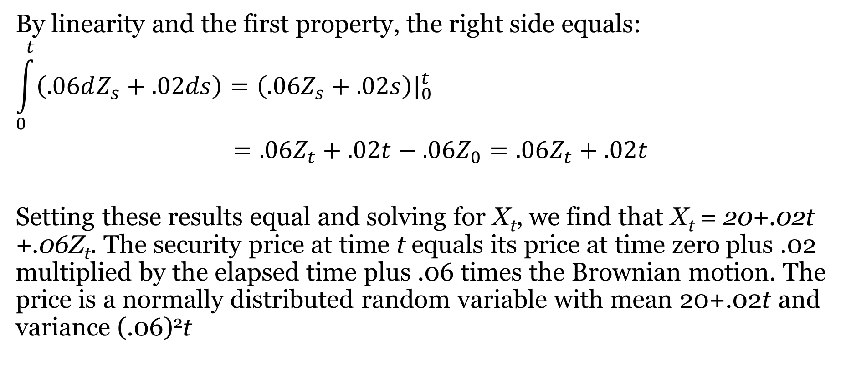
Illustration (Continued)
By linearity and the first property, the right side equals:
$$\int_{0}^{t}{\left(.06dZ_{s}+.02ds\right)=\left(.06Z_{s}+.02s\right)|_{0}^{t}}$$
$=.06Z_{t}+.02t−.06Z_{0}=.06Z_{t}+.02t$
Setting these results equal and solving for X_{t}, we find that X_{t} = 20+.02t +.06Z_{t}. The security price at time t equals its price at time zero plus .02 multiplied by the elapsed time plus .06 times the Brownian motion. The price is a normally distributed random variable with mean 20+.02t and variance (.06)²t

Slide 20
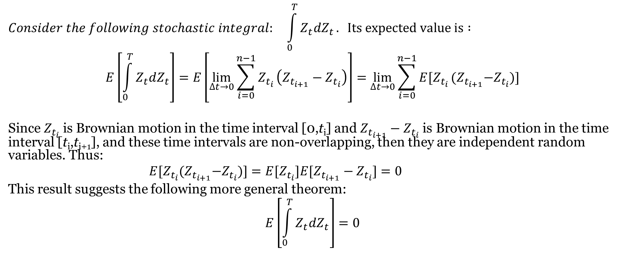
More on Defining Stochastic Integrals
$$Consider the following stochastic integral: \int_{0}^{T}{Z_{t}dZ_{t}}. Its expected value is :$$
$$E\left[\int_{0}^{T}{Z_{t}dZ_{t}}\right]=E\left[\lim_{∆t→0}{\sum_{i=0}^{n−1}{Z_{t_{i}}}}\left(Z_{t_{i+1}}−Z_{t_{i}}\right)\right]=\lim_{∆t→0}{\sum_{i=0}^{n−1}{{E[Z}_{t_{i}}}}{(Z}_{t_{i+1}}−Z_{t_{i}})]$$
Since $Z_{t_{i}}$ is Brownian motion in the time interval [0,t_{i}] and $Z_{t_{i+1}}−Z_{t_{i}}$ is Brownian motion in the time interval [t_{i},t_{i+1}], and these time intervals are non-overlapping, then they are independent random variables. Thus:
$$E[Z_{t_{i}}{(Z}_{t_{i+1}}−Z_{t_{i}})]=E[Z_{t_{i}}]E[Z_{t_{i+1}}−Z_{t_{i}}]=0$$
This result suggests the following more general theorem:
$$E\left[\int_{0}^{T}{Z_{t}dZ_{t}}\right]=0$$

Slide 21
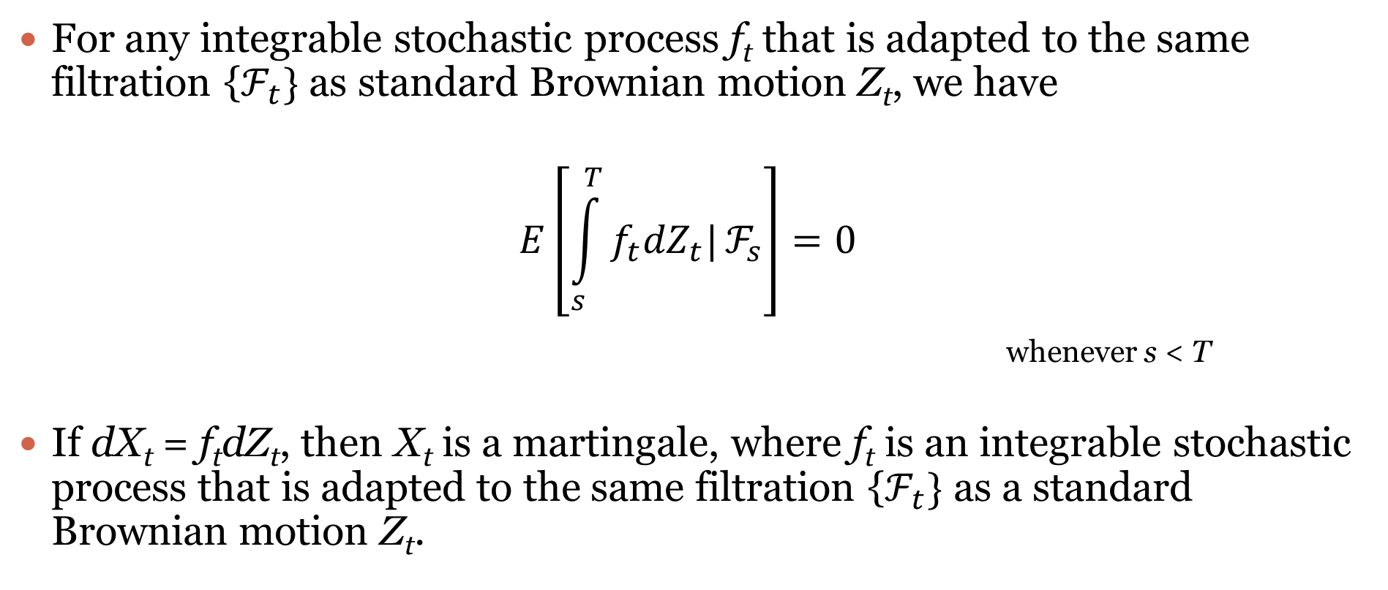
Significant Results based on Stochastic Integration
For any integrable stochastic process f_{t} that is adapted to the same filtration {$ℱ_{t}\}$ as standard Brownian motion Z_{t}, we have
$$E\left[\int_{s}^{T}{f_{t}{dZ}_{t}|}ℱ_{s}\right]=0$$
whenever s < T
If dX_{t} = f_{t}dZ_{t}, then X_{t} is a martingale, where f_{t} is an integrable stochastic process that is adapted to the same filtration {$ℱ_{t}\}$ as a standard Brownian motion Z_{t}.

Slide 22

Itô Isometry
If f_{t} is a square integrable stochastic process, then
$$E\left[{\left(\int_{0}^{T}{f_{t}{dZ}_{t})}\right)}^{2}\right]=\int_{0}^{T}{E\left[f_{t}^{2}\right]dt.}$$

Slide 23
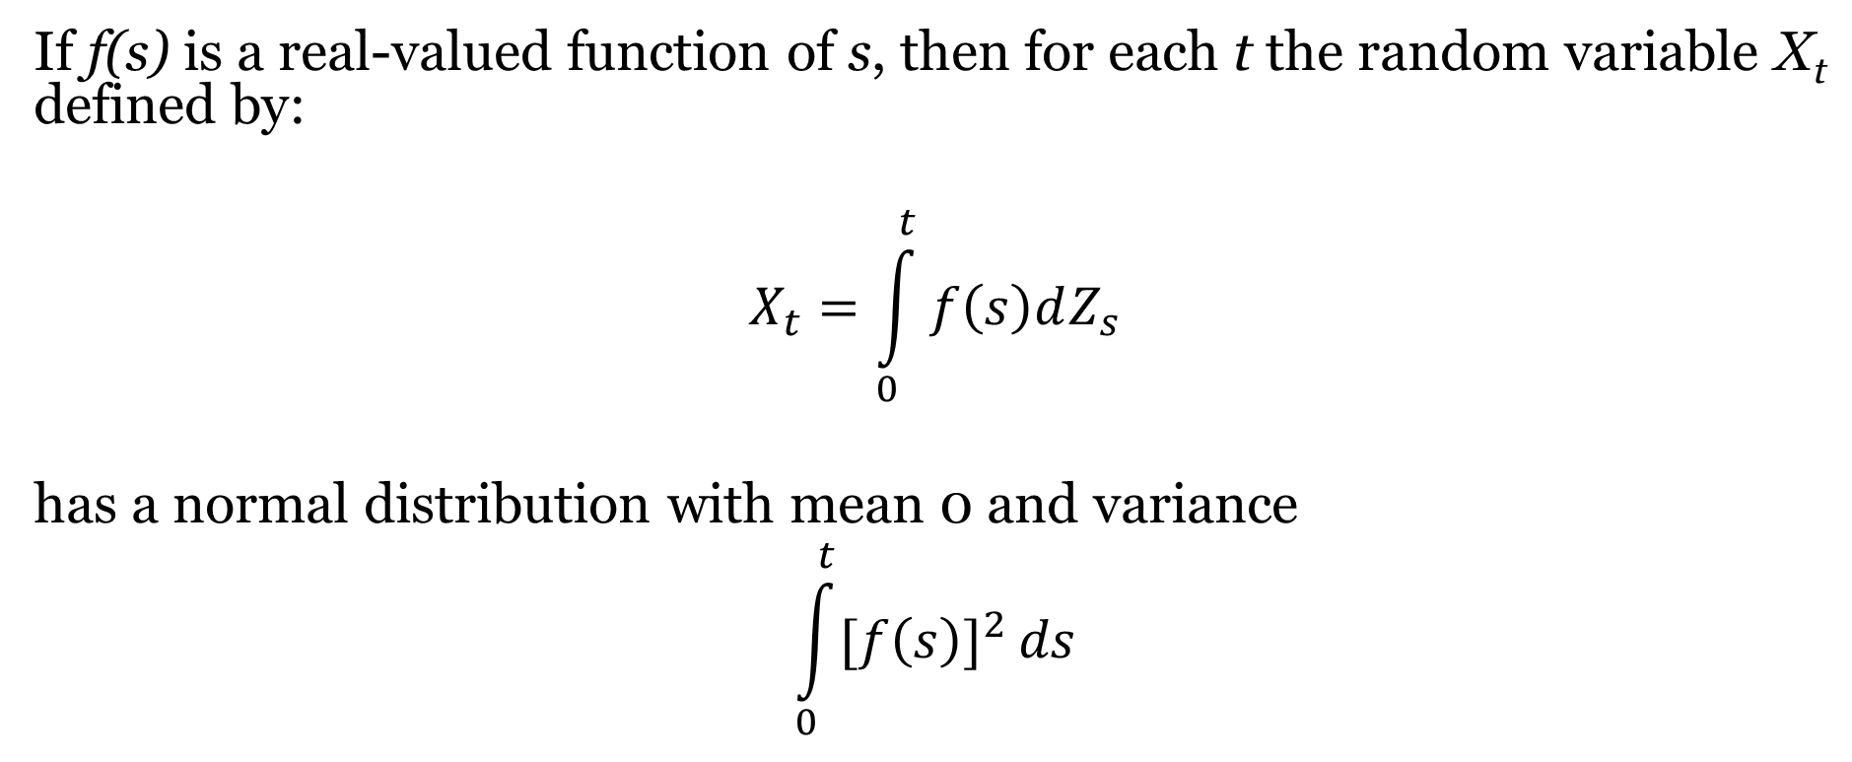
Characteristics of Integrals of Real-Valued Functions with Respect to Brownian Motion
If f(s) is a real-valued function of s, then for each t the random variable X_{t} defined by:
$$X_{t}=\int_{0}^{t}{f\left(s\right)dZ_{s}}$$
has a normal distribution with mean 0 and variance
$$\int_{0}^{t}{{[f\left(s\right)]}^{2}}ds$$

Slide 24
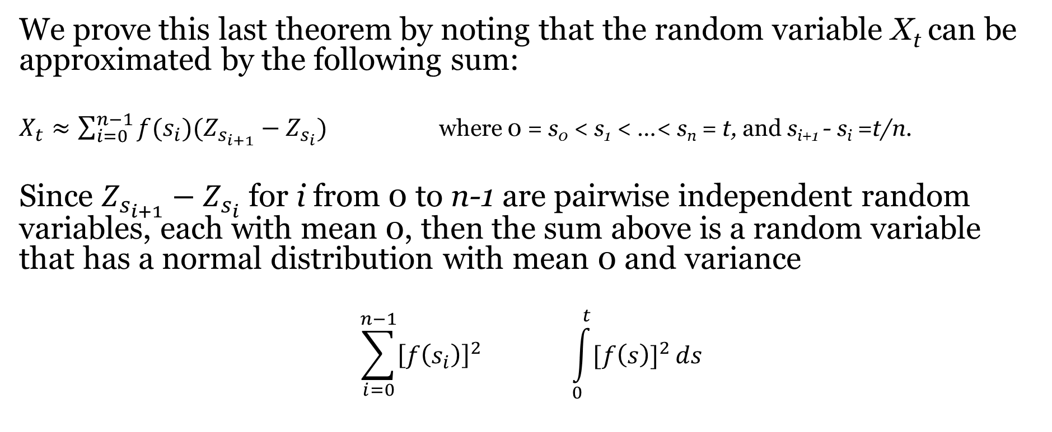
Proof
We prove this last theorem by noting that the random variable X_{t} can be approximated by the following sum:
$X_{t}≈\sum_{i=0}^{n−1}{f(s_{i})(Z_{s_{i+1}}}−Z_{s_{i}})$ where 0 = s₀ < s₁ < …< s_{n} = t, and s_{i+1} - s_{i} =t/n.
Since $Z_{s_{i+1}}−Z_{s_{i}}$ for i from 0 to n-1 are pairwise independent random variables, each with mean 0, then the sum above is a random variable that has a normal distribution with mean 0 and variance
$$\sum_{i=0}^{n−1}{{\left[f\left(s_{i}\right)\right]}^{2}} \int_{0}^{t}{{[f\left(s\right)]}^{2}}ds$$
By the fundamental theorem of calculus, in the limit as n approaches $∞$ the variance approaches above.

Slide 25
Converting Certain Stochastic Processes to Martingales
Martingale processes and deterministic processes are normally much easier to analyze and manipulate than other stochastic processes containing both drift and random elements. One major reason for this is that working with martingales free us from having to calculate unknown risk-adjusted discount rates and risk premiums in the valuation process. One type of procedure to convert drift processes to martingales involves changing the probability measure.

Slide 26
The Radon-Nikodym Derivative
The Radon-Nikodym process is useful for converting physical probability measures to equivalent martingales. It is often easier to price a security under a particular measure, such as an equivalent measure that produces a martingale than it is to price a security under a physical probability that is not a martingale. This process is essentially converting from a pricing framework in which investors have risk preferences to risk-neutral pricing framework.
The Radon-Nikodym derivative is a "bridge" that converts one probability measure to an equivalent measure.

Slide 27
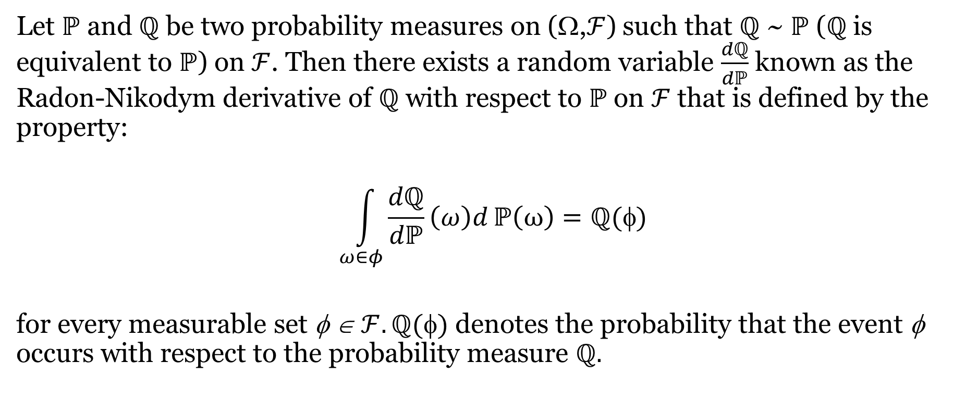
The Radon-Nikodym Derivative
Let ℙ and ℚ be two probability measures on (Ω,$ℱ$) such that ℚ ~ ℙ (ℚ is equivalent to ℙ) on $ℱ$. Then there exists a random variable $\frac{dℚ}{dℙ}$ known as the Radon-Nikodym derivative of ℚ with respect to ℙ on $ℱ$ that is defined by the property:
$$\int_{ω∈φ}^{ }{\frac{dℚ}{dℙ}\left(ω\right)d}ℙ\left(ω\right)=ℚ(φ)$$
for every measurable set φ ∈ $ℱ. ℚ()$ denotes the probability that the event φ occurs with respect to the probability measure $ℚ.$

Slide 28
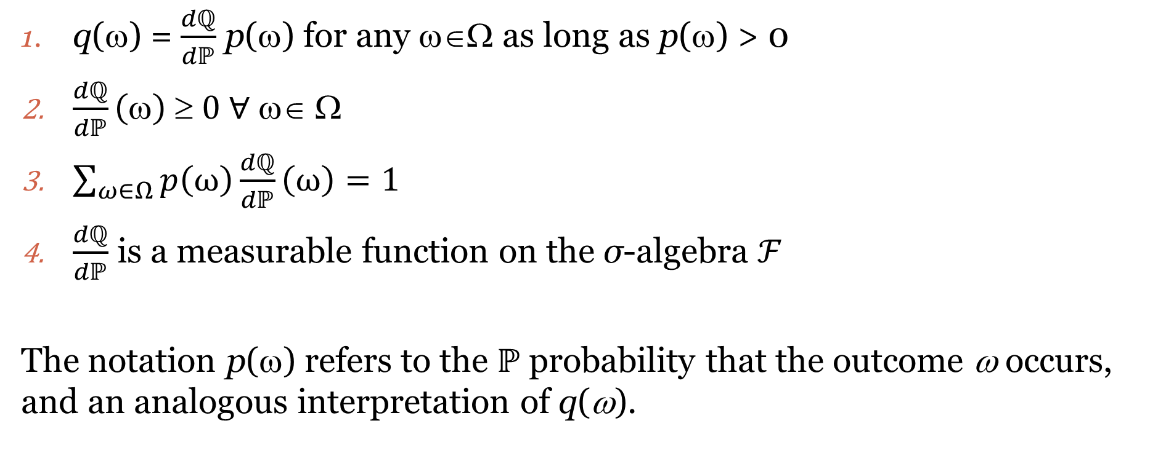
Properties of the Radon-Nikodym Derivative
q(ω) = $\frac{dℚ}{dℙ}$ p(ω) for any ω∈Ω as long as p(ω) > 0
$\frac{dℚ}{dℙ}\left(ω\right) ≥ 0$ $∀$ ω∈ Ω
$\sum_{ω∈Ω}{p\left(ω\right)\frac{dℚ}{dℙ}}\left(ω\right)=1$
$\frac{dℚ}{dℙ}$ is a measurable function on the σ-algebra $ℱ$
The notation p(ω) refers to the $ℙ$ probability that the outcome ω occurs, and an analogous interpretation of q(ω).

Slide 29
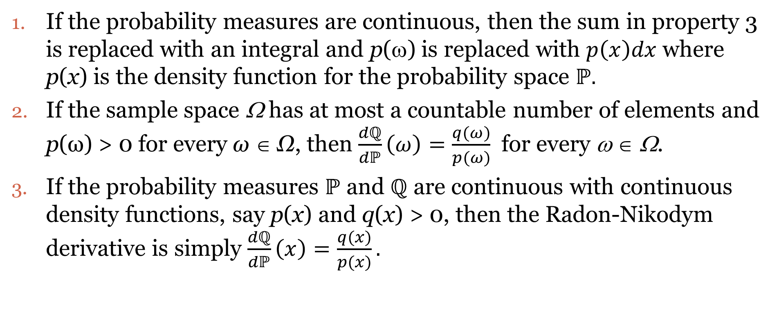
Properties of Radon-Nikodym Derivative (continued)
If the probability measures are continuous, then the sum in property 3 is replaced with an integral and p(ω) is replaced with $p\left(x\right)dx$where p(x) is the density function for the probability space $ℙ.$
If the sample space Ω has at most a countable number of elements and p(ω) > 0 for every ω ∈ Ω, then $\frac{dℚ}{dℙ}\left(ω\right)=\frac{q(ω)}{p(ω)}$ for every ω ∈ Ω.
If the probability measures $ℙ$ and $ℚ$ are continuous with continuous density functions, say p(x) and q(x) > 0, then the Radon-Nikodym derivative is simply $\frac{dℚ}{dℙ}\left(x\right)=\frac{q(x)}{p(x)}.$

Slide 30
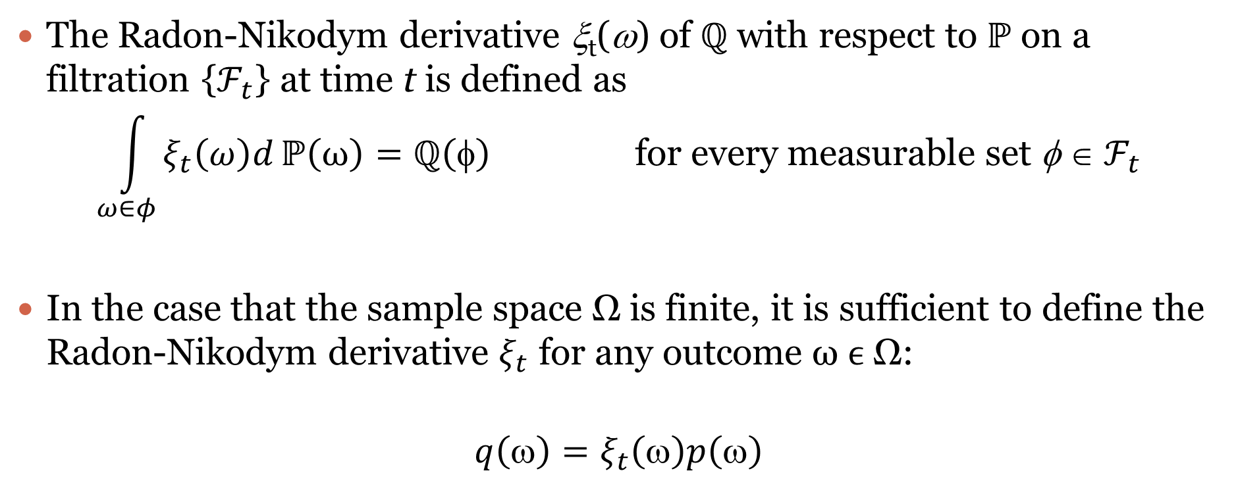
The Radon-Nikodym Derivative ξ_{t}(ω)
The Radon-Nikodym derivative ξ_{t}(ω) of ℚ with respect to ℙ on a filtration {$ℱ_{t}$} at time t is defined as
$$\int_{ω∈φ}^{ }{ξ_{t}\left(ω\right)d}ℙ\left(ω\right)=ℚ\left(φ\right) \text{for} \text{every} \text{measurable} \text{set} \text{φ} \text{∈} ℱ_{t}$$
In the case that the sample space Ω is finite, it is sufficient to define the Radon-Nikodym derivative $ξ_{t}$ for any outcome ω ϵ Ω:
$$q\left(ω\right)=ξ_{t}\left(ω\right)p\left(ω\right)$$

Slide 31
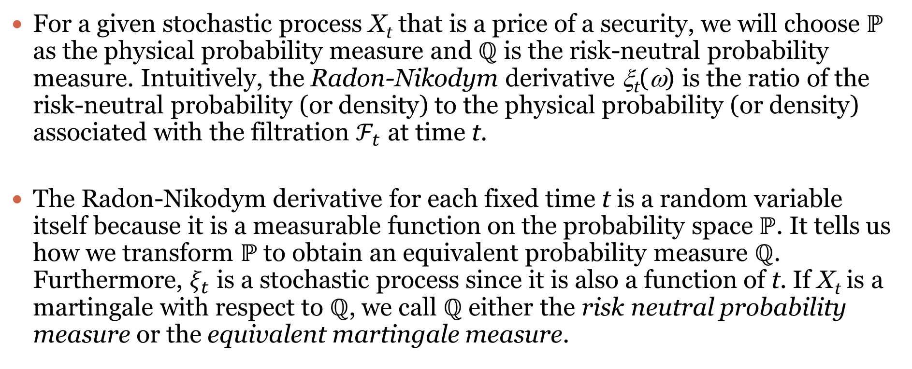
The Radon-Nikodym Derivative ξ_{t}(ω) (Continued)
For a given stochastic process X_{t} that is a price of a security, we will choose ℙ as the physical probability measure and ℚ is the risk-neutral probability measure. Intuitively, the Radon-Nikodym derivative ξ_{t}(ω) is the ratio of the risk-neutral probability (or density) to the physical probability (or density) associated with the filtration $ℱ_{t}$ at time t.
The Radon-Nikodym derivative for each fixed time t is a random variable itself because it is a measurable function on the probability space ℙ. It tells us how we transform ℙ to obtain an equivalent probability measure ℚ. Furthermore, $ξ_{t}$ is a stochastic process since it is also a function of t. If X_{t} is a martingale with respect to ℚ, we call ℚ either the risk neutral probability measure or the equivalent martingale measure.

Slide 32
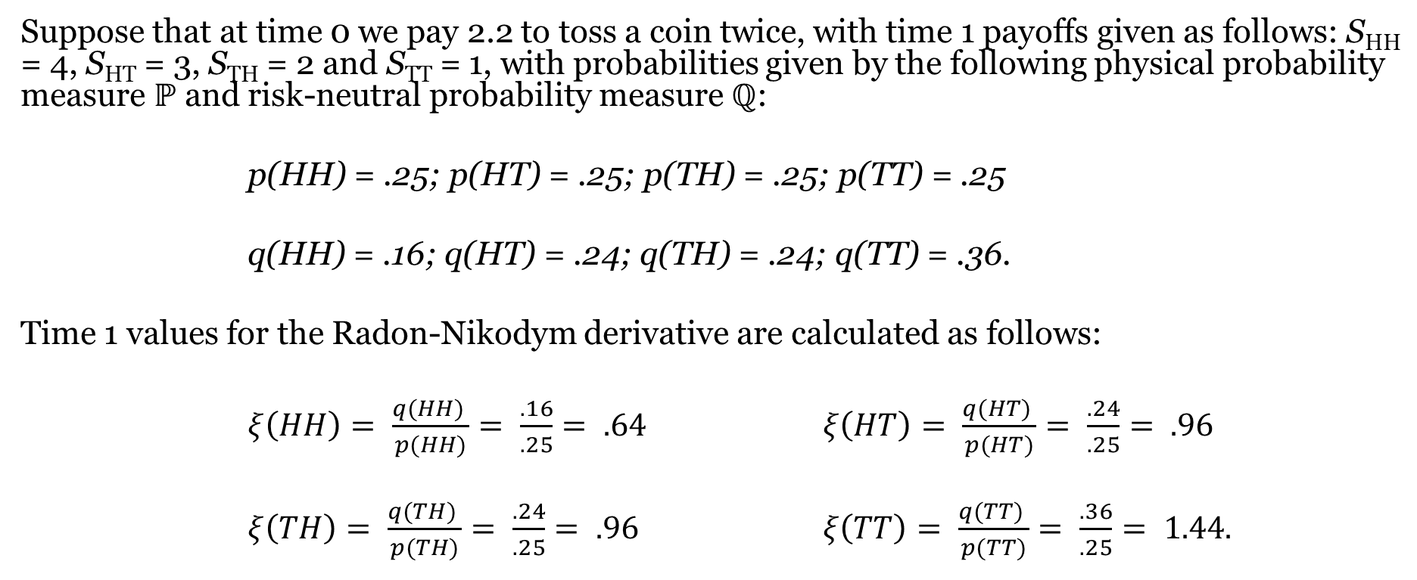
Illustration 1: The Radon-Nikodym Derivative and 2 Coin Tosses
Suppose that at time 0 we pay 2.2 to toss a coin twice, with time 1 payoffs given as follows: S_{HH} = 4, S_{HT} = 3, S_{TH} = 2 and S_{TT} = 1, with probabilities given by the following physical probability measure ℙ and risk-neutral probability measure ℚ:
p(HH) = .25; p(HT) = .25; p(TH) = .25; p(TT) = .25
q(HH) = .16; q(HT) = .24; q(TH) = .24; q(TT) = .36.
Time 1 values for the Radon-Nikodym derivative are calculated as follows:
$ξ\left(HH\right)= \frac{q(HH) }{p(HH)}= \frac{.16}{.25}= .64$ $ξ\left(HT\right)= \frac{q(HT) }{p(HT)}= \frac{.24}{.25}= .96$
$ξ\left(TH\right)= \frac{q(TH) }{p(TH)}= \frac{.24}{.25}= .96$ $ξ\left(TT\right)= \frac{q(TT) }{p(TT)}= \frac{.36}{.25}= 1.44.$

Slide 33
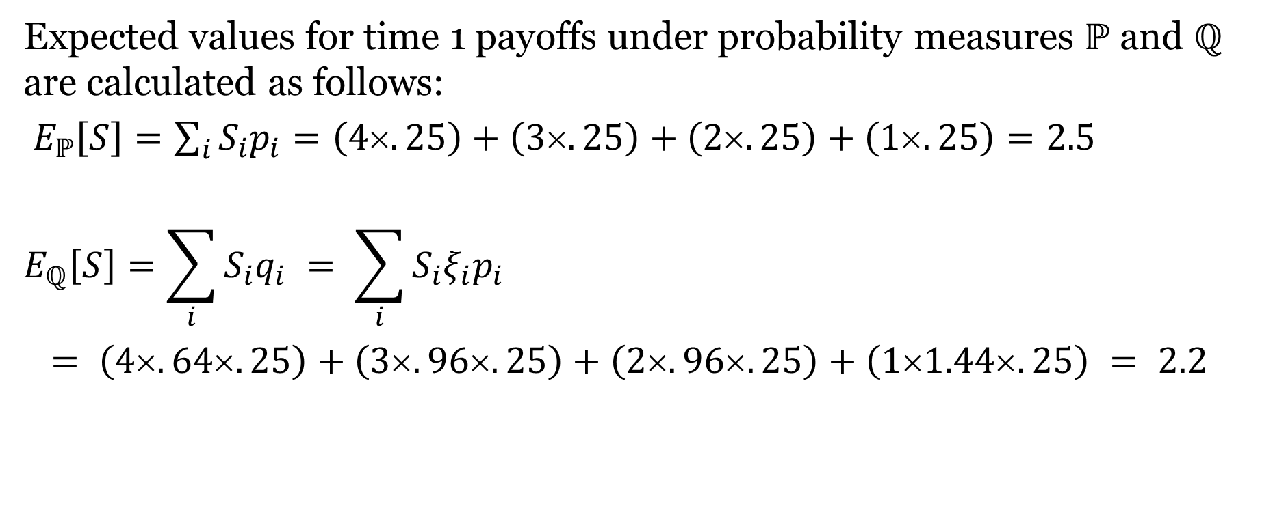
Illustration 1 (Continued)
Expected values for time 1 payoffs under probability measures ℙ and ℚ are calculated as follows:
$E_{ℙ}\left[S\right]=\sum_{i}{S_{i}p_{i}}=\left(4×.25\right)+\left(3×.25\right)+\left(2×.25\right)+\left(1×.25\right)=2.5$
$$E_{ℚ}\left[S\right]=\sum_{i}{S_{i}q_{i}} = \sum_{i}{S_{i}{ξ_{i}p}_{i}}$$
$= \left(4.64.25\right)+\left(3.96.25\right)+\left(2.96.25\right)+\left(11.44.25\right) = 2.2$
Note that the process S is a martingale to risk-neutral measure ℚ; that is, we pay at time zero for the toss exactly its expected time 1 payoff in this one time period scenario.

Slide 34
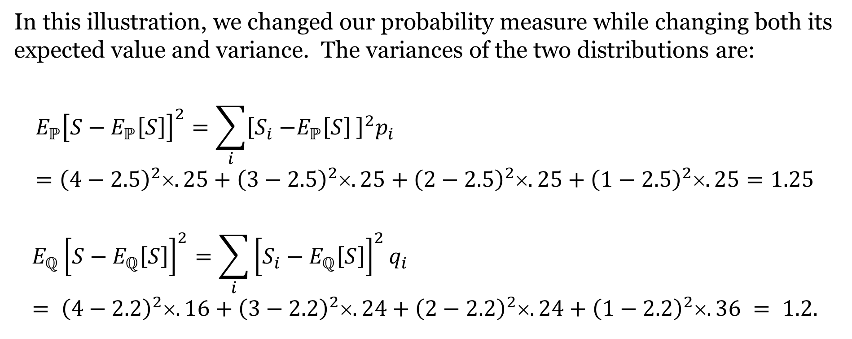
Illustration 1 (Continued)
In this illustration, we changed our probability measure while changing both its expected value and variance. The variances of the two distributions are:
$$E_{ℙ}{\left[S−E_{ℙ}\left[S\right]\right]}^{2}=\sum_{i}{{\left[S_{i}{−E_{ℙ}\left[S\right]}_{ }\right]}^{2}p_{i}}={\left(4−2.5\right)}^{2}×.25+{\left(3−2.5\right)}^{2}×.25+{\left(2−2.5\right)}^{2}×.25+{\left(1−2.5\right)}^{2}×.25=1.25$$
$$E_{ℚ}{\left[S−E_{ℚ}\left[S\right]\right]}^{2}=\sum_{i}{{\left[S_{i}−E_{ℚ}\left[S\right]\right]}^{2}q_{i}} = {\left(4−2.2\right)}^{2}×.16+{\left(3−2.2\right)}^{2}×.24+{\left(2−2.2\right)}^{2}×.24+{\left(1−2.2\right)}^{2}×.36 = 1.2.$$

Slide 35
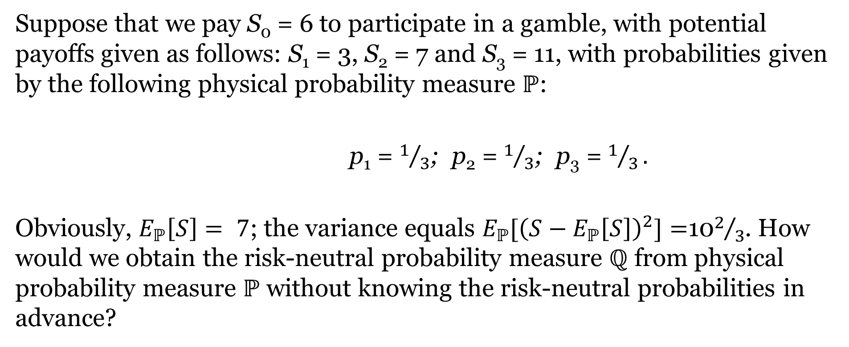
Illustration 2: Calculating Risk-Neutral Probabilities and the Radon-Nikodym Derivative
Suppose that we pay S₀ = 6 to participate in a gamble, with potential payoffs given as follows: S₁ = 3, S₂ = 7 and S₃ = 11, with probabilities given by the following physical probability measure ℙ:
p₁ = $1/3$; p₂ = $1/3$; p₃ = $1/3.$
Obviously, $E_{ℙ}\left[S\right]= 7$; the variance equals $E_{ℙ}[{\left(S−E_{ℙ}\left[S\right]\right)}^{2}]=$10$2/3$. How would we obtain the risk-neutral probability measure ℚ from physical probability measure ℙ without knowing the risk-neutral probabilities in advance?

Slide 36
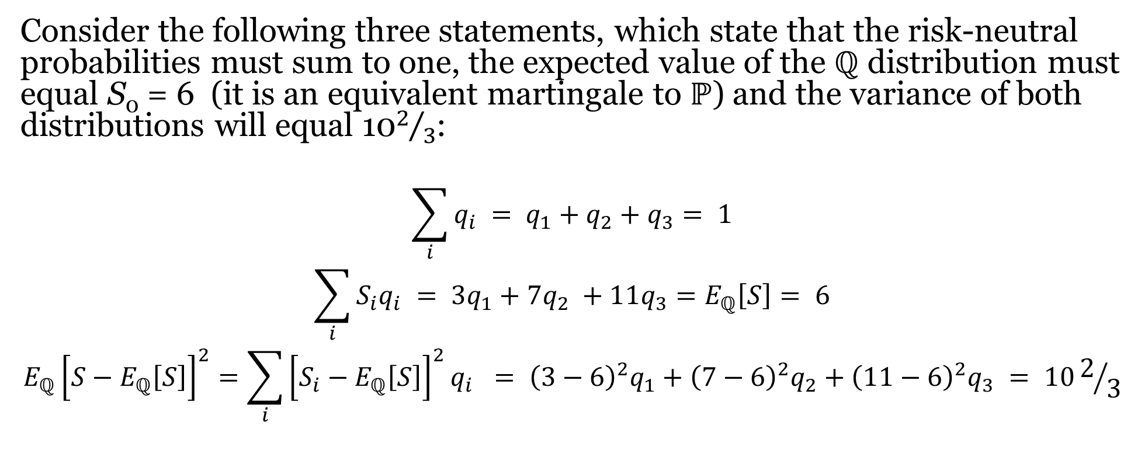
Illustration 2 (Continued)
Consider the following three statements, which state that the risk-neutral probabilities must sum to one, the expected value of the ℚ distribution must equal S₀ = 6 (it is an equivalent martingale to ℙ) and the variance of both distributions will equal 10$2/3$:
$$\sum_{i}{q_{i}} = q_{1}+q_{2}+q_{3}= 1$$
$$\sum_{i}{S_{i}q_{i}} = {3q}_{1}+{7q}_{2} +{11q}_{3}=E_{ℚ}\left[S\right]= 6$$
$$E_{ℚ}{\left[S−E_{ℚ}\left[S\right]\right]}^{2}=\sum_{i}{{\left[S_{i}−E_{ℚ}\left[S\right]\right]}^{2}q_{i}} = {\left(3−6\right)}^{2}q_{1}+{\left(7−6\right)}^{2}q_{2}+{\left(11−6\right)}^{2}q_{3} = 102/3$$

Slide 37
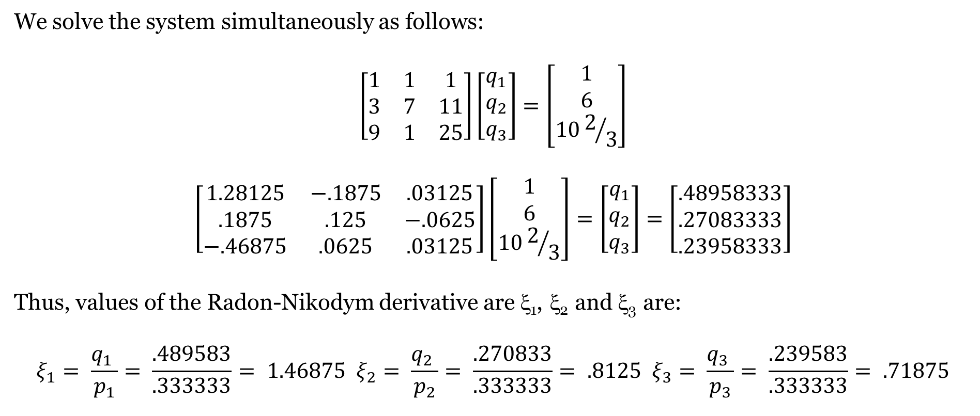
Illustration 2 (Continued)
We solve the system simultaneously as follows:
$$\left[\begin{matrix}1 & 1 & 1 \\ 3 & 7 & 11 \\ 9 & 1 & 25\end{matrix}\right]\left[\begin{matrix}q_{1} \\ q_{2} \\ q_{3}\end{matrix}\right]=\left[\begin{matrix}1 \\ 6 \\ 102/3\end{matrix}\right]$$
$$\left[\begin{matrix}1.28125 & −.1875 & .03125 \\ .1875 & .125 & −.0625 \\ −.46875 & .0625 & .03125\end{matrix}\right]\left[\begin{matrix}1 \\ 6 \\ 102/3\end{matrix}\right]=\left[\begin{matrix}q_{1} \\ q_{2} \\ q_{3}\end{matrix}\right]=\left[\begin{matrix}.48958333 \\ .27083333 \\ .23958333\end{matrix}\right]$$
Thus, values of the Radon-Nikodym derivative are ξ₁, ξ₂ and ξ₃ are:
$$ξ_{1}= \frac{q_{1} }{p_{1}}= \frac{.489583}{.333333}= 1.46875 ξ_{2}= \frac{q_{2} }{p_{2}}= \frac{.270833}{.333333}= .8125 ξ_{3}= \frac{q_{3} }{p_{3}}= \frac{.239583}{.333333}= .71875$$

Slide 38
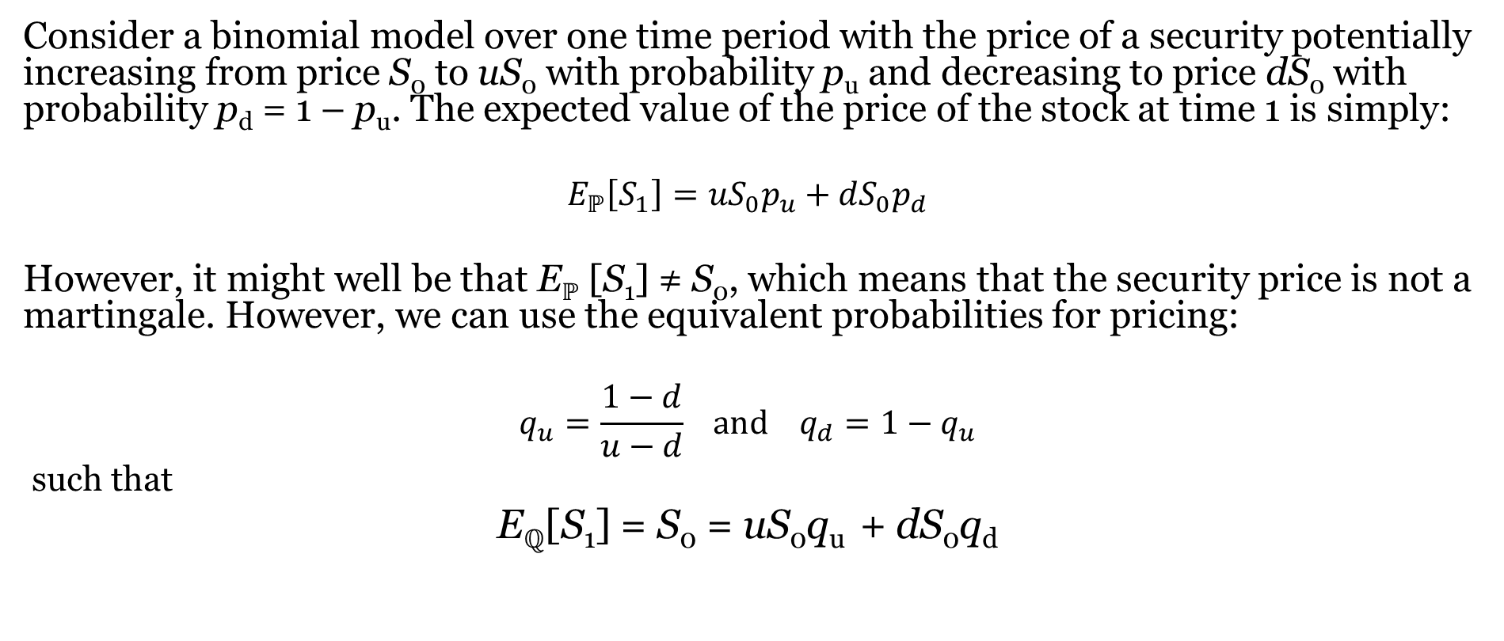
The Radon-Nikodym Derivative And Binomial Pricing
Consider a binomial model over one time period with the price of a security potentially increasing from price S₀ to uS₀ with probability p_{u} and decreasing to price dS₀ with probability p_{d} = 1 – p_{u}. The expected value of the price of the stock at time 1 is simply:
$$E_{ℙ}\left[S_{1}\right]={uS}_{0}p_{u}+{dS}_{0}p_{d}$$
However, it might well be that E_{ℙ} [S₁] ≠ S₀, which means that the security price is not a martingale. However, we can use the equivalent probabilities for pricing:
$$q_{u}=\frac{1−d}{u−d} and q_{d}=1−q_{u}$$
such that
E_{ℚ}[S₁] = S₀ = uS₀q_{u} + dS₀q_{d}
After a change in the numeraire, these arbitrage-free probabilities will ensure consistent pricing in which $E_{ℚ}\left[S_{1}\right]=S_{0}$ in terms of the riskless bond.

Slide 39
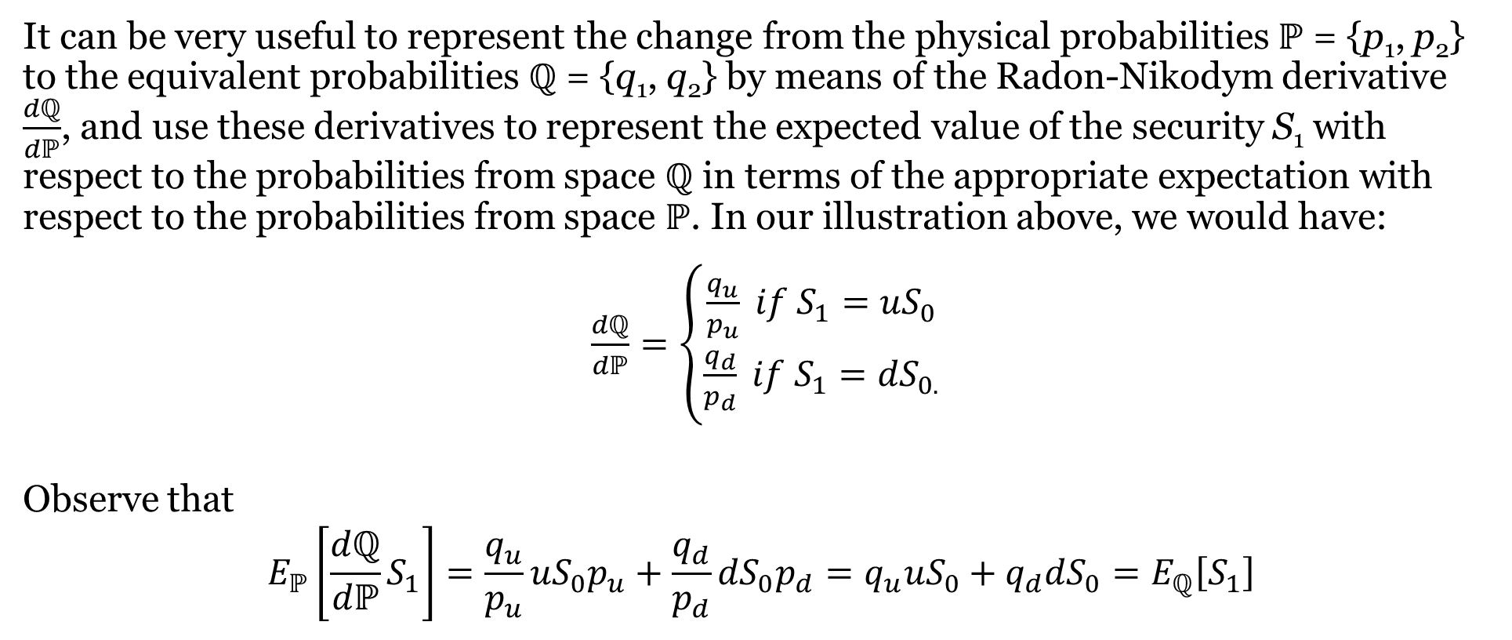
The Radon-Nikodym Derivative And Binomial Pricing (Continued)
It can be very useful to represent the change from the physical probabilities ℙ = {p₁, p₂} to the equivalent probabilities ℚ = {q₁, q₂} by means of the Radon-Nikodym derivative $\frac{dℚ}{dℙ}$, and use these derivatives to represent the expected value of the security S₁ with respect to the probabilities from space ℚ in terms of the appropriate expectation with respect to the probabilities from space ℙ. In our illustration above, we would have:
$\frac{dℚ}{dℙ}=\left\{\begin{aligned}\frac{q_{u}}{p_{u}} if S_{1}={uS}_{0} \\ \frac{q_{d}}{p_{d}} if S_{1}={dS}_{0.}\end{aligned}\right.$
Observe that
$$E_{ℙ}\left[\frac{dℚ}{dℙ}S_{1}\right]=\frac{q_{u}}{p_{u}}{uS}_{0}p_{u}+\frac{q_{d}}{p_{d}}{dS}_{0}p_{d}=q_{u}{uS}_{0}+q_{d}{dS}_{0}=E_{ℚ}\left[S_{1}\right]$$

Slide 40
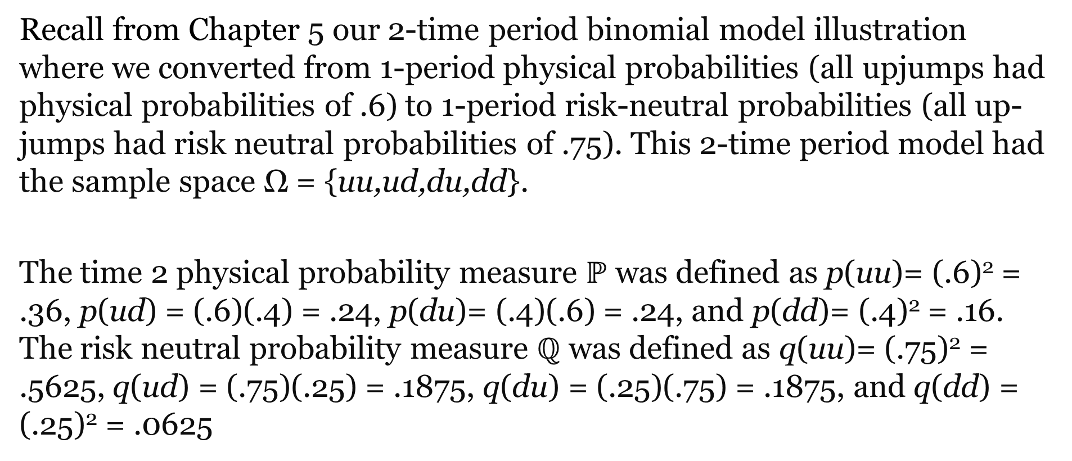
Radon-Nikodym Derivatives In A Multiple Period Binomial Environment
Recall from Chapter 5 our 2-time period binomial model illustration where we converted from 1-period physical probabilities (all upjumps had physical probabilities of .6) to 1-period risk-neutral probabilities (all up-jumps had risk neutral probabilities of .75). This 2-time period model had the sample space Ω = {uu,ud,du,dd}.
The time 2 physical probability measure $ℙ$ was defined as p(uu)= (.6)² = .36, p(ud) = (.6)(.4) = .24, p(du)= (.4)(.6) = .24, and p(dd)= (.4)² = .16. The risk neutral probability measure $ℚ$ was defined as q(uu)= (.75)² = .5625, q(ud) = (.75)(.25) = .1875, q(du) = (.25)(.75) = .1875, and q(dd) = (.25)² = .0625

Slide 41
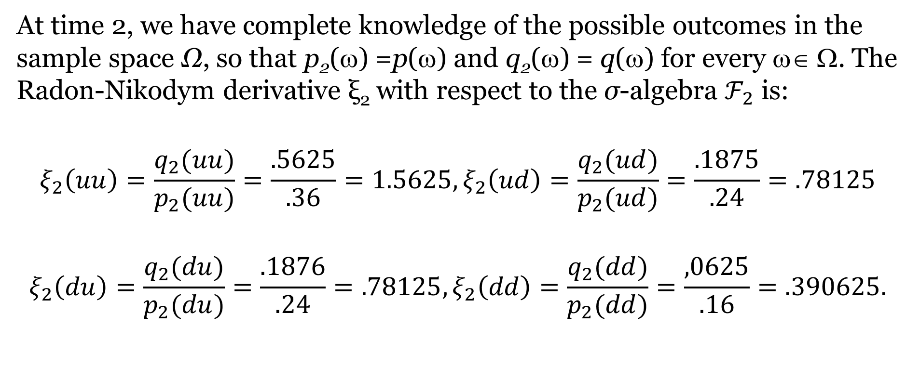
Radon-Nikodym Derivatives In A Multiple Period Binomial Environment (Continued)
At time 2, we have complete knowledge of the possible outcomes in the sample space Ω, so that p₂(ω) =p(ω) and q₂(ω) = q(ω) for every ω∈ Ω. The Radon-Nikodym derivative ξ₂ with respect to the σ-algebra $ℱ_{2}$ is:
$$ξ_{2}\left(uu\right)=\frac{q_{2}(uu)}{p_{2}(uu)}=\frac{.5625}{.36}=1.5625,ξ_{2}\left(ud\right)=\frac{q_{2}(ud)}{p_{2}(ud)}=\frac{.1875}{.24}=.78125$$
$$ξ_{2}\left(du\right)=\frac{q_{2}(du)}{p_{2}(du)}=\frac{.1876}{.24}=.78125,ξ_{2}\left(dd\right)=\frac{q_{2}(dd)}{p_{2}(dd)}=\frac{,0625}{.16}=.390625.$$

Slide 42
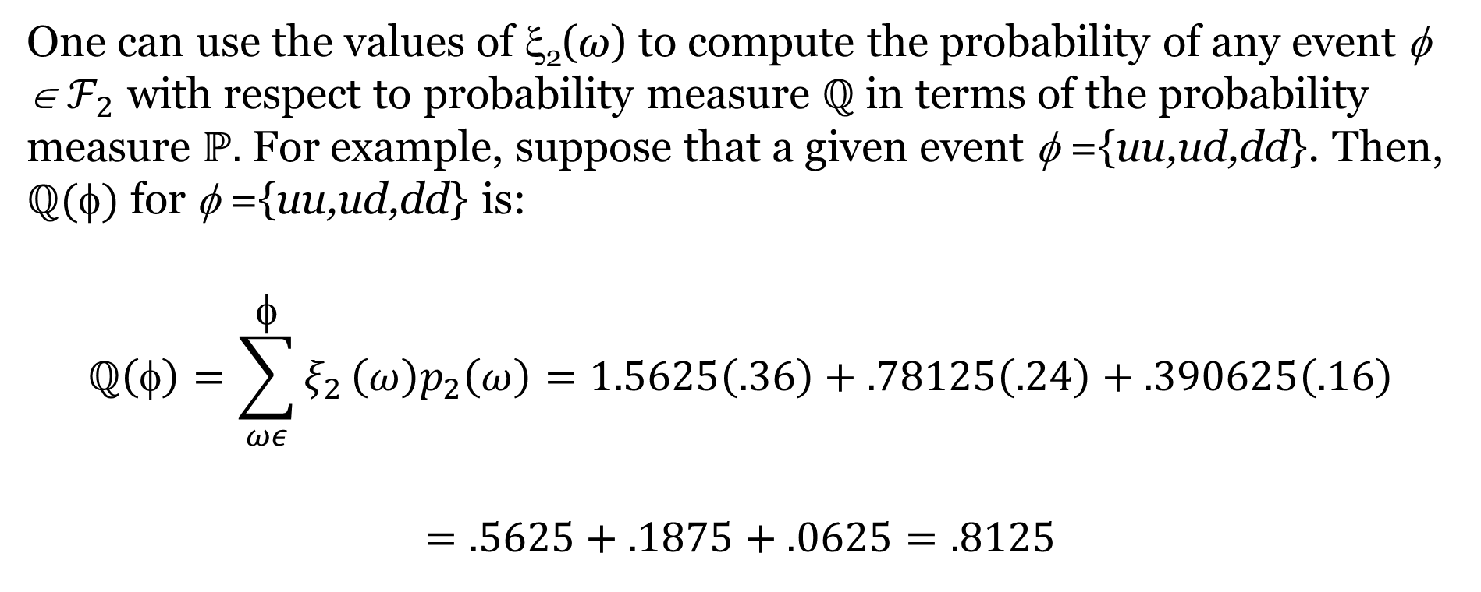
Radon-Nikodym Derivatives In A Multiple Period Binomial Environment (Continued)
One can use the values of ξ₂(ω) to compute the probability of any event φ ∈$ℱ_{2}$ with respect to probability measure $ℚ$ in terms of the probability measure $ℙ.$ For example, suppose that a given event φ ={uu,ud,dd}. Then, $ℚ()$ for φ ={uu,ud,dd} is:
$$ℚ\left(φ\right)=\sum_{ωε}^{φ}{ξ_{2}}\left(ω\right)p_{2}\left(ω\right)=1.5625\left(.36\right)+.78125\left(.24\right)+.390625\left(.16\right)$$
$$=.5625+.1875+.0625=.8125$$

Slide 43
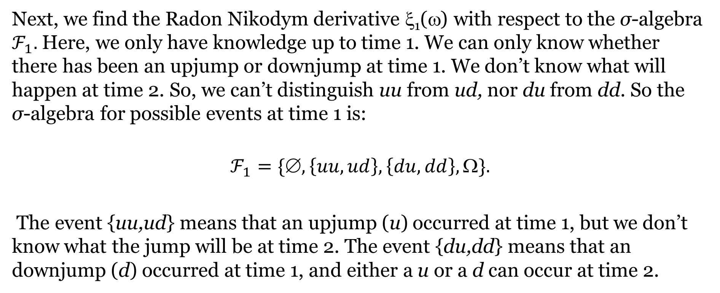
Radon-Nikodym Derivatives In A Multiple Period Binomial Environment (Continued)
Next, we find the Radon Nikodym derivative ξ₁(ω) with respect to the σ-algebra $ℱ_{1}.$ Here, we only have knowledge up to time 1. We can only know whether there has been an upjump or downjump at time 1. We don’t know what will happen at time 2. So, we can’t distinguish uu from ud, nor du from dd. So the σ-algebra for possible events at time 1 is:
$$ℱ_{1}=\{∅,\left\{uu,ud\right\},\left\{du,dd\right\},Ω\}.$$
The event {uu,ud} means that an upjump (u) occurred at time 1, but we don’t know what the jump will be at time 2. The event {du,dd} means that an downjump (d) occurred at time 1, and either a u or a d can occur at time 2.

Slide 44
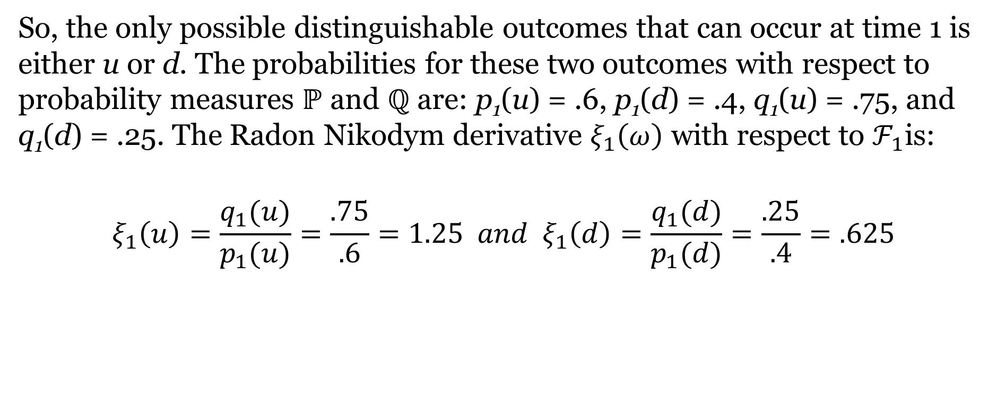
Radon-Nikodym Derivatives In A Multiple Period Binomial Environment (Continued)
So, the only possible distinguishable outcomes that can occur at time 1 is either u or d. The probabilities for these two outcomes with respect to probability measures $ℙ$ and $ℚ$ are: p₁(u) = .6, p₁(d) = .4, q₁(u) = .75, and q₁(d) = .25. The Radon Nikodym derivative $ξ_{1}\left(ω\right)$ with respect to $ℱ_{1}$is:
$$ξ_{1}\left(u\right)=\frac{q_{1}(u)}{p_{1}(u)}=\frac{.75}{.6}=1.25 and ξ_{1}\left(d\right)=\frac{q_{1}(d)}{p_{1}(d)}=\frac{.25}{.4}=.625$$

Slide 45
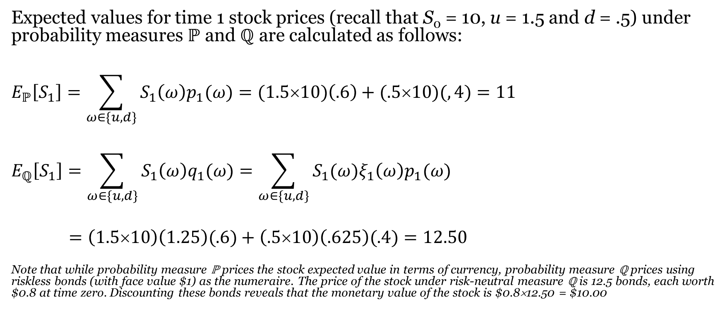
Radon-Nikodym Derivatives In A Multiple Period Binomial Environment (Continued)
Expected values for time 1 stock prices (recall that S₀ = 10, u = 1.5 and d = .5) under probability measures ℙ and ℚ are calculated as follows:
$$E_{ℙ}\left[S_{1}\right]=\sum_{ω∈\{u,d\}}{S_{1}{\left(ω\right)p}_{1}(ω)}=(1.5×10)\left(.6\right)+(.5×10)(,4)=11$$
$$E_{ℚ}\left[S_{1}\right]=\sum_{ω∈\{u,d\}}{S_{1}{\left(ω\right)q}_{1}(ω)}=\sum_{ω∈\{u,d\}}{S_{1}(ω){ξ_{1}\left(ω\right)p}_{1}(ω)}$$
$=\left(1.5×10\right)\left(1.25\right)(.6)+\left(.5×10\right)\left(.625\right)(.4)=12.50$
Note that while probability measure ℙ prices the stock expected value in terms of currency, probability measure ℚ prices using riskless bonds (with face value $1) as the numeraire. The price of the stock under risk-neutral measure ℚ is 12.5 bonds, each worth $0.8 at time zero. Discounting these bonds reveals that the monetary value of the stock is $0.8×12.50 = $10.00

Slide 46
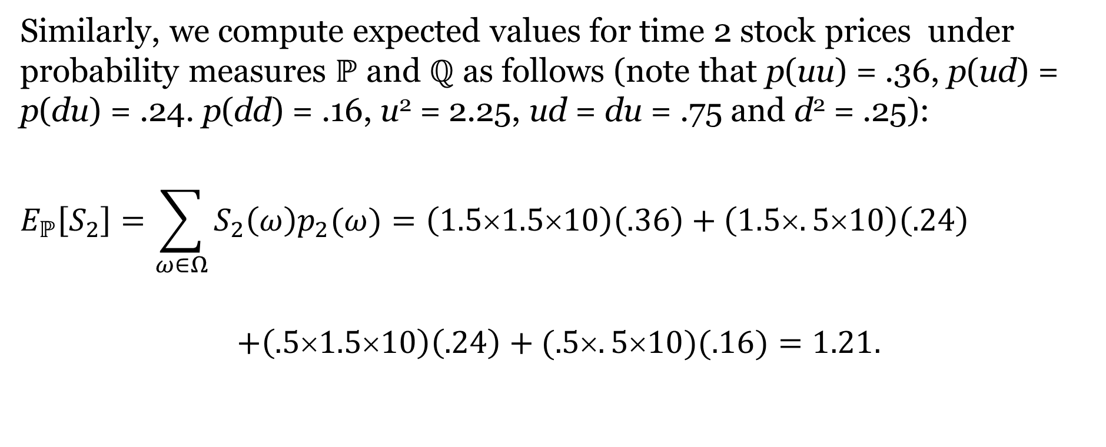
Radon-Nikodym Derivatives In A Multiple Period Binomial Environment (Continued)
Similarly, we compute expected values for time 2 stock prices under probability measures ℙ and ℚ as follows (note that p(uu) = .36, p(ud) = p(du) = .24. p(dd) = .16, u² = 2.25, ud = du = .75 and d² = .25):
$$E_{ℙ}\left[S_{2}\right]=\sum_{ω∈Ω}{S_{2}{\left(ω\right)p}_{2}(ω)}=\left(1.5×1.5×10\right)\left(.36\right)+\left(1.5×.5×10\right)\left(.24\right)$$
$$+\left(.5×1.5×10\right)\left(.24\right)+(.5×.5×10)(.16)=1.21.$$

Slide 47
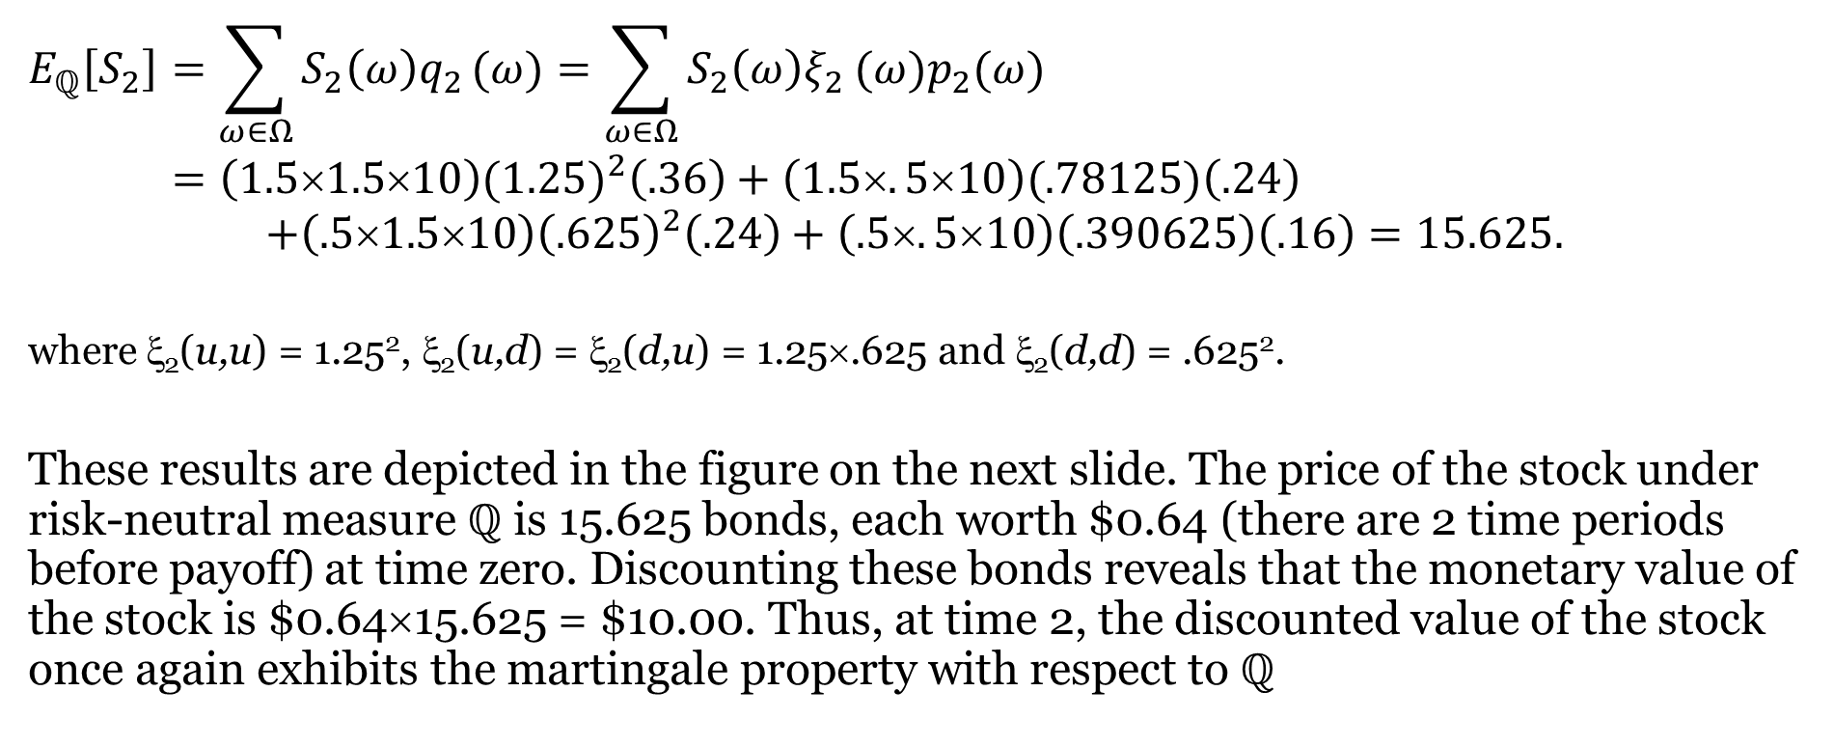
Radon-Nikodym Derivatives In A Multiple Period Binomial Environment (Continued)
$$E_{ℚ}\left[S_{2}\right]=\sum_{ω∈Ω}{S_{2}{\left(ω\right)q}_{2}}(ω)=\sum_{ω∈Ω}{S_{2}{\left(ω\right)ξ}_{2}}(ω)p_{2}(ω)$$
$=\left(1.5×1.5×10\right){(1.25)}^{2}\left(.36\right)+\left(1.5×.5×10\right)(.78125)\left(.24\right)$
$$+\left(.5×1.5×10\right){\left(.625\right)}^{2}\left(.24\right)+\left(.5×.5×10\right)\left(.390625\right)\left(.16\right)=15.625.$$
where ξ₂(u,u) = 1.25², ξ₂(u,d) = ξ₂(d,u) = 1.25×.625 and ξ₂(d,d) = .625².
These results are depicted in the figure on the next slide. The price of the stock under risk-neutral measure ℚ is 15.625 bonds, each worth $0.64 (there are 2 time periods before payoff) at time zero. Discounting these bonds reveals that the monetary value of the stock is $0.64×15.625 = $10.00. Thus, at time 2, the discounted value of the stock once again exhibits the martingale property with respect to ℚ

Slide 48
Radon-Nikodym Derivatives In A Multiple Period Binomial Environment (Continued)
Time 0 Time 1 Time 2
uu
uuS₀ = 22.5, ξ₂(uu) = 1.5625
u
uS₀ = 15
ξ₁(u)=1.25
udS₀ = 7.5, ξ₂(ud) = .78125
ud
S₀=10
duS₀ = 7.5, ξ₂(du) = .78125
du
d
dS₀ = 5
ξ₁(d)=.625
dd
ddS₀ = 2.5, ξ₂(dd) = .390625

Slide 49
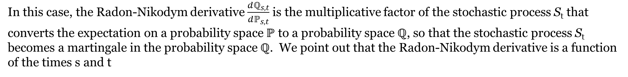
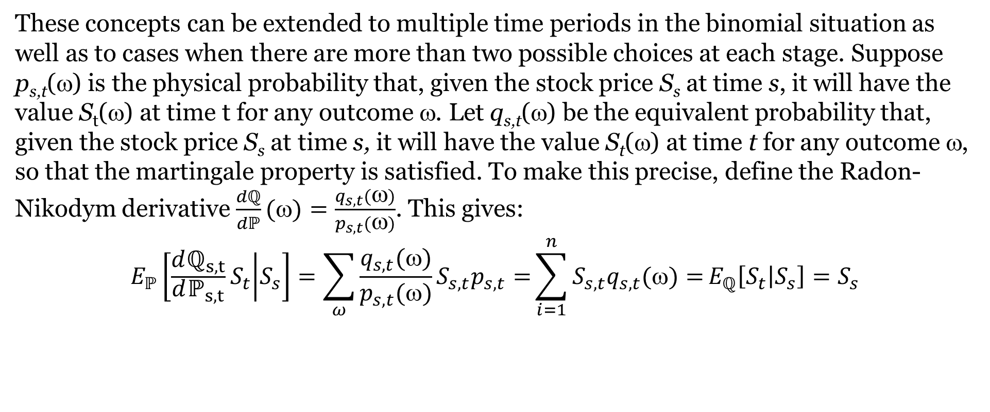
Radon-Nikodym Derivatives In A Multiple Period Binomial Environment (Continued)
These concepts can be extended to multiple time periods in the binomial situation as well as to cases when there are more than two possible choices at each stage. Suppose p_{s,t}(ω) is the physical probability that, given the stock price S_{s} at time s, it will have the value S_{t}(ω) at time t for any outcome ω. Let q_{s,t}(ω) be the equivalent probability that, given the stock price S_{s} at time s, it will have the value S_{t}(ω) at time t for any outcome ω, so that the martingale property is satisfied. To make this precise, define the Radon-Nikodym derivative $\frac{dℚ}{dℙ}(ω)=\frac{q_{s,t}(ω)}{p_{s,t}(ω)}$. This gives:
$$E_{ℙ}\left[\frac{dℚ_{s,t}}{dℙ_{s,t}}S_{t} | S_{s}\right]=\sum_{ω}^{ }{\frac{q_{s,t}()}{p_{s,t}()}S_{s,t}p_{s,t}=}\sum_{i=1}^{n}{S_{s,t}q_{s,t}()=}E_{ℚ}\left[S_{t} | S_{s}\right]=S_{s}$$
In this case, the Radon-Nikodym derivative $\frac{dℚ_{s,t}}{dℙ_{s,t}}$ is the multiplicative factor of the stochastic process S_{t} that converts the expectation on a probability space ℙ to a probability space ℚ, so that the stochastic process S_{t} becomes a martingale in the probability space ℚ. We point out that the Radon-Nikodym derivative is a function of the times s and t

Slide 50
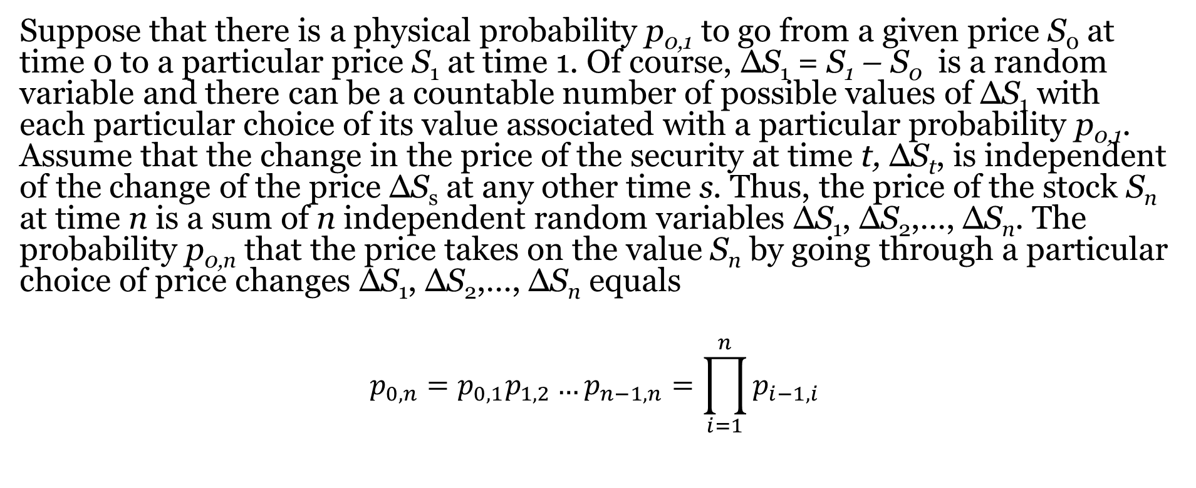
Radon-Nikodym Derivatives And Multiple Time Periods
Suppose that there is a physical probability p_{0,1} to go from a given price S₀ at time 0 to a particular price S₁ at time 1. Of course, ΔS₁ = S₁ – S₀ is a random variable and there can be a countable number of possible values of ΔS₁ with each particular choice of its value associated with a particular probability p_{0,1}. Assume that the change in the price of the security at time t, ΔS_{t}, is independent of the change of the price ΔS_{s} at any other time s. Thus, the price of the stock S_{n} at time n is a sum of n independent random variables ΔS₁, ΔS₂,…, ΔS_{n}. The probability p_{0,n} that the price takes on the value S_{n} by going through a particular choice of price changes ΔS₁, ΔS₂,…, ΔS_{n} equals
$$p_{0,n}=p_{0,1}p_{1,2}…p_{n−1,n}=\prod_{i=1}^{n}{p_{i−1,i}}$$

Slide 51
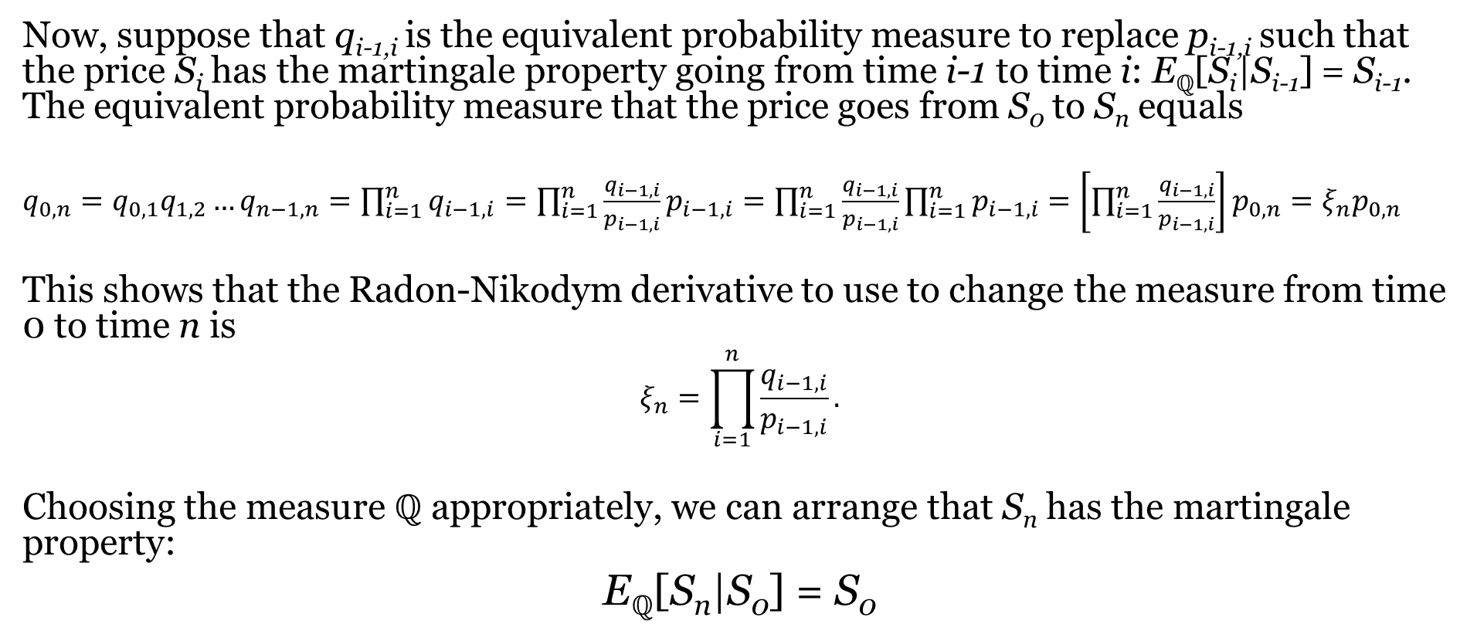
Radon-Nikodym Derivatives And Multiple Time Periods (Continued)
Now, suppose that q_{i-1,i} is the equivalent probability measure to replace p_{i-1,i} such that the price S_{i} has the martingale property going from time i-1 to time i: E_{ℚ}[S_{i}|S_{i-1}] = S_{i-1}. The equivalent probability measure that the price goes from S₀ to S_{n} equals
$q_{0,n}=q_{0,1}q_{1,2}…q_{n−1,n}=\prod_{i=1}^{n}{q_{i−1,i}}=\prod_{i=1}^{n}{\frac{q_{i−1,i}}{p_{i−1,i}}p_{i−1,i}}=\prod_{i=1}^{n}{\frac{q_{i−1,i}}{p_{i−1,i}}}\prod_{i=1}^{n}{p_{i−1,i}}$ $=\left[\prod_{i=1}^{n}{\frac{q_{i−1,i}}{p_{i−1,i}}}\right]p_{0,n}=ξ_{n}p_{0,n}$
This shows that the Radon-Nikodym derivative to use to change the measure from time 0 to time n is
$$ξ_{n}=\prod_{i=1}^{n}{\frac{q_{i−1,i}}{p_{i−1,i}}}.$$
Choosing the measure ℚ appropriately, we can arrange that S_{n} has the martingale property:
E_{ℚ}[S_{n}|S₀] = S₀

Slide 52
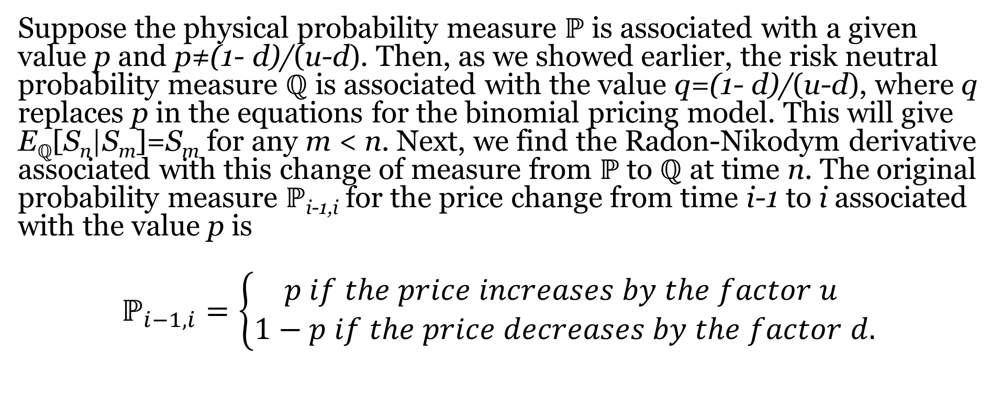
Illustration: The Binomial Pricing Model
Suppose the physical probability measure ℙ is associated with a given value p and p≠(1- d)/(u-d). Then, as we showed earlier, the risk neutral probability measure ℚ is associated with the value q=(1- d)/(u-d), where q replaces p in the equations for the binomial pricing model. This will give E_{ℚ}[S_{n}|S_{m}]=S_{m} for any m < n. Next, we find the Radon-Nikodym derivative associated with this change of measure from ℙ to ℚ at time n. The original probability measure ℙ_{i-1,i} for the price change from time i-1 to i associated with the value p is
$$ℙ_{i−1,i}=\left\{\begin{matrix}p if the price increases by the factor u \\ 1−p if the price decreases by the factor d.\end{matrix}\right.$$

Slide 53
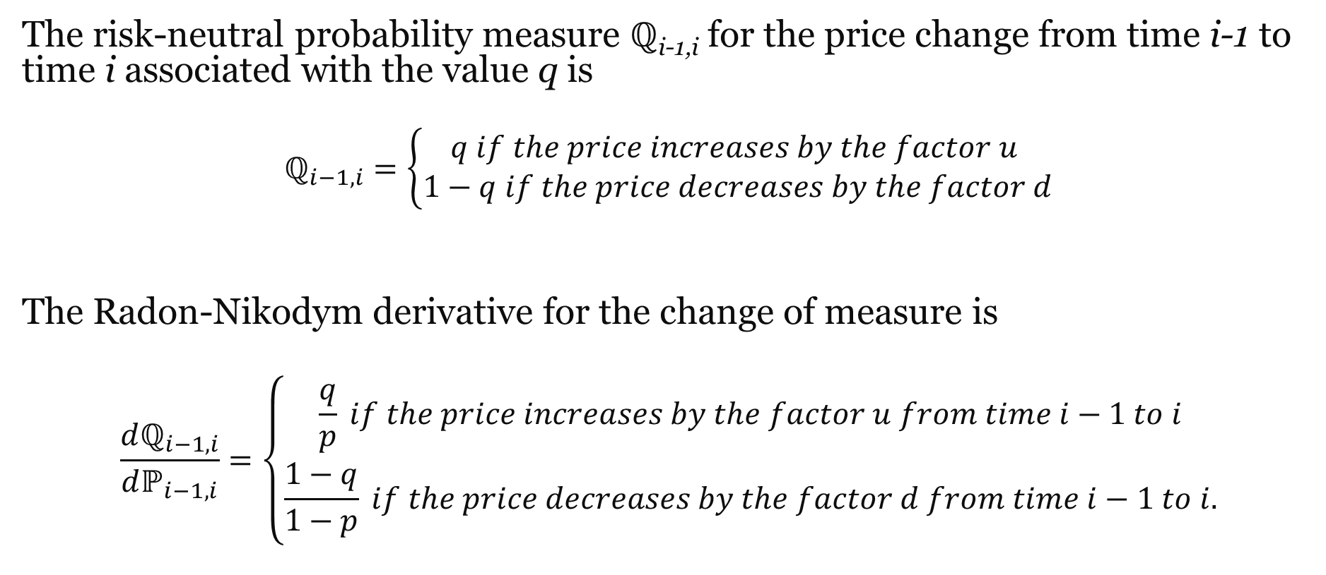
Illustration: The Binomial Pricing Model (Continued)
The risk-neutral probability measure ℚ_{i-1,i} for the price change from time i-1 to time i associated with the value q is
$$ℚ_{i−1,i}=\left\{\begin{matrix}q if the price increases by the factor u \\ 1−q if the price decreases by the factor d\end{matrix}\right.$$
The Radon-Nikodym derivative for the change of measure is
$$\frac{dℚ_{i−1,i}}{dℙ_{i−1,i}}=\left\{\begin{matrix}\frac{q}{p} if the price increases by the factor u from time i−1 to i \\ \frac{1−q}{1−p} if the price decreases by the factor d from time i−1 to i.\end{matrix}\right.$$
where q=(1- d)/(u-d).

Slide 54
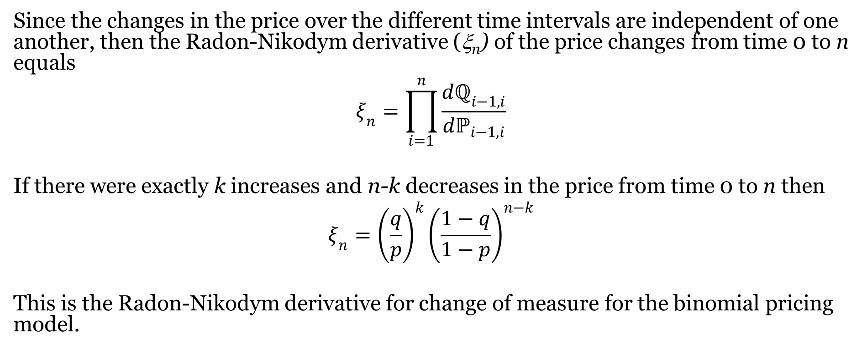
Illustration: The Binomial Pricing Model (Continued)
Since the changes in the price over the different time intervals are independent of one another, then the Radon-Nikodym derivative (ξ_{n}) of the price changes from time 0 to n equals
$$ξ_{n}=\prod_{i=1}^{n}{\frac{dℚ_{i−1,i}}{dℙ_{i−1,i}}}$$
If there were exactly k increases and n-k decreases in the price from time 0 to n then
$$ξ_{n}={\left(\frac{q}{p}\right)}^{k}{\left(\frac{1−q}{1−p}\right)}^{n−k}$$
This is the Radon-Nikodym derivative for change of measure for the binomial pricing model.

Slide 55
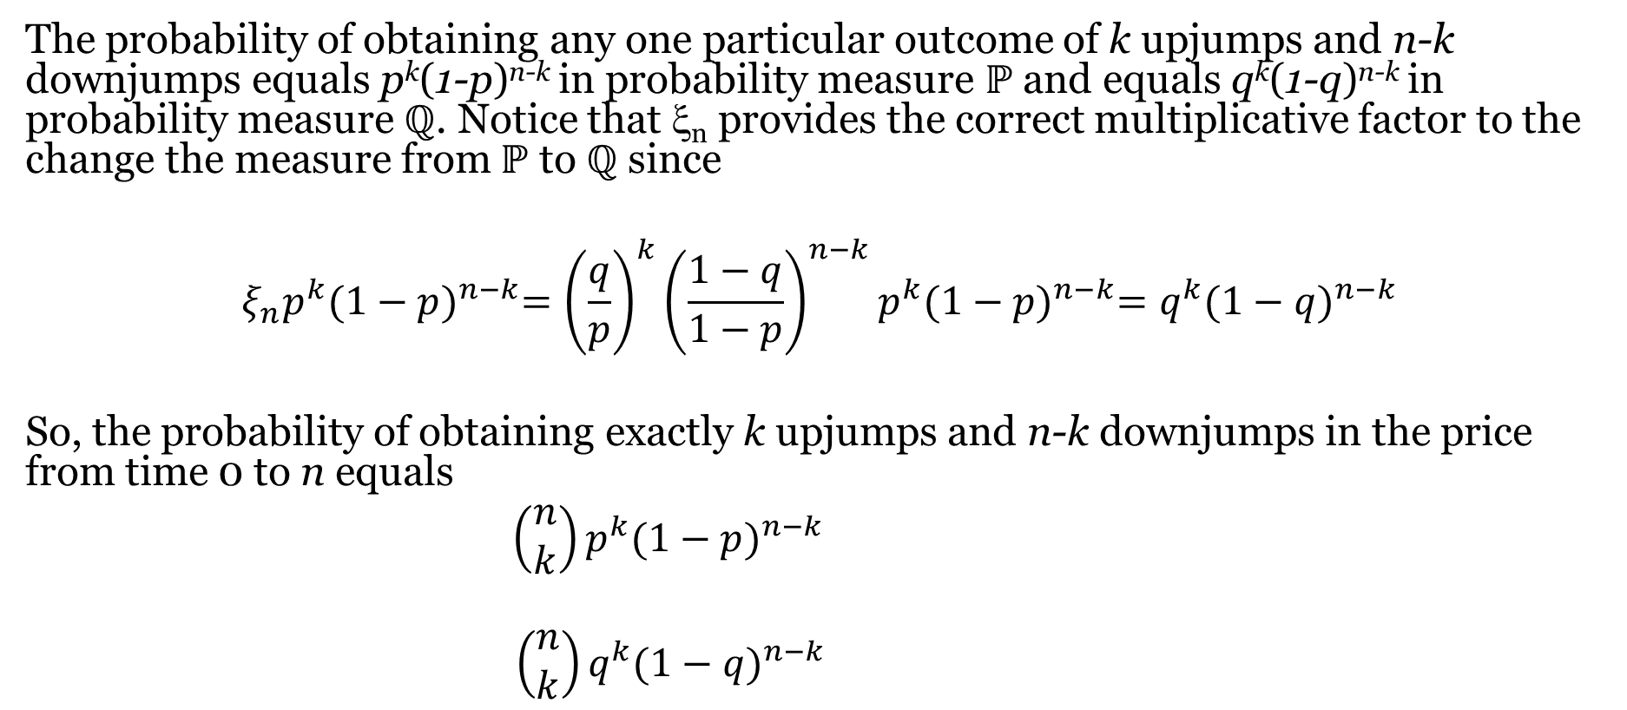
Illustration: The Binomial Pricing Model (Continued)
The probability of obtaining any one particular outcome of k upjumps and n-k downjumps equals p^{k}(1-p)^{n-k} in probability measure ℙ and equals q^{k}(1-q)^{n-k} in probability measure ℚ. Notice that ξ_{n} provides the correct multiplicative factor to the change the measure from ℙ to ℚ since
$$ξ_{n}p^{k}{(1−p)}^{n−k}={\left(\frac{q}{p}\right)}^{k}{\left(\frac{1−q}{1−p}\right)}^{n−k}p^{k}{(1−p)}^{n−k}=q^{k}{(1−q)}^{n−k}$$
So, the probability of obtaining exactly k upjumps and n-k downjumps in the price from time 0 to n equals
$\left(\begin{matrix}n \\ k\end{matrix}\right)p^{k}{(1−p)}^{n−k}$
$\left(\begin{matrix}n \\ k\end{matrix}\right)q^{k}{(1−q)}^{n−k}$
$$\text{with} \text{respect} \text{to} \text{probability} \text{measure} \text{ℙ}\text{, }\text{and} \text{equals}$$
$$\text{with} \text{respect} \text{to} \text{probability} \text{measure}\text{ℚ}$$

Slide 56
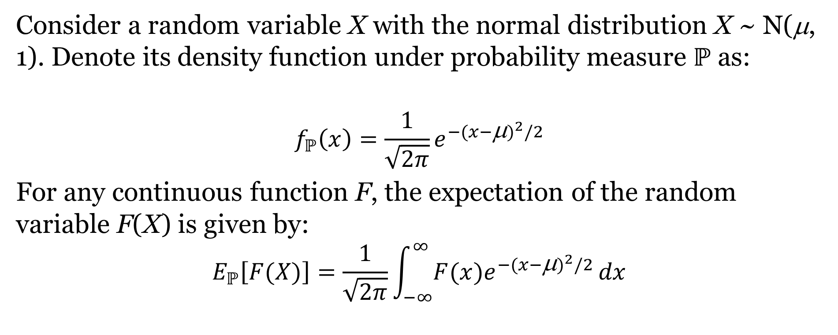
Change Of Normal Density
Consider a random variable X with the normal distribution X ~ N(μ, 1). Denote its density function under probability measure ℙ as:
$$f_{ℙ}\left(x\right)=\frac{1}{\sqrt{2π}}e^{−{(x−\text{μ})}^{2}/2}$$
For any continuous function F, the expectation of the random variable F(X) is given by:
$$E_{ℙ}\left[F(X)\right]=\frac{1}{\sqrt{2π}}\int_{−∞}^{∞}{F(x)e^{−{(x−\text{μ})}^{2}/2}}dx$$
If F(X) = X, we recognize this as the mean $E_{ℙ}\left[X\right]=μ$. If F(X)=(X-μ)², we recognize this as the variance $E_{ℙ}\left[{(X−μ)}^{2}\right]=1.$

Slide 57

Change Of Normal Density (Continued)
Suppose that we were to multiply both sides of the density function $f_{ℙ}\left(x\right)$by $e^{−μx+μ^{2}/2}$ :
$$e^{−μx+\frac{μ^{2}}{2}}f_{ℙ}\left(x\right)=e^{−μx+\frac{μ^{2}}{2}}∙\frac{1}{\sqrt{2π}}e^{−\frac{{\left(x−μ\right)}^{2}}{2}}$$
$$=\frac{1}{\sqrt{2π}}e^{− \frac{x^{2}}{2} − \frac{μ^{2}}{2} + \frac{2μx}{2} +μx+ \frac{μ^{2}}{2}}=\frac{1}{\sqrt{2π}}e^{−\frac{x^{2}}{2}}$$
By multiplying both side of our density function in $ℙ$-space by $e^{−μx+μ^{2}/2}$, we produced a new probability measure for our rand variable X such that the new random variable still has normal distribution with variance 1, but with a mean of 0 as we will see in next slide.

Slide 58

Change Of Normal Density (Continued)
Now let ℚ be a new measure , and its density function is:
$$f_{ℚ}\left(x\right)=\frac{1}{\sqrt{2π}}e^{− \frac{x^{2}}{2}}$$
For any continuous function F, the expectation of F(X) with respect to ℚ :
$$E_{ℚ}\left[F(X)\right]=\frac{1}{\sqrt{2π}}\int_{−∞}^{∞}{F(x)e^{− x^{2}/2}}dx$$
If F(X)=X, we recognize this as the mean $E_{ℚ}\left[X\right]=0$ . If F(X)=(X-μ)², we recognize this as the variance $E_{ℚ}\left[{(X−μ)}^{2}\right]=1.$

Slide 59

Change Of Normal Density (Continued)
we define a change of measure for a continuous probability space as follows:
$$f_{ℚ}\left(x\right)=\frac{1}{\sqrt{2π}}e^{− \frac{x^{2}}{2}}=e^{−μx+μ^{2}/2}f_{ℙ}\left(x\right)=ξ\left(x\right)f_{ℙ}\left(x\right)=\frac{dℚ}{dℙ}f_{ℙ}\left(x\right)$$
Here, we have defined the Radon-Nikodym derivative for our change of measure:
$$\frac{dℚ}{dℙ}\left(x\right)=ξ\left(x\right)=e^{−μx+\frac{μ^{2}}{2}}$$

Slide 60

Illustration: Change Of Normal Density
Suppose that we were to begin with a random variable X with mean μ under probability measure ℙ, and we seek to transform this measure to an equivalent probability measure ℚ with a mean of zero by employing the change of measure process that we just worked through. More specifically, suppose that we wish to change a measure with distribution N(.5, 1) to another with distribution N(0, 1)
The normal density p(x) associated with value x, along with Radon-Nikodym derivatives and equivalent densities q(x) are computed as follows:
$$f_{ℙ}\left(x\right)=\frac{1}{\sqrt{2π}}e^{−{\left(x−.5\right)}^{2}/2} and ξ\left(x\right)=e^{−.5x+{.5}^{2}/2} {q\left(x\right)=f}_{ℚ}\left(x\right)=f_{ℙ}\left(x\right)ξ\left(x\right)$$

Slide 61

Illustration: Change Of Normal Density (Continued)
Change of Normal Density

Slide 62

More General Shifts
Now consider a normal density function for a random variable X ~ N(μ, σ²) under probability measure ℙ:
$${ f}_{ℙ}\left(x\right)=\frac{1}{σ\sqrt{2π}}e^{−\frac{1}{2}{\left(\frac{x−μ}{σ}\right)}^{2}}$$
Suppose that we wish to shift our mean left (λ > 0) or right (λ < 0) by some arbitrary constant λ. By multiplying both sides of our density function in ℙ-space by $e^{\left(−\frac{λx}{σ^{2}}+ \frac{μλ}{σ^{2}} − \frac{{ λ}^{2}}{2σ^{2}}\right)}$, we will produce a new probability measure for our random variable X, which has a normal distribution with mean μ-λ and unchanged variance σ². (see next slide)

Slide 63

More General Shifts (Continued)
We will call this new measure ℚ, and its density function is:
$$f_{ℚ}\left(x\right)=\frac{1}{σ\sqrt{2π}}e^{−\frac{1}{2}{\left(\frac{x−(μ−λ)}{σ}\right)}^{2}}=ξ\left(x\right)f_{ℙ}\left(x\right)=\frac{dℚ}{dℙ}f_{ℙ}\left(x\right)$$
We have defined the Radon-Nikodym derivative for our change of measure:
$$\frac{dℚ}{dℙ}\left(x\right)=ξ\left(x\right)=e^{\left(−\frac{λx}{σ^{2}}+ \frac{μλ}{σ^{2}} −\frac{λ^{2}}{2σ^{2}}\right)}$$
This change of measure allows us to shift the mean of a normal distribution without affecting its variance.

Slide 64

Change Of Brownian Motion
First, consider the process X_{t} = Z_{t} + μt, where Z_{t} is a standard Brownian motion and μ ≥ 0 is a constant or drift term. Denote ℙ as the probability space for this process. We wish to find a change of measure that changes the mean μ while maintaining the variance of ℙ. Observe that for any fixed t, X_{t} ~ N(μt,t). To simplify the notation and generalize the process, consider a random variable X ~ N(μ, σ²) in probability space ℙ. We saw in the previous section that if X ~ N(μ, σ²), then the change in measure
$$\frac{dℚ}{dℙ}=e^{\left(−\frac{λx}{σ^{2}}+ \frac{μλ}{σ^{2}} − \frac{λ^{2}}{2σ^{2}}\right)}$$
results in the random variable X having the distribution $\hat{X}$~ N(μ - λ,σ²) in probability space ℚ. Note that we renamed the random variable X to be $\hat{X}$ in the new probability space ℚ.

Slide 65

Change Of Brownian Motion (Continued)
Next, making the replacements: X→ Z_{t} +μt, σ²→ t, μ→ μt, and λ→ λt, suggests that the stochastic process Z_{t} + μt in probability space ℙ becomes the process ${\hat{Z}}_{t}+\left(μ−λ\right)t$ in the probability space ℚ with the change of measure given by the Radon-Nikodym derivative at time t:
$$ξ_{t}=e^{\left[−\frac{λt\left(Z_{t}+μt\right)}{t}+ \frac{μt\left(λt\right)}{t} − \frac{{(λt)}^{2}}{2t}\right]}=e^{−λZ_{t}− \frac{1}{2}λ^{2}t}$$
${\hat{Z}}_{t}$ is Brownian motion in the probability space ℚ.

Slide 66
The Cameron-Martin-Girsanov Theorem
The Cameron-Martin-Girsanov Theorem provides conditions under which probability measures for continuous-time stochastic processes can be converted to risk-neutral measures. More generally, the Cameron-Martin-Girsanov Theorem can be used to convert one probability measure to another of the same type with the same variance but with a different drift.

Slide 67

Multiple Time Periods: Discrete Case To Continuous Case
Suppose X_{t} follows a stochastic process in continuous time t such that its differential satisfies dX_{t} = dZ_{t} + μ_{t} dt where Z_{t} is Brownian motion with respect to some probability measure ℙ and μ_{t} is a continuous real-valued function of t. We solve for X_{t} as follows:
$$X_{t}−X_{0}=\int_{0}^{t}{\left(dZ_{s}+μ_{s}ds\right)} X_{t}=X_{0}+Z_{t}+\int_{0}^{t}{μ_{s}ds}$$
In this case, we say that the price X_{t} follows a Brownian motion process with variable drift

Slide 68

Multiple Time Periods: Discrete Case To Continuous Case (Continued)
The above continuous process can be approximated by a discrete process in the following way. Divide the time interval [0,t] into n equal subintervals [t_{i-1},t_{i}] with t_{i} – t_{i-1} =Δt =t/n for each i = 1,2,…,n. This implies that t_{i} = ti/n. Define ${∆X}_{t_{i}}=X_{t_{i}}−X_{t_{i−1}}$. This implies that
$$X_{t}=X_{0}+∆X_{t_{1}}+∆X_{t_{2}}+…+{∆X}_{t_{n}}$$
For each ${∆X}_{t_{i}}$ we have
$${∆X}_{t_{i}}=Z_{t_{i}}−Z_{t_{i−1}}+\int_{t_{i−1}}^{t_{i}}{μ_{s}ds}≈Z_{t_{i}}−Z_{t_{i−1}}+μ_{t_{i−1}}∆t$$

Slide 69

Multiple Time Periods: Discrete Case To Continuous Case (Continued)
Thus, we can approximate the process X_{t} by:
$$X_{t}≈X_{0}+\sum_{i=1}^{n}{(}Z_{t_{i}}−Z_{t_{i−1}}+μ_{t_{i−1}}∆t).$$
Since $Z_{t_{i}}−Z_{t_{i−1}}\sim N\left(0,∆t\right)$, $Z_{t_{i}}−Z_{t_{i−1}}+μ_{t_{i−1}}∆t \sim N\left(μ_{t_{i−1}}∆t,∆t\right).$ This means that the random variable $Z_{t_{i}}−Z_{t_{i−1}}+μ_{t_{i−1}}∆t$ has the density function
$$\frac{1}{\sqrt{2π∆t}}e^{−\frac{{(x_{i}−μ_{t_{i−1}}∆t)}^{2}}{2∆t}}$$

Slide 70

Multiple Time Periods: Discrete Case To Continuous Case (Continued)
Now, label the probability measure associated with this density function by ℙ_{i}. In section 6.3.6, we demonstrated that using the Radon-Nikodym derivative
$${ξ_{t}=e}^{−λZ_{t}−\frac{1}{2}λ^{2}t}$$
changed the random variable Z_{t} + μt to the random variable ${\hat{Z}}_{t}+\left(μ−λ\right)t.$ In this proof, we will only take into consideration the probability distribution features of the processes and not attempt to justify their additional continuity and independence properties.

Slide 71

Multiple Time Periods: Discrete Case To Continuous Case (Continued)
Making the replacements $Z_{t}→Z_{t_{i}}−Z_{t_{i−1}},μ→μ_{t_{i−1}},t→∆t, and λ→λ_{t_{i−1}}$, we conclude that the change in measure from ℙ_{i-1,i} to ℚ_{i-1,i} with the Radon-Nikodym derivative:
$$\frac{dℚ_{i−1,i}}{dℙ_{i−1,i}}=e^{−λ_{t_{i−1}}{(Z_{t_{i}}−Z}_{t_{i−1}})−\frac{1}{2}λ_{t_{i−1}}^{2}∆t}$$
will change the random variable $Z_{t_{i}}−Z_{t_{i−1}}+μ_{t_{i−1}}∆t$ to the random variable ${\hat{Z}}_{t_{i}}−{\hat{Z}}_{t_{i−1}}+(μ_{t_{i−1}}−λ_{t_{i−1}})∆t$ where ${\hat{Z}}_{t_{i}}−{\hat{Z}}_{t_{i−1}}$ is Brownian motion with respect to the probability measure ℚ_{i-1,i}. ${\{Z_{t_{i}}−Z_{t_{i−1}}+μ_{t_{i−1}}∆t\}}_{i=1}^{n}$ are independent random variables since ${\{\left[t_{i−1},t_{i}\right]\}}_{i=1}^{n}$ are non-overlapping intervals.

Slide 72

Multiple Time Periods: Discrete Case To Continuous Case (Continued)
Since the density function for a sum of independent random variables equals the product of their density functions, then the density function for
$$\sum_{i=1}^{n}{(Z_{t_{i}}−Z_{t_{i−1}}}+μ_{t_{i−1}}∆t)$$
is the product:
$$\prod_{i=1}^{n}{\frac{1}{\sqrt{2π∆t}}e^{−\frac{{(x_{i}−μ_{t_{i−1}}∆t)}^{2}}{2∆t}}}$$

Slide 73

Multiple Time Periods: Discrete Case To Continuous Case (Continued)
Next, label the probability measure associated with this density function as ℙ_{n}. Since ${\{Z_{t_{i}}−Z_{t_{i−1}}\}}_{i=1}^{n}$ are independent random variables, then the Radon-Nikodym derivative $\frac{dℚ_{n}}{dℙ_{n}}$ to use to go from the random variable $\sum_{i=1}^{n}{(Z_{t_{i}}−Z_{t_{i−1}}+μ_{t_{i−1}}∆t)}$ with respect to the probability measure ℙ_{n} to the random variable $\sum_{i=1}^{n}{[{\hat{Z}}_{t_{i}}−{\hat{Z}}_{t_{i−1}}+(μ_{t_{i−1}}−λ_{t_{i−1}})∆t]}$ with respect to the probability measure ℚ_{n} must be the product of the Radon-Nikodym derivatives $\frac{dℚ_{i−1,i}}{dℙ_{i−1,i}}$ at each time increment from t_{i-1,i} to t_{i} extending from 1 to n:
$$\frac{dℚ_{n}}{dℙ_{n}}=\prod_{i=1}^{n}{\frac{dℚ_{i−1,i}}{dℙ_{i−1,i}}=}\prod_{i=1}^{n}{e^{−λ_{t_{i−1}}{(Z_{t_{i}}−Z}_{t_{i−1}})−\frac{1}{2}λ_{t_{i−1}}^{2}∆t}}$$
$=e^{−\sum_{i=1}^{n}{λ_{t_{i−1}}{(Z_{t_{i}}−Z}_{t_{i−1}})− \frac{1}{2}\sum_{i=1}^{n}{λ_{t_{i−1}}^{2}∆t}}}$

Slide 74

Multiple Time Periods: Discrete Case To Continuous Case (Continued)
Referring to the definitions of stochastic integration in Section 6.1.2, in the limit as n → ∞, we obtain
$$ξ_{t}=e^{−\int_{0}^{t}{λ_{s}dZ_{s}− \frac{1}{2}\int_{0}^{t}{λ_{s}^{2}ds}}}.$$
This is the Radon-Nikodym derivative required for the change of measure in the Cameron-Martin-Girsanov Theorem (see the following section) in the event that μ_{t} and λ_{t} are continuous real-valued functions. This result can be generalized to any integrable stochastic processes μ_{t} and λ_{t}, which is the statement of the Cameron-Martin-Girsanov Theorem.

Slide 75

The Cameron-Martin-Girsanov Theorem
The Cameron-Martin-Girsanov Theorem applies to stochastic processes X_{t} that are represented as Brownian motion with drift:
$$dX_{t}=dZ_{t}+μ_{t}dt$$
under probability measure ℙ with μ_{t} itself as a stochastic process and $Zt$ is standard Brownian motion. The theorem states that, under certain technical conditions (e.g., a finite variance), we can shift the drift so that dX_{t} = ${d\hat{Z}}_{t}+\left(μ_{t}−λ_{t}\right)dt$ in an equivalent probability space ℚ using the Radon-Nikodym derivative
$$ξ_{t}=e^{−\int_{0}^{t}{λ_{s}}dZ_{s}− \frac{1}{2}\int_{0}^{t}{λ_{s}^{2}ds}}$$

Slide 76

Illustration: Applying The Cameron-Martin-Girsanov Theorem
Consider the process dX_{t} = dZ_{t} +.05dt under some probability measure ℙ with X₀ = 10. Solving for X_{t} gives:
$$X_{t}−X_{0}=\int_{0}^{t}{dX_{s}=}\int_{0}^{t}{\left(dZ_{s}+.05ds\right)}=Z_{t}+.05t,$$
so that X_{t} =Z_{t} + .05t + X₀. Because of the drift term .05t, X_{t} is not a martingale with respect to the probability measure ℙ. Using the Cameron-Martin-Girsanov Theorem, we will be able to find an equivalent probability measure ℚ, so that the process X_{t} with respect to the probability measure ℚ will be a martingale. Choose λ = .05 in the Cameron-Martin-Girsanov Theorem so that the Radon-Nikodym derivative for the change in measure will be
$$ξ_{t}=e^{−\int_{0}^{t}{.05}dZ_{s}−\frac{1}{2}\int_{0}^{t}{{(.05)}^{2}ds}}=e^{−.05Z_{t}−.00125t}$$

Slide 77

Illustration: Applying The Cameron-Martin-Girsanov Theorem (Continued)
By the Cameron-Martin-Girsanov Theorem, this will result in the process X_{t} taking the form
$$d{\hat{X}}_{t}=d{\hat{Z}}_{t}+\left(.05−.05\right)dt=d{\hat{Z}}_{t}$$
where ${\hat{Z}}_{t}$ is Brownian motion with respect to the probability measure ℚ. Since obviously ${\hat{X}}_{t}={\hat{Z}}_{t}+{\hat{X}}_{0},$ then ${\hat{X}}_{t}$ is a martingale with respect to the probability measure ℚ. The density function of X_{t} with respect to measure ℙ, the Radon Nikodym derivative and the density function of ${\hat{X}}_{t}$with respect to ℚ are given as follows:
$$f_{ℙ}\left(x\right)=\frac{1}{\sqrt{2π}}e^{−{\left(x−μt\right)}^{2}/2t}=\frac{1}{\sqrt{2π}}e^{−{\left(x−.05t\right)}^{2}/2t} and ξ_{t}(x)=e^{−.05x+.00125t}$$
$$f_{ℚ}\left(x\right)=f_{ℙ}\left(x\right)ξ_{t}\left(x\right)=\frac{1}{\sqrt{2π}}e^{−\frac{{\left(x−.05t\right)}^{2}}{2t}}e^{−.05x+.00125t}=\frac{1}{\sqrt{2π}}e^{− \frac{1}{2t}x^{2}+.05x−.00125t−.05x+.00125t}=\frac{1}{\sqrt{2π}}e^{− \frac{1}{2t}x^{2}}$$

Slide 78
The Martingale Representation Theorem
Suppose that M_{t} is a martingale process of the form
dM_{t} = σ_{t}dZ_{t} + μ_{t}dt
So that σ_{t} ≠ 0 with probability 1. If N_{t} is another martingale with respect to the same probability measure, then there exists a stochastic process η_{t} such that N_{t} can be expressed in the form dN_{t} = η_{t}dM_{t}. This result will be of use in chapter 7 in order to obtain arbitrage-free pricing of derivatives.

Slide 79

A Discussion On Taylor Series Expansions
To estimate the change in an infinitely differentiable function $y$ = $y$(t), we have :
If Δt is small, higher order terms (involving Δt raised to powers 2 or greater) are negligible compared to terms just involving Δt. So we have the following approximation when Δt is small:
$$∆y=\frac{dy}{dt}∆t$$
This can also be expressed in differential notation:
$$dy=\frac{dy}{dt}dt y\left(T\right)−y\left(0\right)=\int_{0}^{T}{dy\left(t\right)=}\int_{0}^{T}{\frac{dy}{dt}}dt.$$

Slide 80

Taylor Series And Two Independent Variables
Suppose that $y$ = $y$(x, t); that is, $y$ is a function of the independent variables x and t. The Taylor series expansion can be generalized to two independent variables as follows:
If x = x(t) is a differentiable function of time t, then we have the approximation Δx = x’(t)Δt. Ignoring higher order terms in Δt, we obtain:
$$dy=\frac{∂y}{∂x}x^{′}\left(t\right)dt+\frac{∂y}{∂t}dt y\left(T\right)−y\left(0\right)=\int_{0}^{T}{dy\left(t\right)=}\int_{0}^{T}{\left(\frac{∂y}{∂t}\right.}x^{′}\left(t\right)+\left.\frac{∂y}{∂t}\right)dt$$

Slide 81

The Itô Process
Consider an Itô process, which means that the stochastic process X_{t} satisfies the equation:
The drift of the process is a, while b² is the instantaneous variance and dZ_{t} is a standard Brownian motion process. Taking Δt to be a small change in time and expressing a = a(X_{t}, t) and b = b(X_{t}, t) in order to economize the notation, we can write:
$$∆X_{t}=a∆t+b∆Z_{t}$$
where random variable $∆Z_{t}$ ~ N(0,Δt)

Slide 82

The Itô Process (Continued)
Now, suppose that $y = y$(x, t) is an infinitely differentiable function with respect to the real variables x and t. Now, replace x with X_{t} so that $y = y(Xt, t).$Thus, $y$ itself becomes a stochastic process, since it is a function of a stochastic process X_{t} and time t. The Taylor series expansion above can be used to estimate Δ$y$, the change in $y$, resulting from a change Δt in time:
$$∆y\left(X_{t},t\right)=\frac{∂y}{∂t}∆t+\frac{∂y}{∂x_{ }}\left(a∆t+b∆Z_{t}\right)+\frac{1}{2}∙\frac{ ∂^{2}y}{∂x_{ }^{2}}{\left(a∆t+b∆Z_{t}\right)}^{2}+\frac{1}{2}∙\frac{ ∂^{2}y}{∂t_{ }^{2}}{\left(∆t\right)}^{2}$$
$+\frac{1}{2}∙\frac{ ∂^{2}y}{∂x_{ }∂t}{\left(a∆t+b∆Z_{t}\right)∆t+⋯}^{ }$
$=\frac{∂y}{∂t}∆t+\frac{∂y}{∂x_{ }}\left(a∆t+b∆Z_{t}\right)+\frac{1}{2}∙\frac{ ∂^{2}y}{∂x_{ }^{2}}{\left[a^{2}{\left(∆t\right)}^{2}+2ab∆t∆Z_{t}+b^{2}{\left(∆Z_{t}\right)}^{2}\right]}^{ }$
$+\frac{1}{2}∙\frac{ ∂^{2}y}{∂t_{ }^{2}}{\left(∆t\right)}^{2}+\frac{1}{2}∙\frac{ ∂^{2}y}{∂x_{ }∂t}{[a{\left(∆t\right)}^{2}+b∆Z_{t}∆t]+⋯}^{ }$

Slide 83

The Itô Process (Continued)
In the expansion above, we also economized the notation for the various partial derivatives evaluated at (x,t)=(X_{t},t) by denoting:
$$\frac{∂y}{∂x}=\frac{∂y}{∂x}\left(X_{t},t\right), \frac{∂y}{∂t}= \frac{∂y}{∂t}\left(X_{t},t\right), \frac{∂^{2}y}{∂x^{2}}=\frac{∂^{2}y}{∂x^{2}}\left(X_{t},t\right),\frac{∂^{2}y}{∂t^{2}}=\frac{∂^{2}y}{∂t^{2}}\left(X_{t},t\right),\frac{∂^{2}y}{∂x∂t}= \frac{∂^{2}y}{∂x∂t}\left(X_{t},t\right).$$
When estimating Δy using the Taylor series expansion, all terms that are negligible compared to Δt as Δt approaches 0 can be dropped. Since (Z_{t+Δt} - Z_{t}) ~ Z $\sqrt{∆t}$ with Z ∼ N(0,1), the terms involving (Δt)², ΔtΔZ_{t}, and higher order terms can all be dropped. Our expansion simplifies to:
$$∆y=\frac{∂y}{∂t}∆t+\frac{∂y}{∂X_{t}}\left(a∆t+b∆Z_{t}\right)+\frac{b^{2}}{2}∙\frac{ ∂^{2}y}{∂X_{t}^{2}}{\left(∆Z_{t}\right)}^{2}$$
Since (ΔZ_{t})² ~ Z²Δt, this term is not negligible. We now state a remarkable fact. We can actually replace (ΔZ_{t})² with Δt, where the random variable has seemingly disappeared. To show this, we will make use of the fact that Brownian motion increments are independent for disjoint intervals.

Slide 84

Demonstration That Δt Can Replace (ΔZ_{t})² In The Differential Δy
We begin by subdividing the interval [t, t + Δt] into n smaller subintervals [t +(i-1)Δt/n, t + iΔt/n] for i = 1, 2, …n. This means that the width of each subinterval equals Δt/n. In the Taylor series expansion above of Δy, the subintervals lead to (ΔZ_{t})² being replaced by ${\sum_{i=1}^{n}{\left(∆_{i}Z_{t}\right)}}^{2}$ with
$${ ∆}_{i}Z_{t}=Z_{t+\frac{i∆t}{n}} − Z_{t+\frac{\left(i−1\right)∆t}{n}}$$
Since
$$∆_{i}Z_{t}=Z_{t+\frac{i∆t}{n}} − Z_{t+\frac{\left(i−1\right)∆t}{n}}∼N\left(0,\frac{∆t}{n}\right)$$
the variance of the random variable Δ_{i}Z_{t} is:
$$E\left[{\left(∆_{i}Z_{t}\right)}^{2}\right]=Var\left(∆_{i}Z_{t}\right)=\frac{∆t}{n}$$

Slide 85

Demonstration That Δt Can Replace (ΔZ_{t})² In The Differential Δy (Continued)
Notice that this result gives us the expected value of the random variable ${\left(∆_{i}Z_{t}\right)}^{2}.$ Next we calculate the variance of ${\left(∆_{i}Z_{t}\right)}^{2}.$ From the second equation above, we see that
$$∆_{i}Z_{t}∼Z\sqrt{\frac{∆t}{n}} \text{with} \text{Z}\text{ ∼ }\text{N}\text{(0,1)} {{(∆}_{i}Z_{t})}^{2}∼Z^{2}\frac{∆t}{n}$$
By the last equation above and the fact that Var(Z²c) = 2c², we obtain:
$$Var\left[{{(∆}_{i}Z_{t})}^{2}\right]=\frac{2{(∆t)}^{2}}{n^{2}}$$

Slide 86

Demonstration That Δt Can Replace (ΔZ_{t})² In The Differential Δy (Continued)
The Brownian motion increments Δ_{i}Z_{t} are independent random variables since the corresponding time intervals are disjoint. Since the variance of a sum of independent random variables is the sum of each of their variances, then:
$$Var\left({\sum_{i=1}^{n}{{\left(∆_{i}Z_{t}\right)}^{2}}}^{ }\right)=\sum_{i=1}^{n}{Var{{ ( (∆}_{i}Z_{t})}^{2})=\sum_{i=1}^{n}{\frac{2{(∆t)}^{2}}{n^{2}}}}=\frac{2{(∆t)}^{2}}{n}$$
Since we showed above that $E\left[{\left(∆_{i}Z_{t}\right)}^{2}\right]=\frac{∆t}{n}$, we see that
$$E\left[{\sum_{i=1}^{n}{{\left(∆_{i}Z_{t}\right)}^{2}}}^{ }\right]=\frac{∆t}{n}n=∆t$$

Slide 87

Demonstration That Δt Can Replace (ΔZ_{t})² In The Differential Δy (Continued)
Thus, the quantity ${\sum_{i=1}^{n}{{\left(∆_{i}Z_{t}\right)}^{2}}}^{ }$ has an expected value of Δt and a variance 2(Δt)²/n that approaches 0 as n approaches infinity. Since (ΔZ_{t})² must approach $\sum_{i=1}^{n}{{\left(∆_{i}Z_{t}\right)}^{2}}$ as n→∞ and as Δt gets arbitrarily small, this implies that (ΔZ_{t})² has an expected value of Δt and a variance approaching 2(Δt)²/n→0. But a random variable with variance 0 is simply equal to its expected value. So, we conclude that (ΔZ_{t})² = Δt.

Slide 88

Itô's Formula
$$∆y=\frac{∂y}{∂t}∆t+\frac{∂y}{∂X_{t}}\left(a∆t+b∆Z_{t}\right)+\frac{b^{2}}{2}∙\frac{ ∂^{2}y}{∂X_{t}^{2}}{\left(∆Z_{t}\right)}^{2}$$
$$∆y=\left(\frac{∂y}{∂t}+a\frac{∂y}{∂x_{ }}+\frac{1}{2}b^{2}\frac{ ∂^{2}y}{∂x_{ }^{2}}\right)∆t+b\frac{∂y}{∂x_{ }}∆Z_{t}$$
We can express this result in differential form, which is known as Itô's formula :
$$dy\left(X_{t},t\right)=\left(\frac{∂y}{∂t}+a\frac{∂y}{∂x_{ }}+\frac{1}{2}b^{2}\frac{ ∂^{2}y}{∂x_{ }^{2}}\right)dt+b\frac{∂y}{∂x_{ }}dZ_{t}.$$
where the partial derivatives are evaluated at (x,t) = (X_{t},t).

Slide 89

Itô's Lemma
Given a real-valued function: $y = y(x,t),$define the stochastic process $y(Xt,t),$where X_{t} is an Itô process dX_{t} = a(X_{t},t)dt + b(X_{t},t)dZ_{t} with Z_{t} denoting standard Brownian motion. By Itô's formula, the differential of the process $y(Xt,t)$satisfies the equation:
$$dy\left(X_{t},t\right)=\left[a\frac{∂y}{∂x}+\frac{∂y}{∂t}+\frac{1}{2}b^{2}\frac{∂^{2}y}{∂x^{2}}\right]dt+b\frac{∂y}{∂x}dZ_{t}$$
where the partial derivatives above are evaluated at (x,t) = (X_{t},t).

Slide 90
Applying Itô's Lemma
Evaluating stochastic integrals is generally trickier than evaluating ordinary real valued integrals. We recommend the following 3-step process to evaluate stochastic integrals:
As a first attempt, apply the form of the solution that mimics the solution for the analogous problem in ordinary calculus.
Invoke Itô's Lemma to find the differential of the attempted solution.
Integrate both sides of the differential and rearrange the result to solve for the desired stochastic integral.

Slide 91

Illustration: Applying Itô's Lemma
Suppose that we seek to evaluate $\int_{0}^{T}{Z_{t}dZ_{t}}$. Using the 3-step technique described above, we evaluate $\int_{0}^{T}{Z_{t}dZ_{t}}$ as follows:
Step1:
Attempt the ordinary calculus solution which would suggest that
Y_{T} = $\int_{0}^{T}{Z_{t}dZ_{t}}=\frac{1}{2}Z_{T}^{2}$

Slide 92

Illustration: Applying Itô's Lemma (Continued)
Step2:
Find the differential of our attempted solution $Y_{T}= \frac{1}{2}Z_{T}^{2}$ using Itô's Lemma. Choose $y(x,t)$= $\frac{1}{2}$x² so that Y_{t} = $y(Zt,t)$= $\frac{1}{2}Z_{t}^{2}.$ With dX_{t} = dZ_{t} = 0·dt+1·dZ_{t}, and invoking Itô's Lemma, we have:
$$dY_{t}=dy\left(Z_{t},t\right)=\left[0∙\frac{∂y}{∂x}+\frac{∂y}{∂t}+\frac{1}{2}{∙1}^{2}∙\frac{∂^{2}y}{∂x^{2}}\right]dt+1∙\frac{∂y}{∂x}dZ_{t}=\frac{∂y}{∂x}dZ_{t}+\frac{∂y}{∂t}dt+\frac{1}{2}\frac{∂^{2}y}{∂x^{2}}dt$$
In Itô's Lemma, we must evaluate the partial derivatives at (x,t) = (Z_{t},t). Since $\frac{∂y}{∂x}$ $=x|_{x=Z_{t}}$ = Z_{t}, $\frac{∂y}{∂t}$ = 0 and $\frac{∂^{2}y}{∂x^{2}}$ = 1, we have:
$$dY_{t}=Z_{t}dZ_{t}+\frac{1}{2}dt$$

Slide 93

Illustration: Applying Itô's Lemma (Continued)
Step3 :
We will integrate both sides of this equation for 0 ≤ t ≤ T. The left side of the following equation is based on our discussion concerning the integral of a stochastic differential at the start of Section 6.1.3. The right side of the following is based on the equation immediately above:
$Y_{T}−Y_{0}=\int_{0}^{T}{dY_{t}}=\int_{0}^{T}{Z_{t}dZ_{t}}+\int_{0}^{T}{\frac{1}{2}dt}$
$\frac{1}{2}{\left(Z_{T}\right)}^{2}−\frac{1}{2}{\left(Z_{0}\right)}^{2}=\int_{0}^{T}{Z_{t}dZ_{t}}+\int_{0}^{T}{\frac{1}{2}dt}$
$\frac{1}{2}{\left(Z_{T}\right)}^{2}=\int_{0}^{T}{Z_{t}dZ_{t}}+\frac{1}{2}T$
$$\int_{0}^{T}{Z_{t}dZ_{t}}=\frac{1}{2}{\left(Z_{T}\right)}^{2}−\frac{1}{2}T$$
Solving for the desired integral

Slide 94

Application: Geometric Brownian Motion
Geometric Brownian motion is an essential model for characterizing the stochastic process for a security with value S_{t} at time t:
$$dS_{t}=μS_{t}dt+σS_{t}dZ_{t}$$
Recall that μ and σ are the geometric mean security return and the standard deviation of the security return per unit of time. We wish to determine the value of the security S_{t} as a function of time. First, rewrite the differential above in the form:
$$\frac{dS_{t}}{S_{t}}=μdt+σdZ_{t}$$

Slide 95

Application: Geometric Brownian Motion (Continued)
Step 1
To evaluate the integral as though S_{t} is a real-valued function:
$$\int_{0}^{T}{\frac{dS_{t}}{S_{t}}}=\ln\left(S_{t}\right)\left|\begin{matrix}T \\ \\ 0\end{matrix}\right.=\ln\left(S_{T}\right)−\ln\left(S_{0}\right)$$

Slide 96
Application: Geometric Brownian Motion (Continued)
Step 2
To take the differential of lnS_{t} using Itô’s Lemma applying it to the function y = y(S_{t},t) = lnS_{t}. In this formulation, dy from Itô's formula is d(lnS_{t}), a is µS_{t} and b is σS_{t}. We substitute these values into Itô's formula as follows:

Slide 97

Application: Geometric Brownian Motion (Continued)
Step 3
By integrating both sides of this equation from t = 0 to t = T, which results in:
$$\int_{0}^{T}{d\ln\left(S_{t}\right)}=\int_{0}^{T}{\left[\left(μ−\frac{1}{2}σ^{2}\right)dt+σdZ_{t}\right]}$$
$$ln(S_{t})\left|\begin{matrix}T \\ \\ 0\end{matrix}\right.=\left(μ−\frac{1}{2}σ^{2}\right)t+σZ_{t}\left|\begin{matrix}T \\ \\ 0\end{matrix}\right.$$
$$lnS_{T}−lnS_{0}=ln\frac{S_{T}}{S_{0}}=\left(μ−\frac{1}{2}σ^{2}\right)T+σZ_{T}$$
$\text{Exponentiating} \text{both} \text{sides} \text{of} \text{this} \text{equation} \text{and} \text{multiplying} \text{by} \text{S}\text{0} \text{yields}\text{:}$ $S_{T}=S_{0}e^{\left(μ−\frac{1}{2}σ^{2}\right)T+σZ_{T}}$

Slide 98

Returns and Price Relatives
The constant α = μ - σ²/2 is known as the mean logarithmic return of the security per unit time. If we express the security price in the form:
$$S_{T}=S_{0}e^{αT+σZ_{T}}$$
then ln(S_{T}/S₀)=αT+σZ_{T} is known as the log of price relative or the logarithmic return. It is also useful to calculate the variance of the logarithmic return.
$$Var\left(ln\frac{S_{T}}{S_{0}}\right)=E\left[{(ln\frac{S_{T}}{S_{0}}−αT)}^{2}\right]=E\left[σ^{2}Z_{T}^{2}\right]=σ^{2}E\left[Z_{T}^{2}\right]=σ^{2}T$$

Slide 99

Returns and Price Relatives (Continued)
In comparison, let’s examine the expected value and variance of the arithmetic return on $S_{T}$ over time T. The arithmetic return over time T is defined as r =$S_{T}$/S0 – 1. To derive expected arithmetic return over time T, we first observe that E[αT + σZ_{T}]= αT and Var[αT + σZ_{T}] = E[$σ^{2}Z_{T}^{2}$] = $σ^{2}T.$ Since αT + σZ_{T} ~ N(αT, $σ^{2}T$) , by equation (2.26) in section 2.6.4, we have:
$$E\left[r\right]=E\left[e^{αT+σZ_{T}}−1\right]=e^{αT+\frac{1}{2}σ^{2}T}−1$$
The variance of the arithmetic return is:
$$Var\left[r\right]=\left(e^{σ^{2}T}−1\right)e^{2αT+σ^{2}T}$$

Slide 100
Itô’s Formula: Numerical Illustration
Suppose, for example, that the following Itô process describes the price path S_{t} of a given stock:
The differential for this process describes the infinitesimal change in the price of the stock. The expected rate of return per unit time is .01 and the standard deviation of the return per unit time is .015. The solution for this equation giving the actual price level at a point in time is given by:

Slide 101

Itô’s Formula: Numerical Illustration (Continued)
The expected value and variance of the log of price relative are given by:
The expected value and variance of the arithmetic return over a single period are given by:
$$E\left[r\right]{=e}^{αT+\frac{1}{2}σ^{2}T}−1=e^{\left(.0098875×1+\frac{1}{2}{.015}^{2}×1\right)}−1=.01005$$
$Var\left[r\right]=\left(e^{σ^{2}T}−1\right)e^{2αT+σ^{2}T}=\left(e^{{.015}^{2}×1}−1\right)e^{\left(2×.0098875×1+{.015}^{2}×1\right)}=.00022957$

Slide 102

Application: Forward Contracts
Let S_{t} be a stock price that follows a geometric Brownian motion:
$$dS_{t}=μS_{t}dt+σS_{t}dZ_{t}$$
Let F_{t,T} be the time t price of a forward contract that trades on that stock, settling at time T:
$$F_{t,T}=S_{t}e^{r(T−t)}$$
Recall Itô’s Formula:

Slide 103

Application: Forward Contracts (Continued)
Here, we choose y(x,t) = xe^{r(T-t)} so that F_{t,T} = y(S_{t}, t). In this case a =μS_{t} and b = σS_{t}. Note that
$\frac{∂y}{∂x}=e^{r(T−t)},\frac{∂y}{∂t}=−rS_{t}e^{r(T−t)},$ and $\frac{∂^{2}y}{∂x^{2}}=0$evaluated at (x,t) = (S_{t},t).
Applying Itô’s Formula gives:
$$dF_{t,T}=\left[μS_{t}e^{r\left(T−t\right)}−rS_{t}e^{r\left(T−t\right)}\right]dt+σS_{t}e^{r\left(T−t\right)}dZ_{t}$$
Since F_{t,T} = S_{t}e^{r(T-t)}, the price of a forward contract on a single equity also follows a geometric Brownian motion process as follows

