Slide 1
Chapter 7 Derivatives Pricing and Applications of Stochastic Calculus

Slide 2
Option Pricing Introduction
We will first employ a probabilistic approach in this chapter to deriving the Black-Scholes model, in which we calculate a conditional expected discounted payoff given a filtration (information set) under a risk-neutral probability measure (Section 7.2.4). Then, we will employ the analytical approach of Black and Scholes themselves, where the option value is the solution to the appropriate boundary value problem. We will discuss estimating unobservable underlying security volatility, an essential input of the model, the models sensitivities to its inputs and then a variety of applications and extensions of the model.

Slide 3
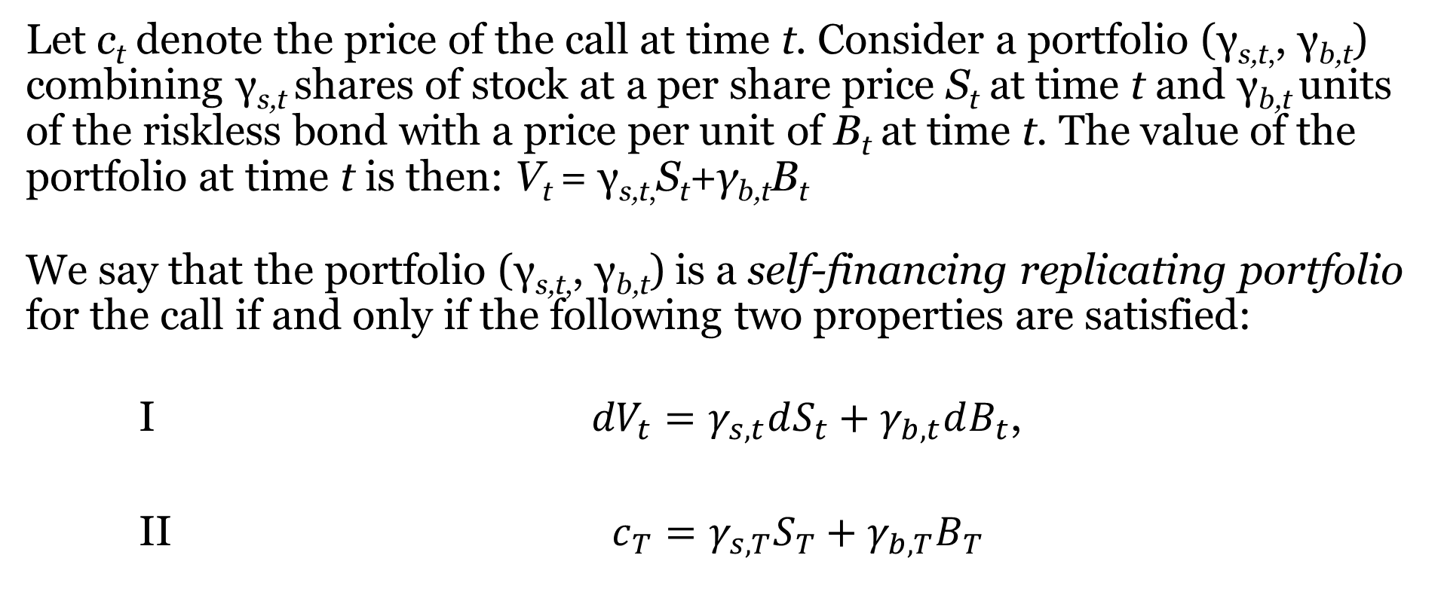
Introducing The Self-Financing Replicating Portfolio
Let c_{t} denote the price of the call at time t. Consider a portfolio (γ_{s,t,}, γ_{b,t}) combining γ_{s,t} shares of stock at a per share price S_{t} at time t and γ_{b,t} units of the riskless bond with a price per unit of B_{t} at time t. The value of the portfolio at time t is then: V_{t} = γ_{s,t,}S_{t}+γ_{b,t}B_{t}
We say that the portfolio (γ_{s,t,}, γ_{b,t}) is a self-financing replicating portfolio for the call if and only if the following two properties are satisfied:
I ${dV}_{t}=γ_{s,t}dS_{t}+γ_{b,t}dB_{t}$,
II $c_{T}=γ_{s,T}S_{T}+γ_{b,T}B_{T}$

Slide 4
Introducing The Self-Financing Replicating Portfolio (Continued)
The Interpretations of Properties Of Self-financing Replicating Portfolio
Property I is called the self-financing property. The interpretation of Property I is that during every infinitesimal time interval (t,t+dt) the change in the value of the portfolio is entirely due to the changes in the prices of the stock and bond. There is no net new investment in the portfolio. In other words, any infinitesimal purchases or sales of the stock and bond (dγ_{s,t} and dγ_{b,t}) will offset each other so that the change in the value of the portfolio is entirely due to the changes in the value of the securities themselves.
Property II states that the expiry date T value of the replicating portfolio will equal the price of the call at expiry date T. We will also assume the absence of arbitrage opportunities.

Slide 5
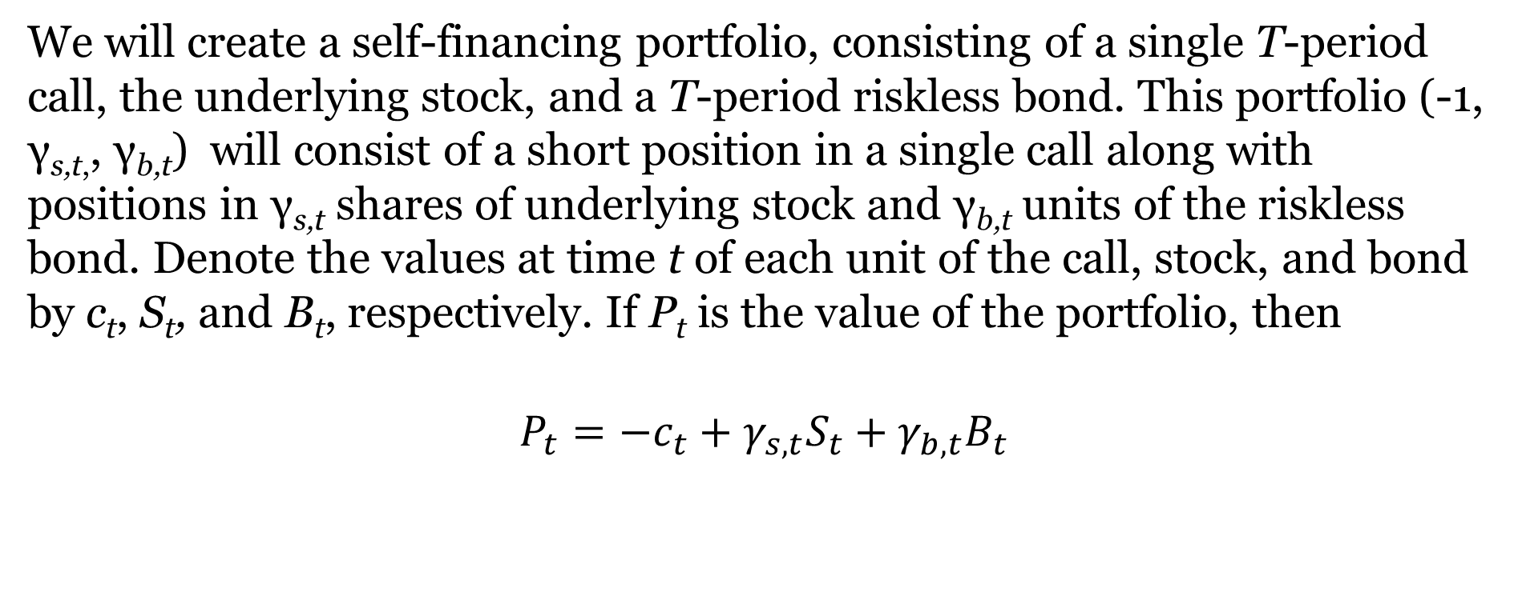
Introducing The Self-Financing Replicating Portfolio (Continued)
We will create a self-financing portfolio, consisting of a single T-period call, the underlying stock, and a T-period riskless bond. This portfolio (-1, γ_{s,t,}, γ_{b,t}) will consist of a short position in a single call along with positions in γ_{s,t} shares of underlying stock and γ_{b,t} units of the riskless bond. Denote the values at time t of each unit of the call, stock, and bond by c_{t}, S_{t}, and B_{t}, respectively. If P_{t} is the value of the portfolio, then
$$P_{t}=−c_{t}+γ_{s,t}S_{t}+γ_{b,t}B_{t}$$
Note: our short position in the call will be offset by a long position in the underlying stock (γ_{s,t} will be positive), and a short position in γ_{b,t} units of the riskless bond (γ_{b,t} will be negative)

Slide 6
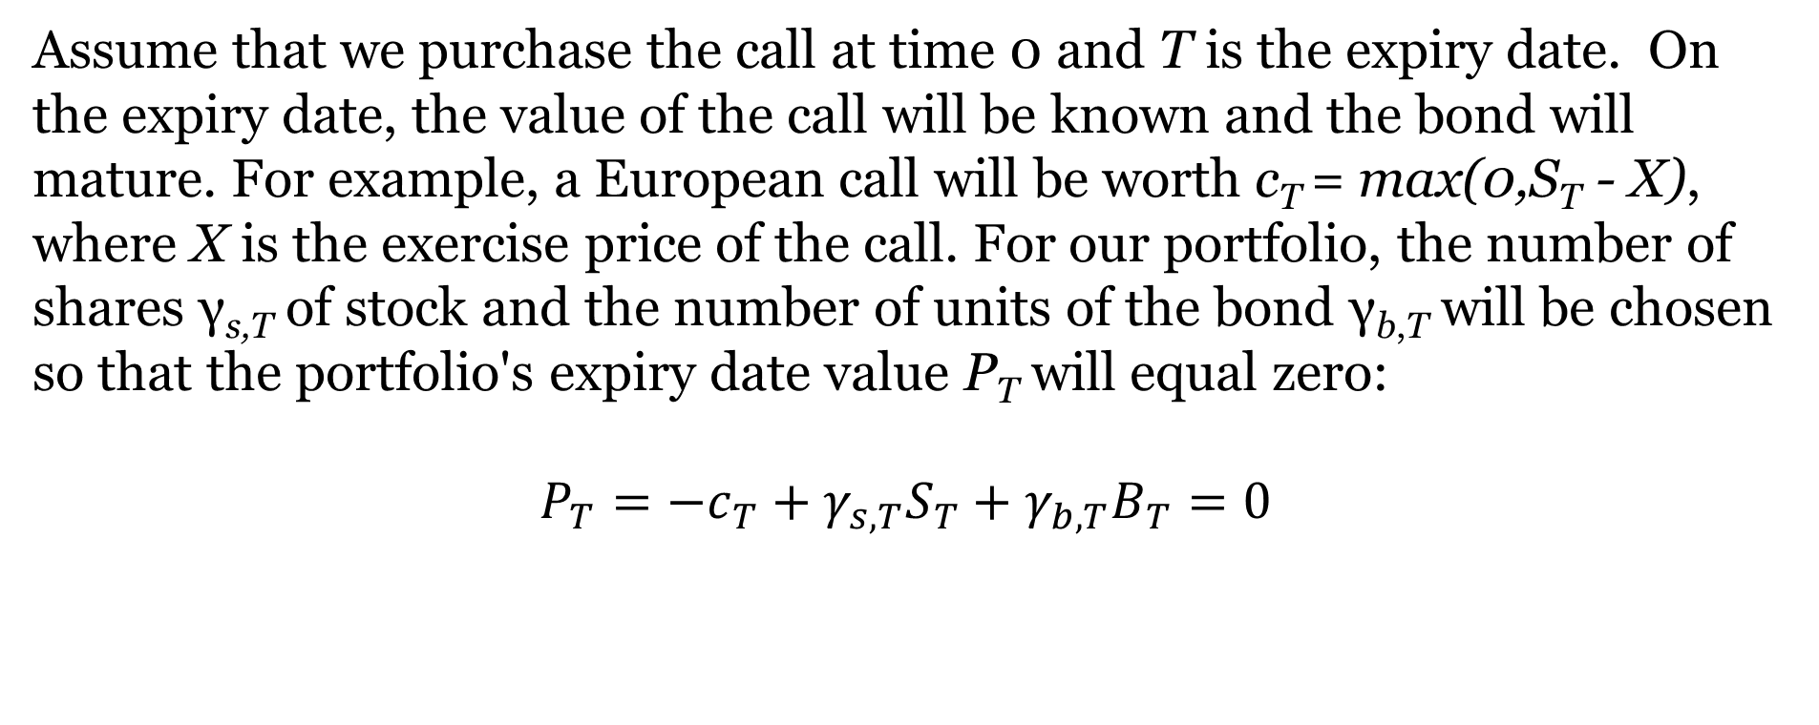
Introducing The Self-Financing Replicating Portfolio (Continued)
Assume that we purchase the call at time 0 and T is the expiry date. On the expiry date, the value of the call will be known and the bond will mature. For example, a European call will be worth c_{T} = max(0,S_{T} - X), where X is the exercise price of the call. For our portfolio, the number of shares γ_{s,T} of stock and the number of units of the bond γ_{b,T} will be chosen so that the portfolio's expiry date value P_{T} will equal zero:
$$P_{T}={−c}_{T}+γ_{s,T}S_{T}+γ_{b,T}B_{T}=0$$

Slide 7
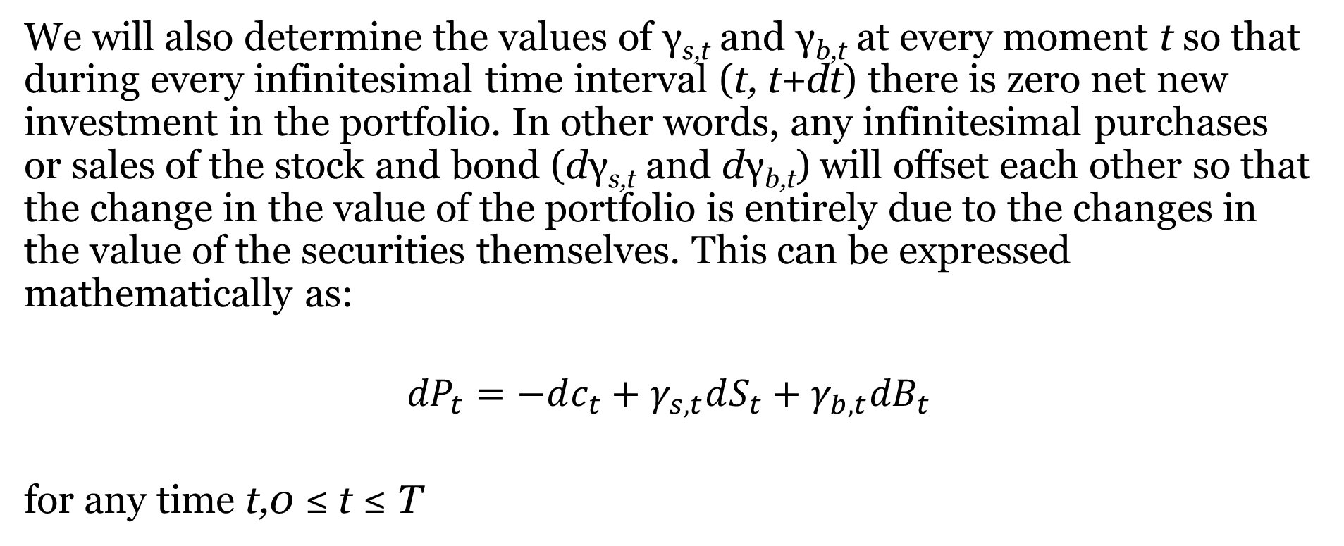
Introducing The Self-Financing Replicating Portfolio (Continued)
We will also determine the values of γ_{s,t} and γ_{b,t} at every moment t so that during every infinitesimal time interval (t, t+dt) there is zero net new investment in the portfolio. In other words, any infinitesimal purchases or sales of the stock and bond (dγ_{s,t} and dγ_{b,t}) will offset each other so that the change in the value of the portfolio is entirely due to the changes in the value of the securities themselves. This can be expressed mathematically as:
$${dP}_{t}=−dc_{t}+γ_{s,t}dS_{t}+γ_{b,t}{dB}_{t}$$
for any time t,0 ≤ t ≤ T

Slide 8
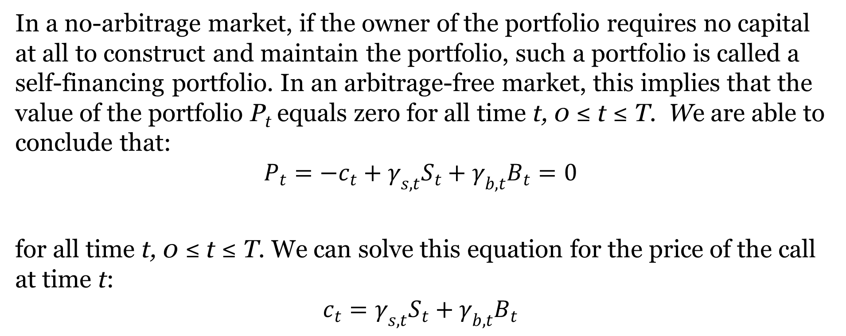
Introducing The Self-Financing Replicating Portfolio (Continued)
In a no-arbitrage market, if the owner of the portfolio requires no capital at all to construct and maintain the portfolio, such a portfolio is called a self-financing portfolio. In an arbitrage-free market, this implies that the value of the portfolio P_{t} equals zero for all time t, 0 ≤ t ≤ T. We are able to conclude that:
$$P_{t}=−c_{t}+γ_{s,t}S_{t}+γ_{b,t}B_{t}=0$$
for all time t, 0 ≤ t ≤ T. We can solve this equation for the price of the call at time t:
$$c_{t}=γ_{s,t}S_{t}+γ_{b,t}B_{t}$$

Slide 9

Introducing The Self-Financing Replicating Portfolio (Continued)
We have reduced the problem to showing that we can construct a self- financing replicating portfolio $V_{t}$ so that properties I and II are satisfied. Although our derivation will be discussed in terms of pricing a call, the derivation will be valid for any security that can be expressed as a portfolio of the stock and riskless bond.

Slide 10
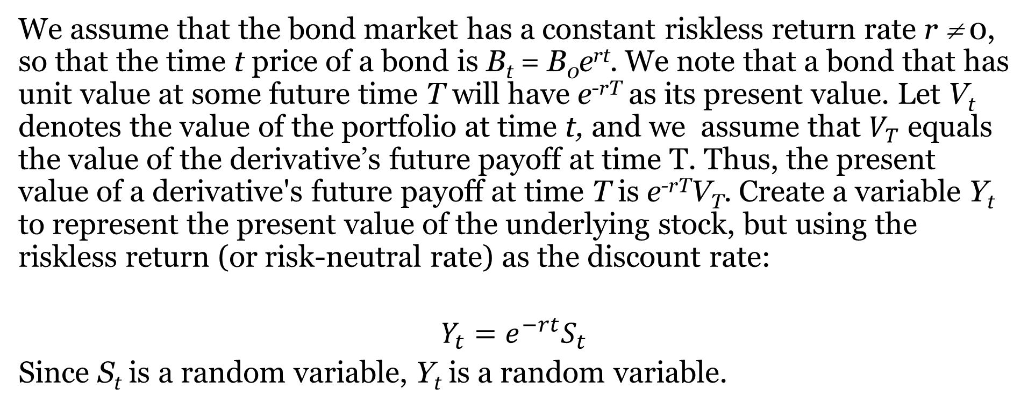
The Martingale Approach To Valuing Derivatives
We assume that the bond market has a constant riskless return rate r ≠ 0, so that the time t price of a bond is B_{t} = B₀e^{rt}. We note that a bond that has unit value at some future time T will have e^{-rT} as its present value. Let V_{t} denotes the value of the portfolio at time t, and we assume that $V_{T}$ equals the value of the derivative’s future payoff at time T. Thus, the present value of a derivative's future payoff at time T is e^{-rT}V_{T}. Create a variable Y_{t} to represent the present value of the underlying stock, but using the riskless return (or risk-neutral rate) as the discount rate:
$$Y_{t}=e^{−rt}S_{t}$$
Since S_{t} is a random variable, Y_{t} is a random variable.

Slide 11
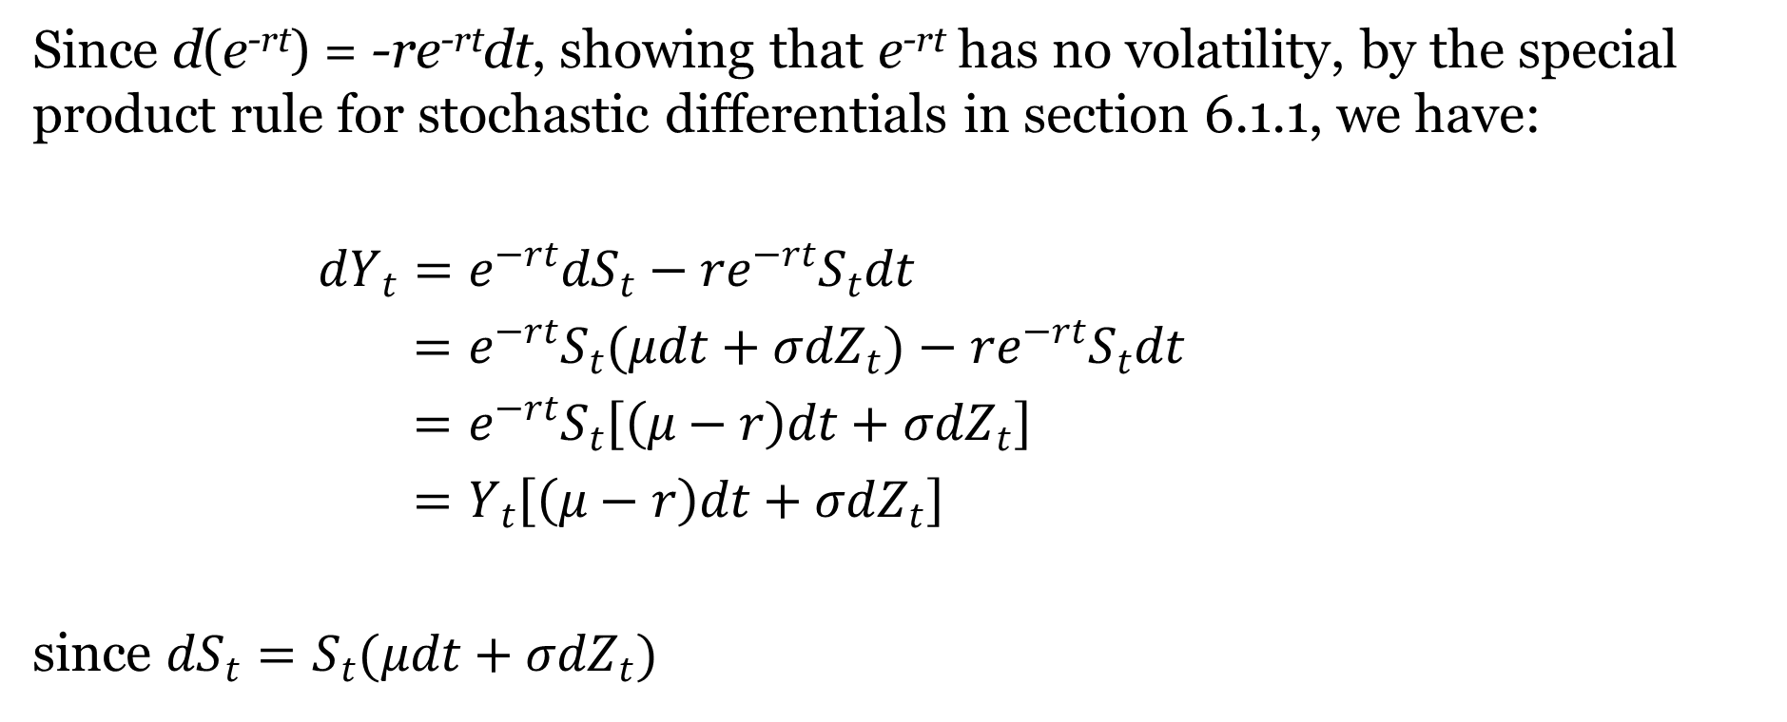
The Martingale Approach To Valuing Derivatives (Continued)
Since d(e^{-rt}) = -re^{-rt}dt, showing that e^{-rt} has no volatility, by the special product rule for stochastic differentials in section 6.1.1, we have:
$dY_{t}=e^{−rt}dS_{t}−re^{−rt}S_{t}dt$
$=e^{−rt}S_{t}(μdt+σdZ_{t})−re^{−rt}S_{t}dt$
$=e^{−rt}S_{t}\left[\left(μ−r\right)dt+σdZ_{t}\right]$
$=Y_{t}\left[\left(μ−r\right)dt+σdZ_{t}\right]$
since ${dS}_{t}=S_{t}(μdt+σdZ_{t})$

Slide 12
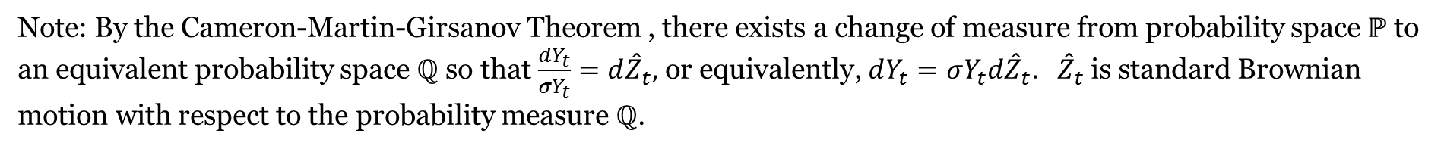
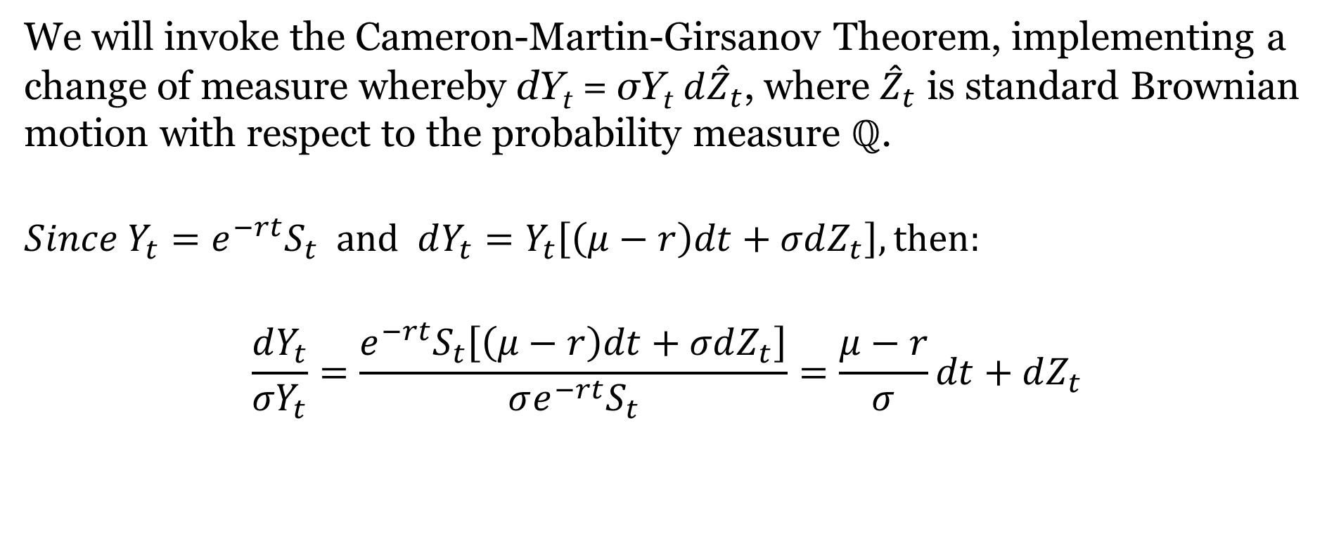
Implementing The Change Of Measure
We will invoke the Cameron-Martin-Girsanov Theorem, implementing a change of measure whereby dY_{t} = σY_{t} ${d\hat{Z}}_{t}$, where ${\hat{Z}}_{t}$ is standard Brownian motion with respect to the probability measure ℚ.
$$Since Y_{t}=e^{−rt}S_{t} and dY_{t}=Y_{t}\left[\left(μ−r\right)dt+σdZ_{t}\right], then:$$
$$\frac{dY_{t}}{{σY}_{t}}=\frac{e^{−rt}S_{t}\left[\left(μ−r\right)dt+σdZ_{t}\right]}{σe^{−rt}S_{t}}=\frac{μ−r}{σ}dt+dZ_{t}$$
Note: By the Cameron-Martin-Girsanov Theorem , there exists a change of measure from probability space $ℙ$ to an equivalent probability space ℚ so that $\frac{dY_{t}}{{σY}_{t}}=d{\hat{Z}}_{t},$ or equivalently, $dY_{t}=σY_{t}d{\hat{Z}}_{t}.$ ${\hat{Z}}_{t}$ is standard Brownian motion with respect to the probability measure ℚ.

Slide 13
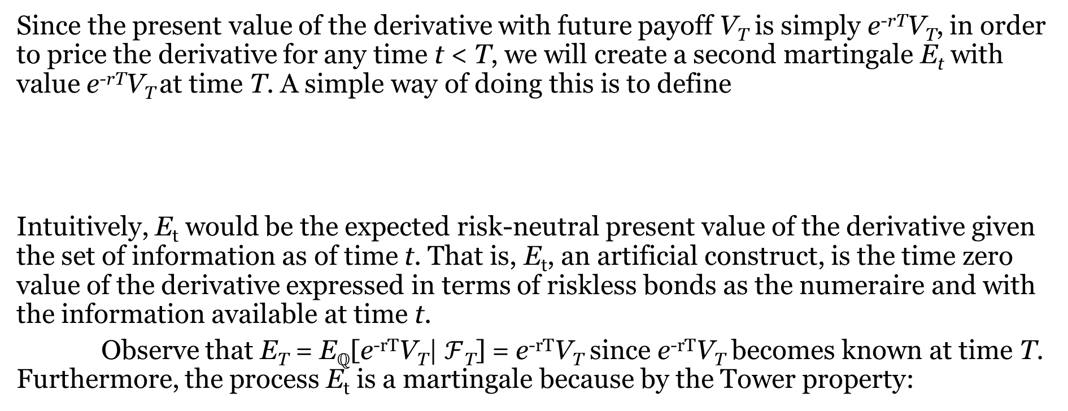
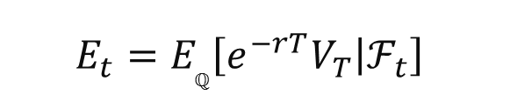
Implementing the Change Of Measure (Continued)
Since the present value of the derivative with future payoff V_{T} is simply e^{-rT}V_{T}, in order to price the derivative for any time t < T, we will create a second martingale E_{t} with value e^{-rT}V_{T} at time T. A simple way of doing this is to define
Intuitively, E_{t} would be the expected risk-neutral present value of the derivative given the set of information as of time t. That is, E_{t}, an artificial construct, is the time zero value of the derivative expressed in terms of riskless bonds as the numeraire and with the information available at time t.
Observe that E_{T} = E_{ℚ}[e^{-rT}V_{T}|$ℱ$_{T}] = e^{-rT}V_{T} since e^{-rT}V_{T} becomes known at time T. Furthermore, the process E_{t} is a martingale because by the Tower property:
$$E_{t}=E_{ℚ}\left[e^{−rT}V_{T} | ℱ_{t}\right]$$
for all u < t

Slide 14
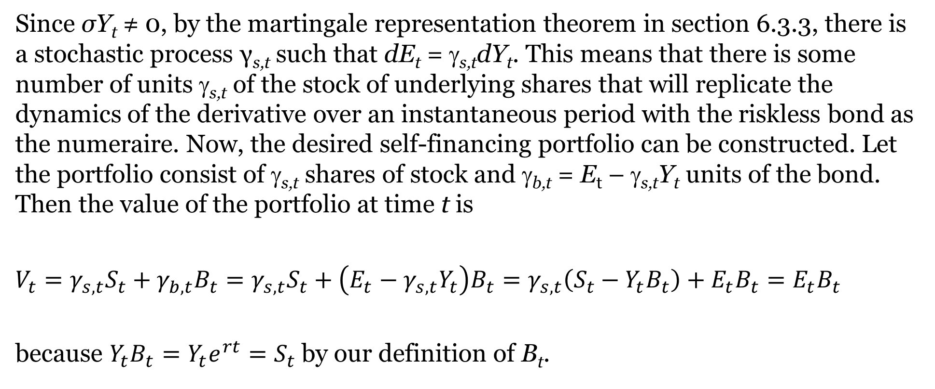
Implementing The Change Of Measure (Continued)
Since σY_{t} ≠ 0, by the martingale representation theorem in section 6.3.3, there is a stochastic process γ_{s,t} such that dE_{t} = γ_{s,t}dY_{t}. This means that there is some number of units γ_{s,t} of the stock of underlying shares that will replicate the dynamics of the derivative over an instantaneous period with the riskless bond as the numeraire. Now, the desired self-financing portfolio can be constructed. Let the portfolio consist of γ_{s,t} shares of stock and γ_{b,t} = E_{t} – γ_{s,t}Y_{t} units of the bond. Then the value of the portfolio at time t is
$V_{t}=γ_{s,t}S_{t}+γ_{b,t}B_{t}=γ_{s,t}S_{t}+\left(E_{t}−γ_{s,t}Y_{t}\right)B_{t}=γ_{s,t}\left(S_{t}−Y_{t}B_{t}\right)+E_{t}B_{t}=E_{t}B_{t}$
because $Y_{t}B_{t}=Y_{t}e^{rt}=S_{t}$ by our definition of B_{t}.

Slide 15
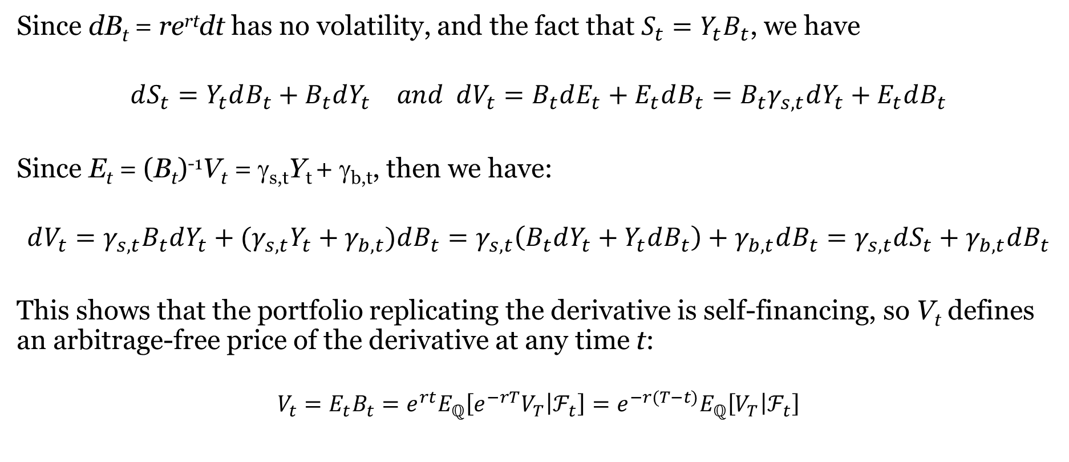
Demonstrating The Self-Financing Characteristic
Since dB_{t} = re^{rt}dt has no volatility, and the fact that ${S_{t}=Y}_{t}B_{t}$, we have
$$dS_{t}=Y_{t}dB_{t}+B_{t}dY_{t} and dV_{t}=B_{t}dE_{t}+E_{t}dB_{t}=B_{t}γ_{s,t}dY_{t}+E_{t}dB_{t}$$
Since E_{t} = (B_{t})⁻¹V_{t} = γ_{s,t}Y_{t} + γ_{b,t}, then we have:
$$dV_{t}=γ_{s,t}B_{t}dY_{t}+(γ_{s,t}Y_{t}+γ_{b,t})dB_{t}=γ_{s,t}\left(B_{t}dY_{t}+Y_{t}dB_{t}\right)+γ_{b,t}dB_{t}=γ_{s,t}dS_{t}+γ_{b,t}dB_{t}$$
This shows that the portfolio replicating the derivative is self-financing, so V_{t} defines an arbitrage-free price of the derivative at any time t:
$$V_{t}=E_{t}B_{t}=e^{rt}E_{ℚ}\left[e^{−rT}V_{T} | ℱ_{t}\right]=e^{−r(T−t)}E_{ℚ}\left[V_{T} | ℱ_{t}\right]$$

Slide 16
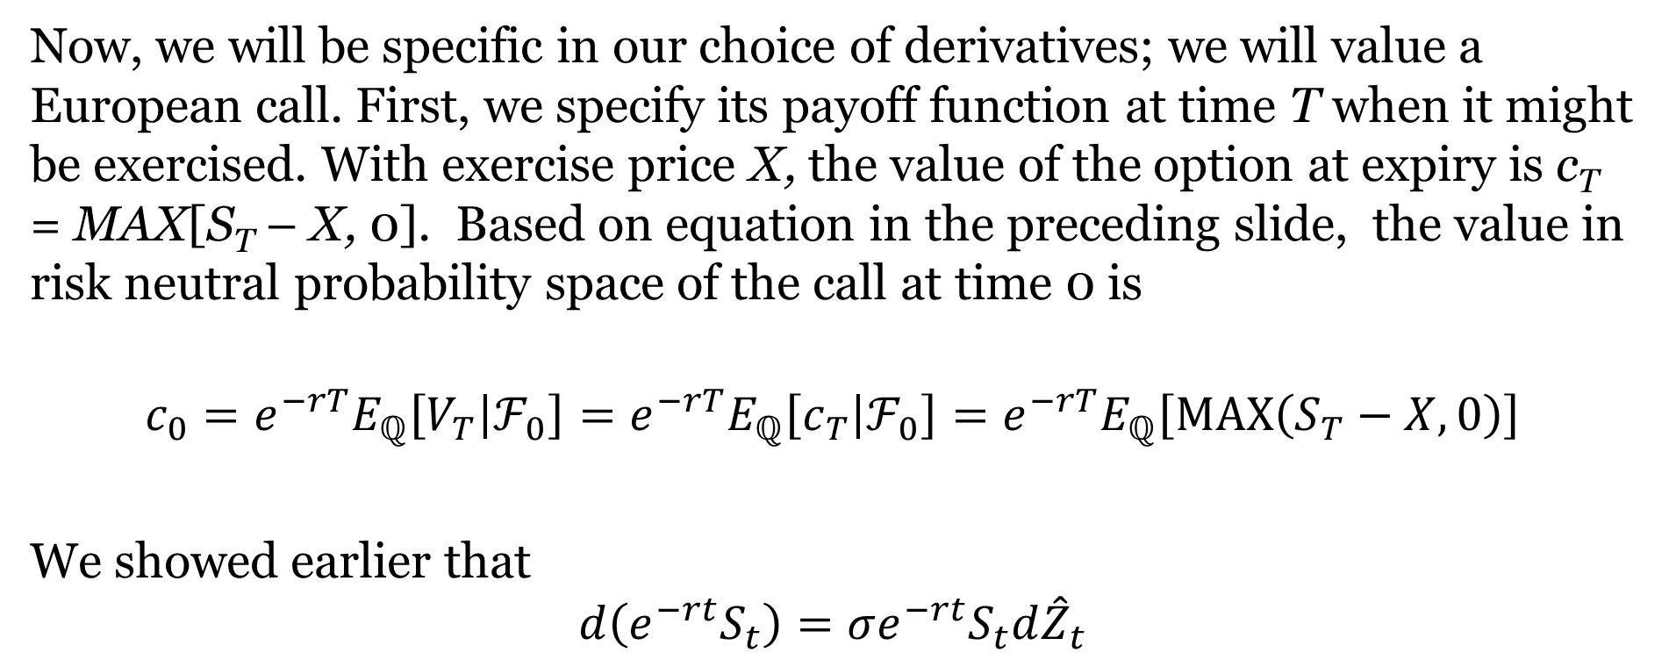
Pricing A European Call Option And The Black-Scholes Formula
Now, we will be specific in our choice of derivatives; we will value a European call. First, we specify its payoff function at time T when it might be exercised. With exercise price X, the value of the option at expiry is c_{T} = MAX[S_{T} – X, 0]. Based on equation in the preceding slide, the value in risk neutral probability space of the call at time 0 is
$$c_{0}={e^{−rT}E}_{ℚ}\left[V_{T} | ℱ_{0}\right]=e^{−rT}E_{ℚ}\left[c_{T} | ℱ_{0}\right]=e^{−rT}E_{ℚ}\left[\operatorname{MAX}\left(S_{T}−X,0\right)\right]$$
We showed earlier that
$$d\left(e^{−rt}S_{t}\right)=σe^{−rt}S_{t}d{\hat{Z}}_{t}$$

Slide 17
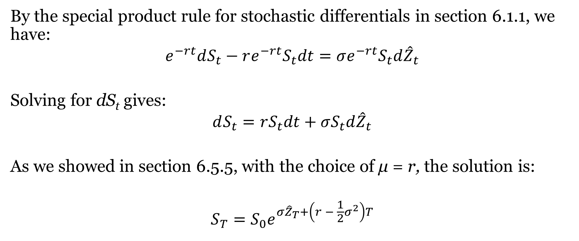
Pricing A European Call Option And The Black-Scholes Formula (Continued)
By the special product rule for stochastic differentials in section 6.1.1, we have:
$$e^{−rt}dS_{t}−re^{−rt}S_{t}dt=σe^{−rt}S_{t}d{\hat{Z}}_{t}$$
Solving for dS_{t} gives:
$$dS_{t}=rS_{t}dt+σS_{t}d{\hat{Z}}_{t}$$
As we showed in section 6.5.5, with the choice of μ = r, the solution is:
$$S_{T}=S_{0}e^{σ{\hat{Z}}_{T}+\left(r − \frac{1}{2}σ^{2}\right)T}$$

Slide 18
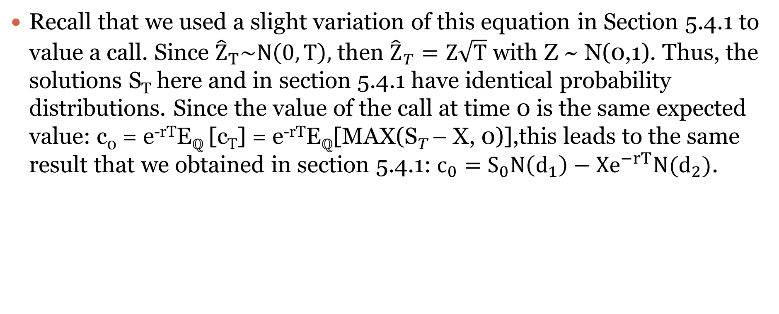
Pricing A European Call Option And The Black-Scholes Formula (Continued)
Recall that we used a slight variation of this equation in Section 5.4.1 to value a call. Since ${\hat{Z}}_{T}\sim N\left(0,T\right),$ then ${\hat{Z}}_{T}=Z\sqrt{T}$ with Z ~ N(0,1). Thus, the solutions S_{T} here and in section 5.4.1 have identical probability distributions. Since the value of the call at time 0 is the same expected value: c₀ = e^{-rT}E_{ℚ} [c_{T}] = e^{-rT}E_{ℚ}[MAX(S_{T} – X, 0)],this leads to the same result that we obtained in section 5.4.1: $c_{0}=$ $S_{0}N\left(d_{1}\right)−Xe^{−rT}N(d_{2})$.

Slide 19
Black-Scholes Assumptions
There exist no restrictions on short sales of stock or writing of call options.
There are no transactions costs.
There exists continuous trading of stocks and options.
There exists a known constant riskless borrowing and lending rate r.
The underlying stock will pay no dividends or make other distributions during the life of the option.
The option can be exercised only on its expiration date; that is, it is a European Option.
Shares of stock and option contracts are infinitely divisible.
Underlying stock prices follow a geometric Brownian motion process:
dS_{t} = μS_{t}dt + σS_{t}dZ_{t}.

Slide 20
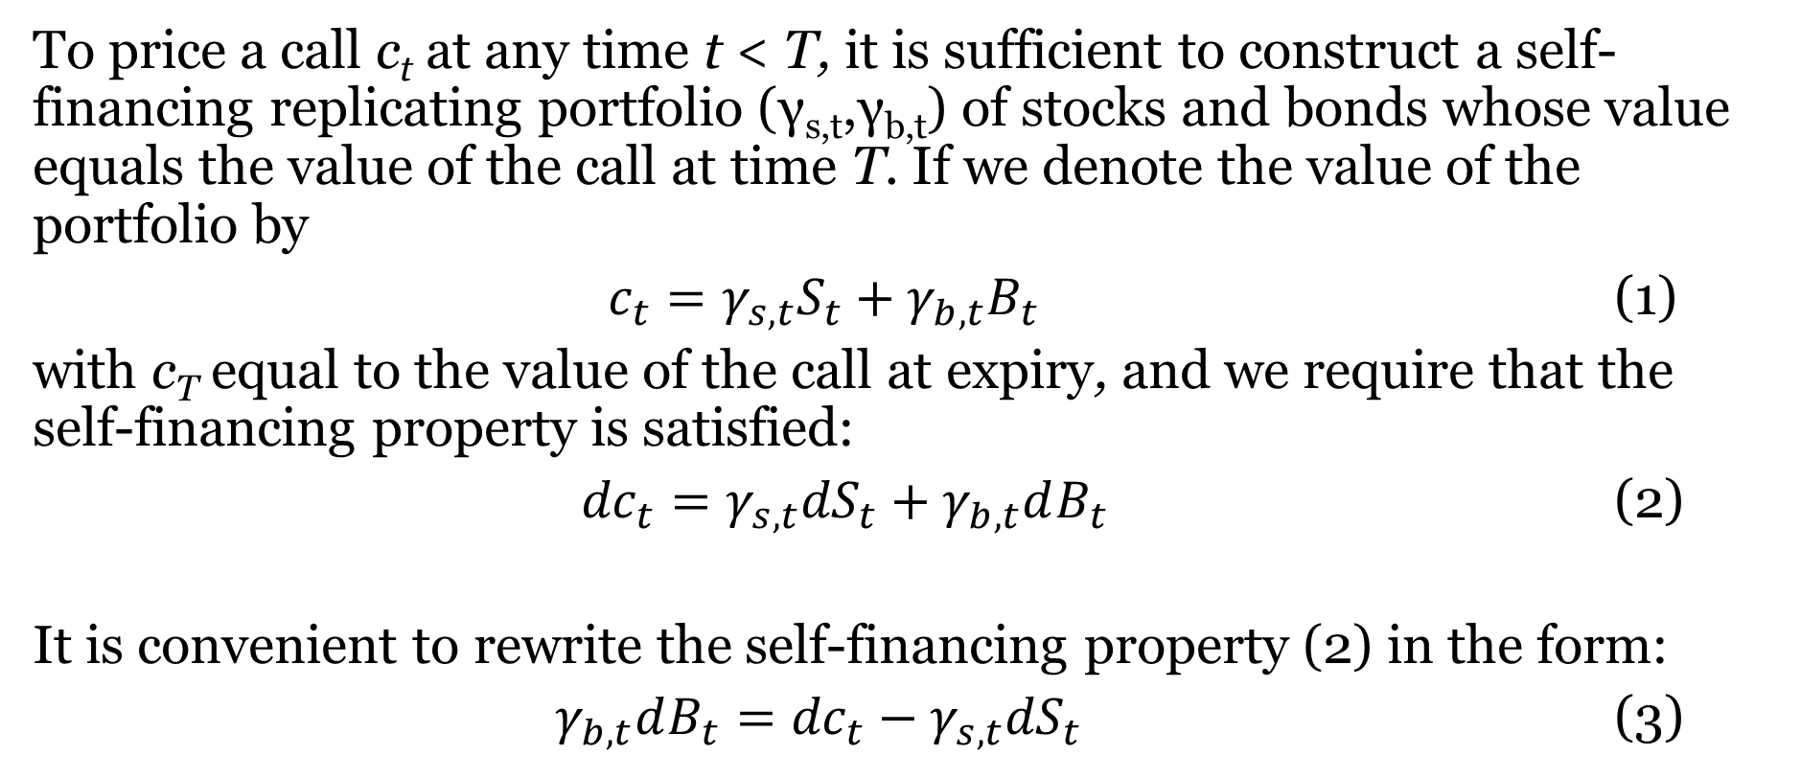
Deriving Black-Scholes
To price a call c_{t} at any time t < T, it is sufficient to construct a self-financing replicating portfolio (γ_{s,t},γ_{b,t}) of stocks and bonds whose value equals the value of the call at time T. If we denote the value of the portfolio by
$c_{t}=γ_{s,t}S_{t}+γ_{b,t}B_{t}$ (1)
with c_{T} equal to the value of the call at expiry, and we require that the self-financing property is satisfied:
${dc}_{t}=γ_{s,t}{dS}_{t}+γ_{b,t}dB_{t}$ (2)
It is convenient to rewrite the self-financing property (2) in the form:
${γ_{b,t}dB_{t}=dc}_{t}−γ_{s,t}{dS}_{t}$ (3)

Slide 21
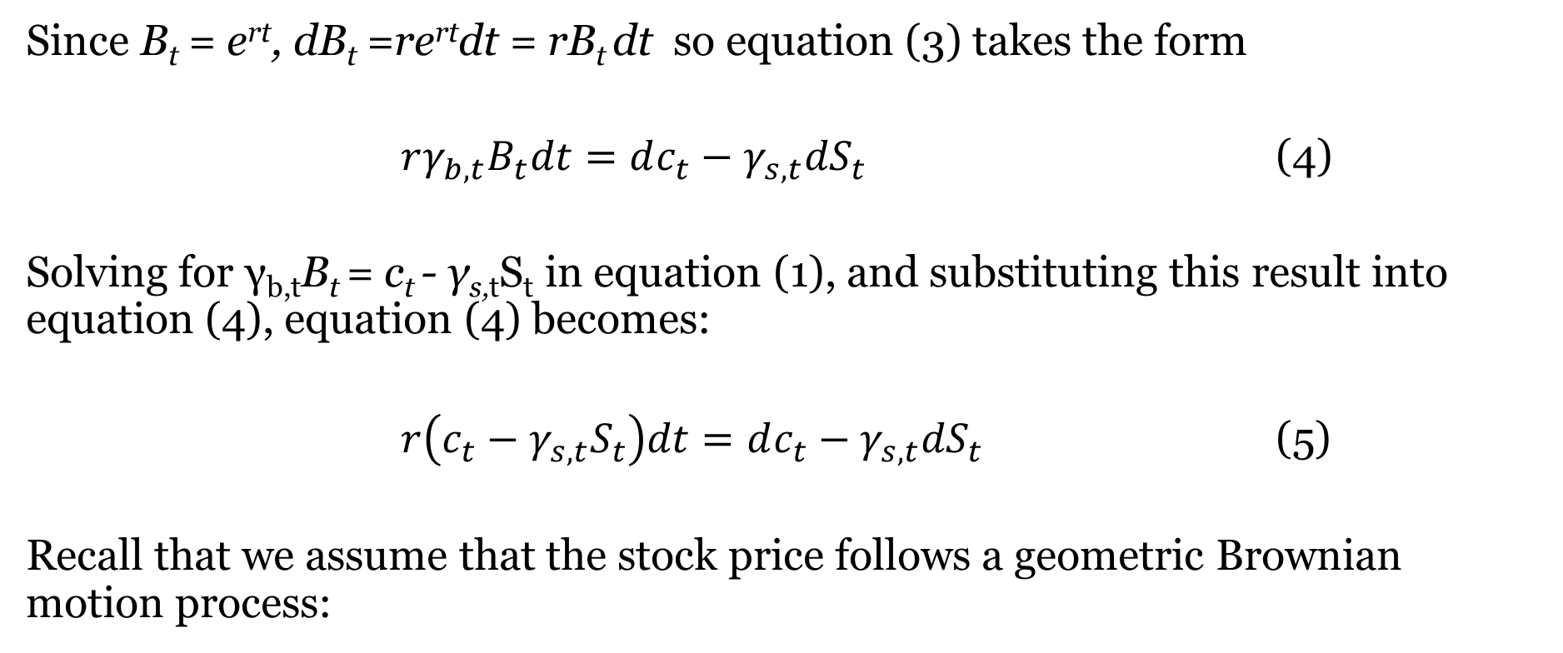
Deriving Black-Scholes (Continued)
Since B_{t} = e^{rt}, dB_{t} =re^{rt}dt = rB_{t} dt so equation (3) takes the form
$rγ_{b,t}B_{t}dt=dc_{t}−γ_{s,t}{dS}_{t}$ (4)
Solving for γ_{b,t}B_{t} = c_{t} - γ_{s,t}S_{t} in equation (1), and substituting this result into equation (4), equation (4) becomes:
$r\left(c_{t}−γ_{s,t}S_{t}\right)dt=dc_{t}−γ_{s,t}{dS}_{t}$ (5)
Recall that we assume that the stock price follows a geometric Brownian motion process:

Slide 22
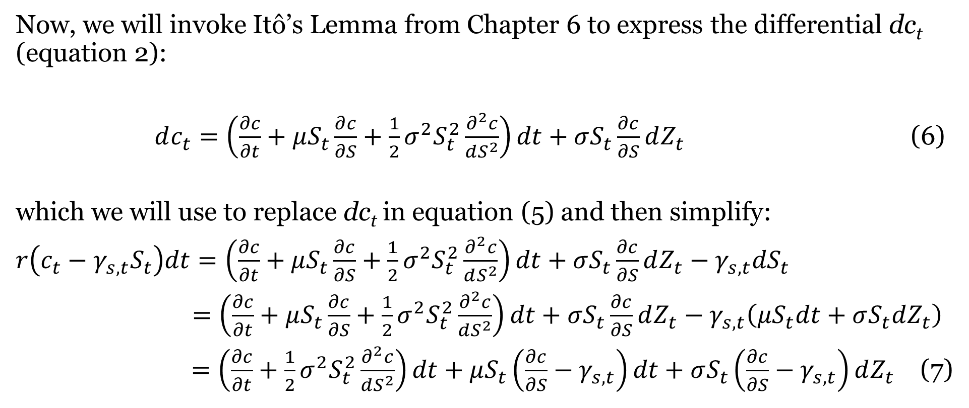
Deriving Black-Scholes (Continued)
Now, we will invoke Itô’s Lemma from Chapter 6 to express the differential dc_{t} (equation 2):
$dc_{t}=\left(\frac{∂c}{∂t}+μS_{t}\frac{∂c}{∂S}+\frac{1}{2}σ^{2}S_{t}^{2}\frac{∂^{2}c}{dS^{2}}\right)dt+σS_{t}\frac{∂c}{∂S}dZ_{t}$ (6)
which we will use to replace dc_{t} in equation (5) and then simplify:
$r\left(c_{t}−γ_{s,t}S_{t}\right)dt=\left(\frac{∂c}{∂t}+μS_{t}\frac{∂c}{∂S}+\frac{1}{2}σ^{2}S_{t}^{2}\frac{∂^{2}c}{dS^{2}}\right)dt+σS_{t}\frac{∂c}{∂S}dZ_{t}−γ_{s,t}{dS}_{t}$
$=\left(\frac{∂c}{∂t}+μS_{t}\frac{∂c}{∂S}+\frac{1}{2}σ^{2}S_{t}^{2}\frac{∂^{2}c}{dS^{2}}\right)dt+σS_{t}\frac{∂c}{∂S}dZ_{t}−γ_{s,t}\left(μS_{t}dt+σS_{t}dZ_{t}\right)$
$=\left(\frac{∂c}{∂t}+\frac{1}{2}σ^{2}S_{t}^{2}\frac{∂^{2}c}{dS^{2}}\right)dt+μS_{t}\left(\frac{∂c}{∂S}−γ_{s,t}\right)dt+σS_{t}\left(\frac{∂c}{∂S}−γ_{s,t}\right)dZ_{t}$ (7)

Slide 23
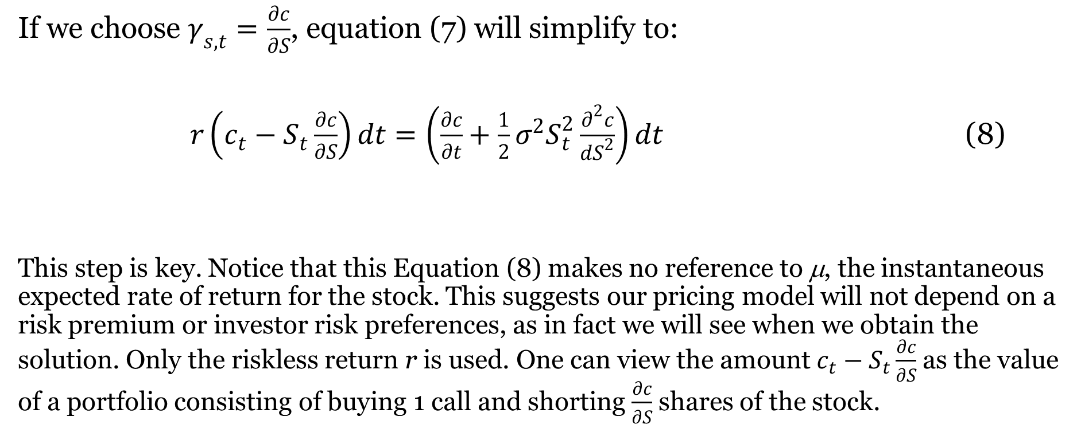
Deriving Black-Scholes (Continued)
If we choose $γ_{s,t}=\frac{∂c}{∂S}$, equation (7) will simplify to:
$r\left(c_{t}−S_{t}\frac{∂c}{∂S}\right)dt=\left(\frac{∂c}{∂t}+\frac{1}{2}σ^{2}S_{t}^{2}\frac{∂^{2}c}{dS^{2}}\right)dt$ (8)
This step is key. Notice that this Equation (8) makes no reference to μ, the instantaneous expected rate of return for the stock. This suggests our pricing model will not depend on a risk premium or investor risk preferences, as in fact we will see when we obtain the solution. Only the riskless return r is used. One can view the amount $c_{t}−S_{t}\frac{∂c}{∂S}$ as the value of a portfolio consisting of buying 1 call and shorting $\frac{∂c}{∂S}$ shares of the stock.

Slide 24
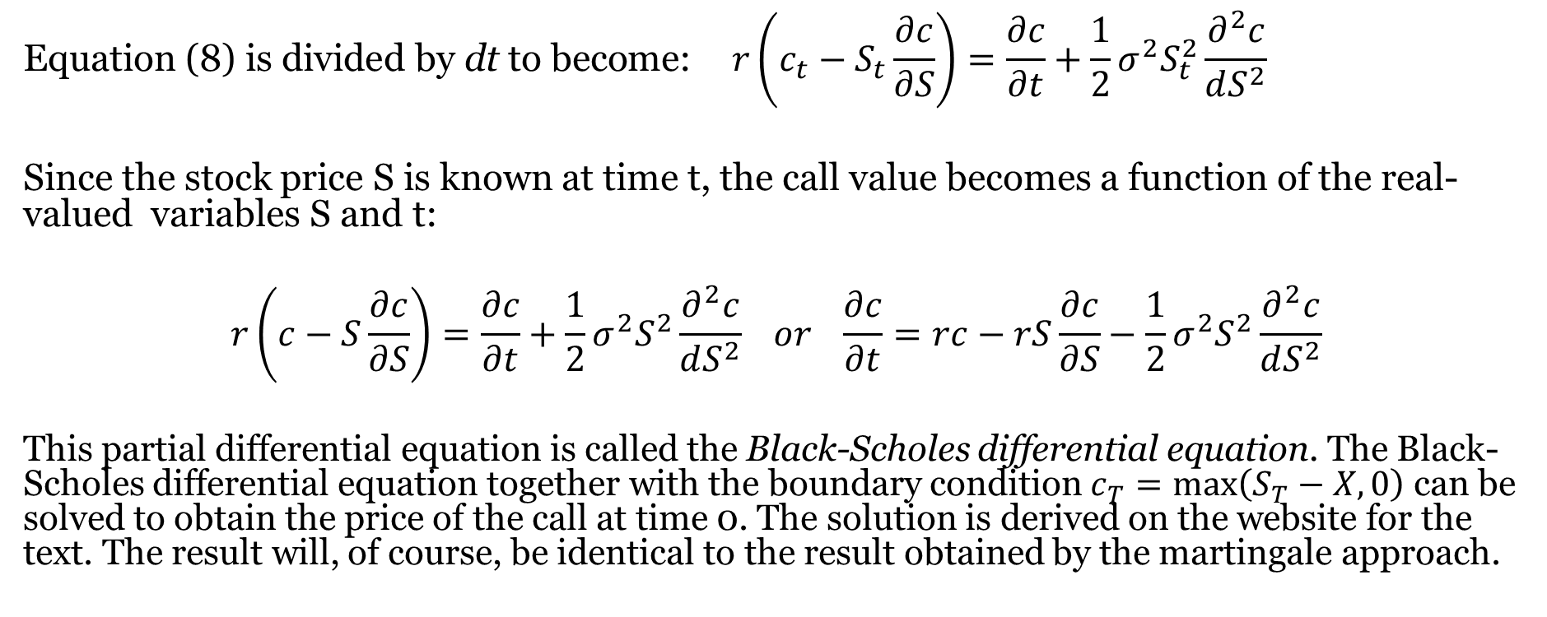
Deriving Black-Scholes (Continued)
$$\text{Equation}\text{ (8) }\text{is} \text{divided} \text{by} \text{dt} \text{to} \text{become}\text{:} r\left(c_{t}−S_{t}\frac{∂c}{∂S}\right)=\frac{∂c}{∂t}+\frac{1}{2}σ^{2}S_{t}^{2}\frac{∂^{2}c}{dS^{2}}$$
Since the stock price S is known at time t, the call value becomes a function of the real-valued variables S and t:
$$r\left(c−S\frac{∂c}{∂S}\right)=\frac{∂c}{∂t}+\frac{1}{2}σ^{2}S^{2}\frac{∂^{2}c}{dS^{2}} or \frac{∂c}{∂t}=rc−rS\frac{∂c}{∂S}−\frac{1}{2}σ^{2}S^{2}\frac{∂^{2}c}{dS^{2}}$$
This partial differential equation is called the Black-Scholes differential equation. The Black-Scholes differential equation together with the boundary condition $c_{T}=\max\left(S_{T}−X,0\right)$ can be solved to obtain the price of the call at time 0. The solution is derived on the website for the text. The result will, of course, be identical to the result obtained by the martingale approach.

Slide 25
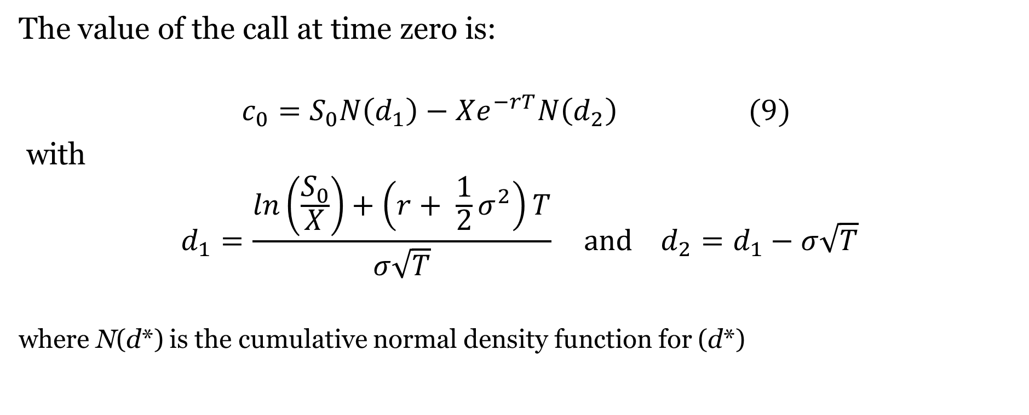
The Solution To The Black-Scholes Differential Equation
The value of the call at time zero is:
$$c_{0}=S_{0}N\left(d_{1}\right)−Xe^{−rT}N\left(d_{2}\right) (9)$$
with
$$d_{1}=\frac{\ln\left(\frac{S_{0}}{X}\right)+\left(r+ \frac{1}{2}σ^{2}\right)T}{σ\sqrt{T}} and d_{2}=d_{1}−σ\sqrt{T}$$
where N(d*) is the cumulative normal density function for (d*)
Note: For the interested reader, a derivation of the solution is in the text website for this chapter

Slide 26
The Black-Scholes Model: A Simple Numerical Illustration
Consider the following example of a Black-Scholes model application where an investor can purchase a six-month call option for $7.00 on a stock that is currently selling for $75. The exercise price of the call is $80 and the current riskless rate of return is 10% per annum. The variance of annual returns on the underlying stock is 16%. At its current price of $7.00, does this option represent a good investment?
We will note the model inputs in symbolic form:
T = .5 r = .10 X = 80 σ² = .16 σ = .4 S₀ = 75
Our first step is to find d₁ and d₂:
.

Slide 27
The Black-Scholes Model: A Simple Numerical Illustration (Continued)
Next, by using a z-table we find cumulative normal density functions for d₁ and d₂:
Finally, we use N(d₁) and N(d₂) to value the call:

Slide 28
The Black-Scholes Model: A Simple Numerical Illustration (Continued)
Since the 7.958 value of the call exceeds its 7.00 market price, the call represents a good purchase. Next, we use the put-call parity relation to find the value of the put as follows:
p₀ = c₀ + Xe^{-rT} - S₀
p₀ = 7.958 + 80(.9512) - 75 = 9.054

Slide 29
Implied Volatility
4 of 5 inputs required for Black-Scholes model are easily observed.
X and T are defined by the option contract.
R and S0 are based on current quotes.
Only σ, the underlying stock return volatility during the life of the option, cannot be observed.
Thus, we often employ a traditional sample estimator for return variance:
σ² = Var[r_{t}] = Var[lnS_{t} - lnS_{t-1}]
The difficulty with this procedure is that it requires that we assume that underlying security return variance is stable over time; more specifically, that future variances equal or can be estimated from historical variances.

Slide 30
Implied Volatility (Continued)
An alternative procedure first suggested by Latane and Rendleman [1976] is based on market prices of options that might be used to imply variance estimates.
The Black-Scholes Option Pricing Model might provide an excellent means to estimate underlying stock variances if the market prices of one or more relevant calls and puts are known.
Essentially, this procedure determines market estimates for underlying stock variance based on known market prices for options on the underlying securities.
When we use this procedure, we assume that the market reveals its estimate of volatility through the market prices of options.

Slide 31
Implied Volatility (Continued)
Consider the following example pertaining to a six-month call currently trading for $8.20 and its underlying stock currently trading for $75:
T = .5 r = .10 c₀ = 8.20 X = 80 S₀ = 75
If investors use the Black-Scholes Options Pricing Model to value calls, the following should be expected:

Slide 32
Implied Volatility (Continued)
Unfortunately, the system of equations required to obtain an implied variance has no closed form solution.
That is, we will be unable to solve this equation set explicitly for standard deviation; we must search, iterate and substitute for a solution.
One can substitute trial values for σ until she finds one that solves the system.
A significant amount of time can be saved by using one of several well-known numerical search procedures such as the Method of Bisection or the Newton-Raphson Method

Slide 33
The Method Of Bisection
We seek to solve the above system of equations for σ. This is equivalent to solving for the root of:
f(σ*) = 0 = 75×N(d₁) – 80×e^{-.1×.5}×N(d₂) - 8.20
based on equations above for d₁ and d₂.
There exists no closed form solution for σ. Thus, we will use the Method of Bisection to search for a solution.

Slide 34
The Method Of Bisection (Continued)
We first arbitrarily select endpoints for our range of guesses, such as b₁=.2 and a₁=.5 so that f(b₁) = -4.46788 < 0 and f(a₁) = 1.860465 > 0.
Since these endpoints result in f(σ) with opposite signs, our first iteration will be in the middle: σ₁ = .5(.2+.5) = .35.
We find that this estimate for σ results in a value of -1.29619 for f(σ). Since this f(σ) is negative, we know that σ* is in the segment b₂=.35 and a₂=.5.
Moving to Row n=2 on the next slide, we repeat the iteration process, finding after 16 iterations that σ*=.41146. Table 1 details the process of iteration.

Slide 35
The Method Of Bisection (Continued)
Using the Bisection Method to Estimate Implied Volatility

Slide 36
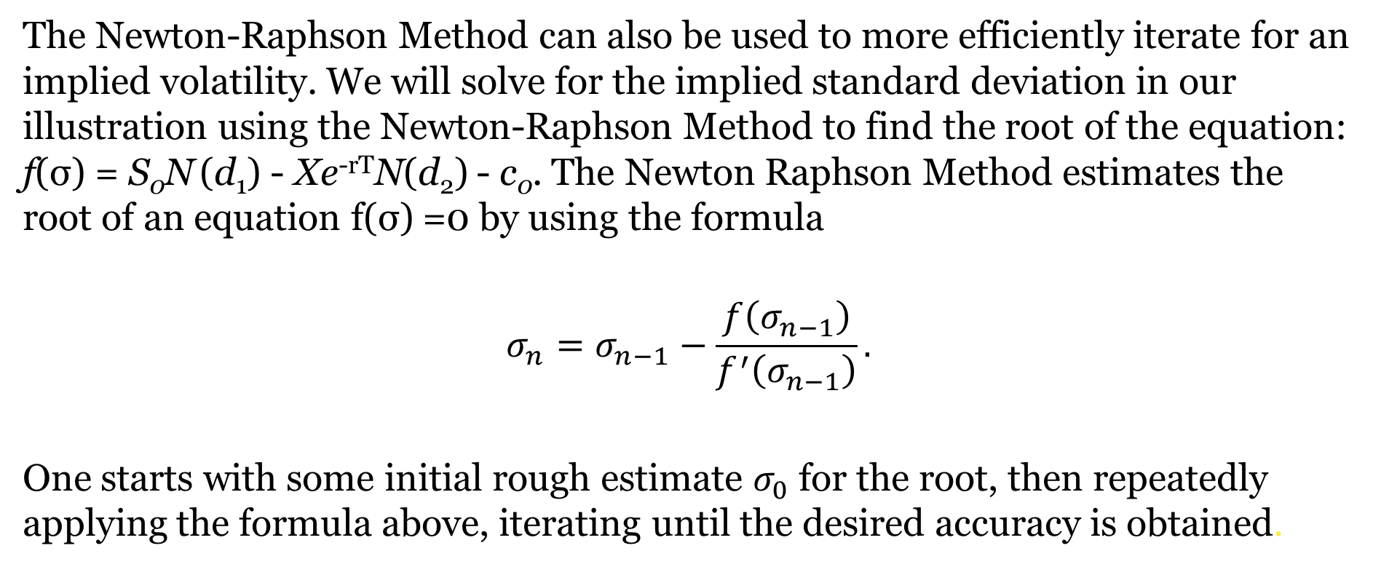
The Newton-Raphson Method
The Newton-Raphson Method can also be used to more efficiently iterate for an implied volatility. We will solve for the implied standard deviation in our illustration using the Newton-Raphson Method to find the root of the equation: f(σ) = S₀N (d₁) ‑ Xe^{‑rT}N(d₂) - c₀. The Newton Raphson Method estimates the root of an equation f(σ) =0 by using the formula
$$σ_{n}=σ_{n−1}−\frac{f\left(σ_{n−1}\right)}{f^{′}\left(σ_{n−1}\right)}.$$
One starts with some initial rough estimate $σ_{0}$ for the root, then repeatedly applying the formula above, iterating until the desired accuracy is obtained.

Slide 37
The Newton-Raphson Method (Continued)
For our example, we arbitrarily choose an initial trial solution of σ = σ₀ = .6. First, we need the derivative of f(σ) with respect to the underlying stock return standard deviation σ. Since we are treating c₀ as a given constant, differentiating this function is equivalent to differentiating the call function c = S₀N (d₁)‑Xe^{‑rT}N(d₂) with respect to σ.
We selected initial trial solution of σ₀ = .6. We see from Table 2 that this standard deviation results in a value of f(σ₀) = 3.95012, implying a variance estimate that is too high. Substituting .6 into Equation 3 for σ₀, we find that f '(σ₀) = 20.82509. Thus, our second trial value for σ is determined by: σ₁ ≈ σ₀ - (f(σ₀) ÷ f '(σ₀)) = .6 - (3.95012 ÷ 20.82509) = .41032. This process continues until we converge to a solution of approximately .41147

Slide 38
The Newton-Raphson Method (Continued)
Notice that the rate of convergence in this example is much faster when using the Newton-Raphson Method than when using the Method of Bisection.

Slide 39
Smiles, Smirks And Aggregating Procedures
We see that with an appropriate iteration methodology, solving for implied volatility is not a difficult matter.
However, another difficulty arising with implied variance estimates results from the fact that there will typically be more than one option trading on the same stock.
However, what if the short- and long-term uncertainty of a stock differ?
Or, what if options with different strike prices disagree on the same underlying stock volatility?
This latter effect in which implied volatilities vary with respect to option exercise prices is sometimes known as the smile or smirk effect.

Slide 40
Smiles, Smirks And Aggregating Procedures (Continued)

Slide 41
The Greeks
Delta
Gamma
Theta
Vega
Rho

Slide 42
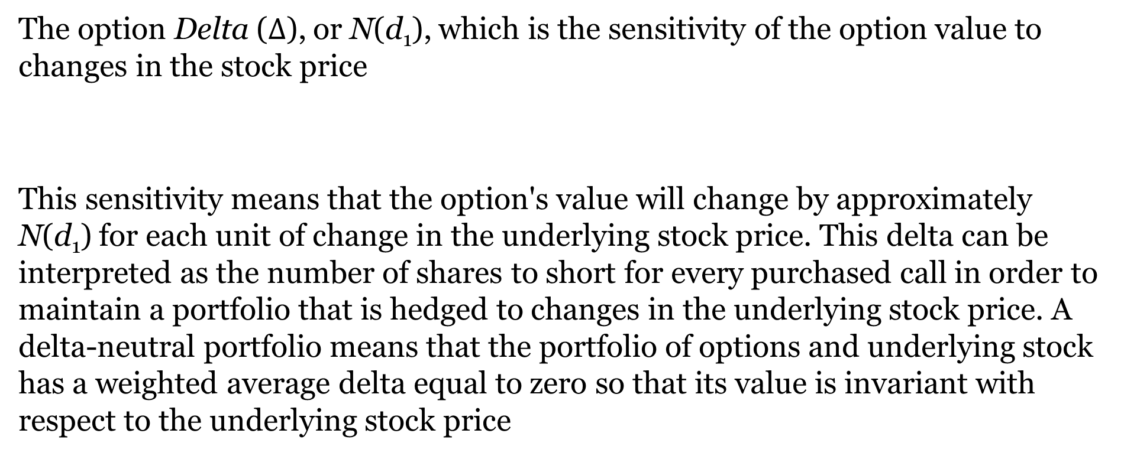
Delta
The option Delta ($∆$), or N(d₁), which is the sensitivity of the option value to changes in the stock price
This sensitivity means that the option's value will change by approximately N(d₁) for each unit of change in the underlying stock price. This delta can be interpreted as the number of shares to short for every purchased call in order to maintain a portfolio that is hedged to changes in the underlying stock price. A delta-neutral portfolio means that the portfolio of options and underlying stock has a weighted average delta equal to zero so that its value is invariant with respect to the underlying stock price

Slide 43
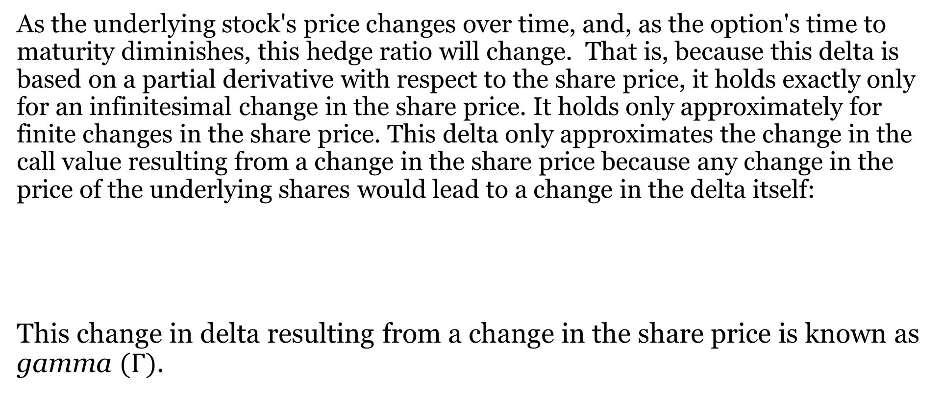
Gamma
As the underlying stock's price changes over time, and, as the option's time to maturity diminishes, this hedge ratio will change. That is, because this delta is based on a partial derivative with respect to the share price, it holds exactly only for an infinitesimal change in the share price. It holds only approximately for finite changes in the share price. This delta only approximates the change in the call value resulting from a change in the share price because any change in the price of the underlying shares would lead to a change in the delta itself:
This change in delta resulting from a change in the share price is known as gamma $(Γ)$.

Slide 44
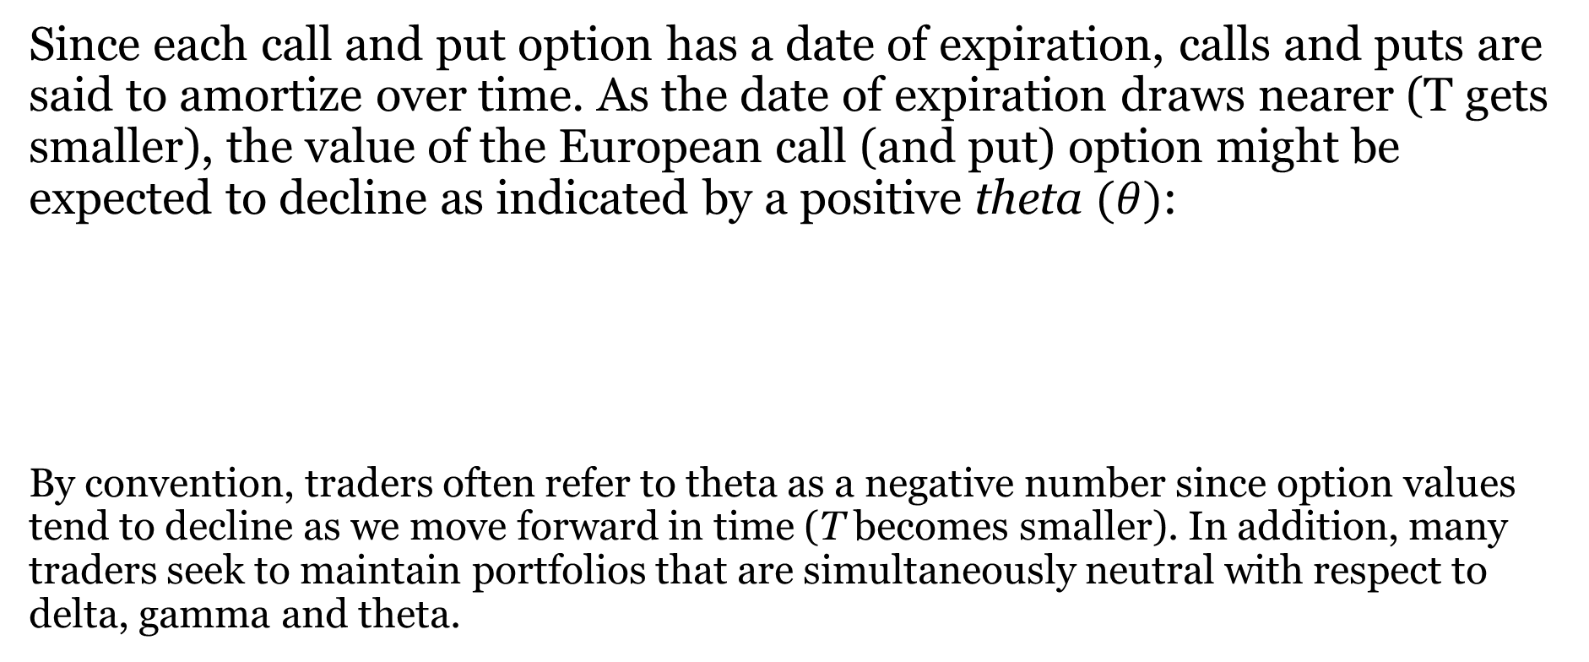
Theta
Since each call and put option has a date of expiration, calls and puts are said to amortize over time. As the date of expiration draws nearer (T gets smaller), the value of the European call (and put) option might be expected to decline as indicated by a positive theta $(θ)$:
By convention, traders often refer to theta as a negative number since option values tend to decline as we move forward in time (T becomes smaller). In addition, many traders seek to maintain portfolios that are simultaneously neutral with respect to delta, gamma and theta.

Slide 45
Vega
Vega (v), which actually is not a Greek letter, measures the sensitivity of the option price to the underlying stock's standard deviation of returns (vega is sometimes known as either kappa or zeta). As one would expect, the call option price is directly related to the underlying stock's standard deviation:

Slide 46
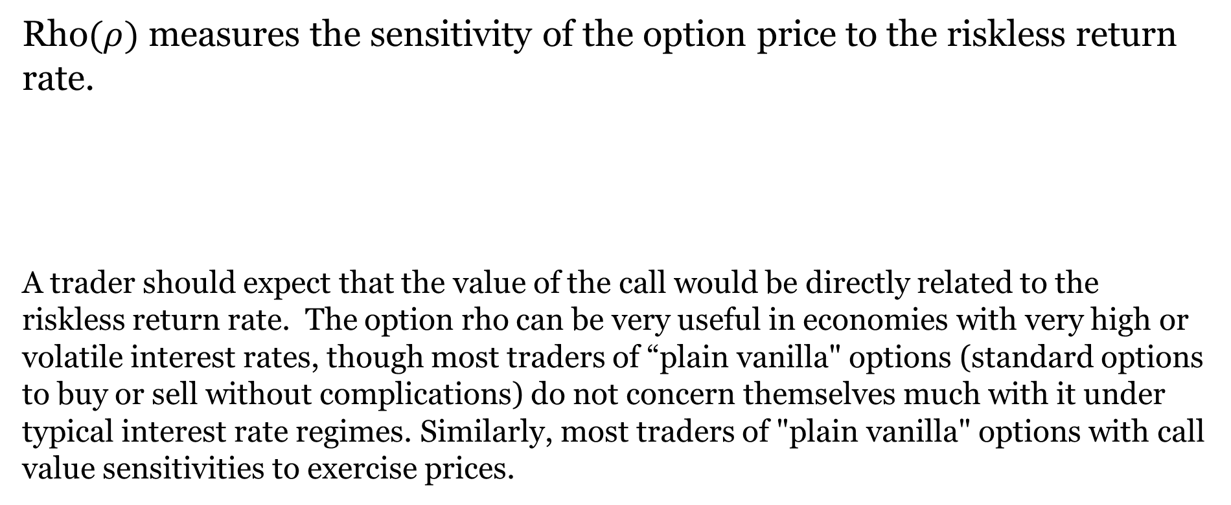
Rho
Rho$(ρ)$ measures the sensitivity of the option price to the riskless return rate.
A trader should expect that the value of the call would be directly related to the riskless return rate. The option rho can be very useful in economies with very high or volatile interest rates, though most traders of “plain vanilla" options (standard options to buy or sell without complications) do not concern themselves much with it under typical interest rate regimes. Similarly, most traders of "plain vanilla" options with call value sensitivities to exercise prices.

Slide 47
Illustration: Greeks Calculations For Calls
Here, we will calculate the Greeks for the call illustration from the previous section 7.4 with the following parameters:
T = .5 r = .10 σ = .41147 X = 80 S₀ = 75 c₀ = 8.20
Delta :
Gamma:

Slide 48
Illustration: Greeks Calculations For Calls (Continued)
Theta:
Vega :
Rho:
Note that traders sometimes change the sign for theta, actually using the derivative ∂c/∂t where T is replaced by (T-t) and t represents time as it approaches T. More generally, a single unit increase in the relevant parameter changes the Black-Scholes estimated call value by an amount approximately equal to the associated "Greek."

Slide 49
Illustration: Greeks Calculations for Puts
If Put-Call Parity holds along with Black-Scholes assumptions given above, the Black-Scholes put value from our example in Section 7.5.1 is computed as follows:
Delta:
Gamma:

Slide 50
Illustration: Greeks Calculations For Puts (Continued)
Theta:
Vega:
Rho:

Slide 51
Compound Options
A compound option is simply an option on an option.
A compound option has two exercise prices and two expiration dates:
  (X₁, T₁) that applies to the right to buy or sell the underlying option
  (X₂, T₂) that applies to buying or selling the underlying security with T₁ < T₂.
Denote the values of the underlying call and put at time t by c_{u,t} and p_{u,t},.
Assume that there is a European option on this underlying option with exercise price X₁ on expiration date T₁.
Compound options come in 4 varieties with the following exercise date T₁ payoff functions, where c_{u,T1} and p_{u,T1} are exercise date underlying call and put values:
Call on call: MAX[c_{u,T1} -X₁, 0]
Put on call: MAX[X₁ - c_{u,T1}, 0]
Call on put: MAX[p_{u,T1} -X₁, 0]
Put on put: MAX[X₁ - p_{u,T1}, 0]

Slide 52
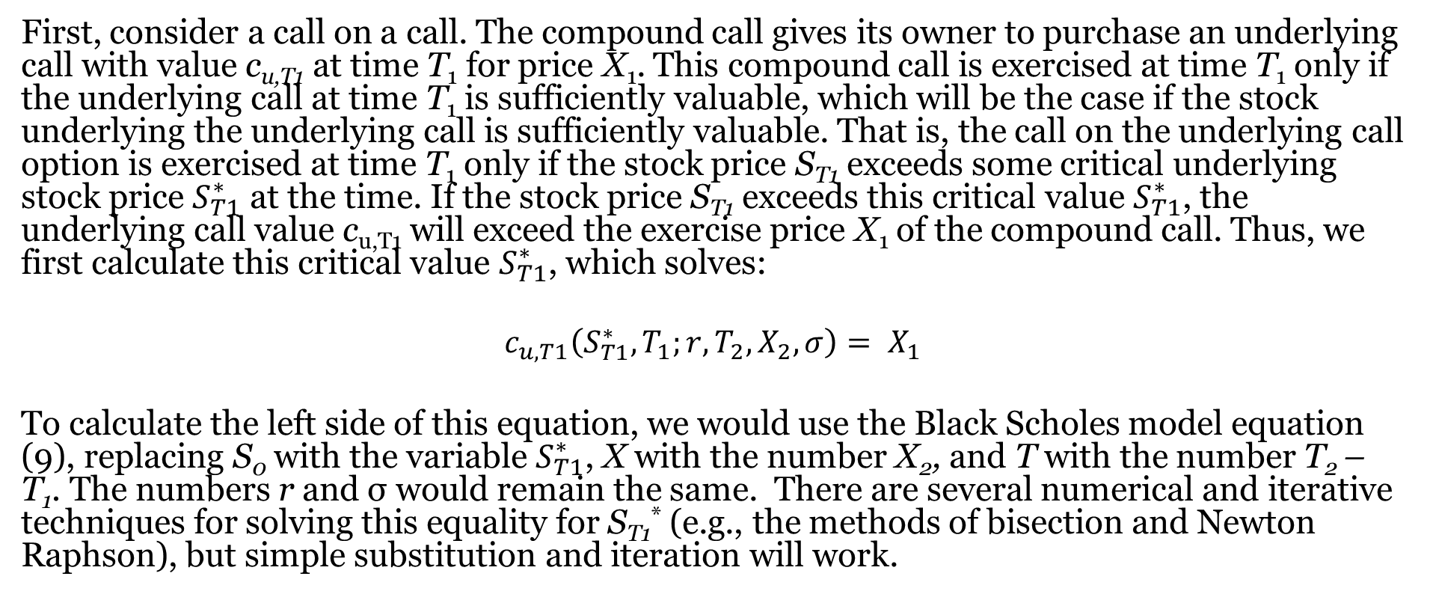
Compound Options (Continued)
First, consider a call on a call. The compound call gives its owner to purchase an underlying call with value c_{u,T1} at time T₁ for price X₁. This compound call is exercised at time T₁ only if the underlying call at time T₁ is sufficiently valuable, which will be the case if the stock underlying the underlying call is sufficiently valuable. That is, the call on the underlying call option is exercised at time T₁ only if the stock price S_{T1} exceeds some critical underlying stock price $S_{T1}^{∗}$ at the time. If the stock price S_{T1} exceeds this critical value $S_{T1}^{∗}$, the underlying call value c_{u,T1} will exceed the exercise price X₁ of the compound call. Thus, we first calculate this critical value $S_{T1}^{∗}$, which solves:
$$c_{u,T1}\left(S_{T1}^{∗}, T_{1};r, T_{2}, X_{2}, σ\right)= X_{1}$$
To calculate the left side of this equation, we would use the Black Scholes model equation (9), replacing S₀ with the variable $S_{T1}^{∗}$, X with the number X₂, and T with the number T₂ – T₁. The numbers r and σ would remain the same. There are several numerical and iterative techniques for solving this equality for S_{T1}* (e.g., the methods of bisection and Newton Raphson), but simple substitution and iteration will work.

Slide 53
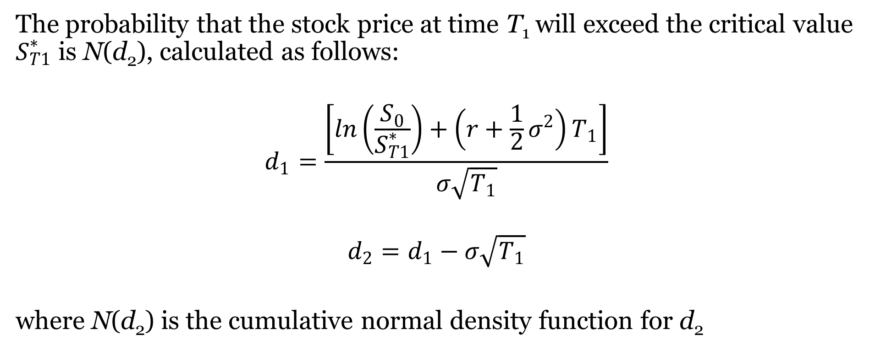
Estimating Exercise Probabilities
The probability that the stock price at time T₁ will exceed the critical value $S_{T1}^{∗}$ is N(d₂), calculated as follows:
$$d_{1}=\frac{\left[ln\left(\frac{S_{0}}{S_{T1}^{∗}}\right)+\left(r+\frac{1}{2}σ^{2}\right)T_{1}\right]}{σ\sqrt{T_{1}}}$$
$$d_{2}=d_{1}−σ\sqrt{T_{1}}$$
where N(d₂) is the cumulative normal density function for d₂

Slide 54
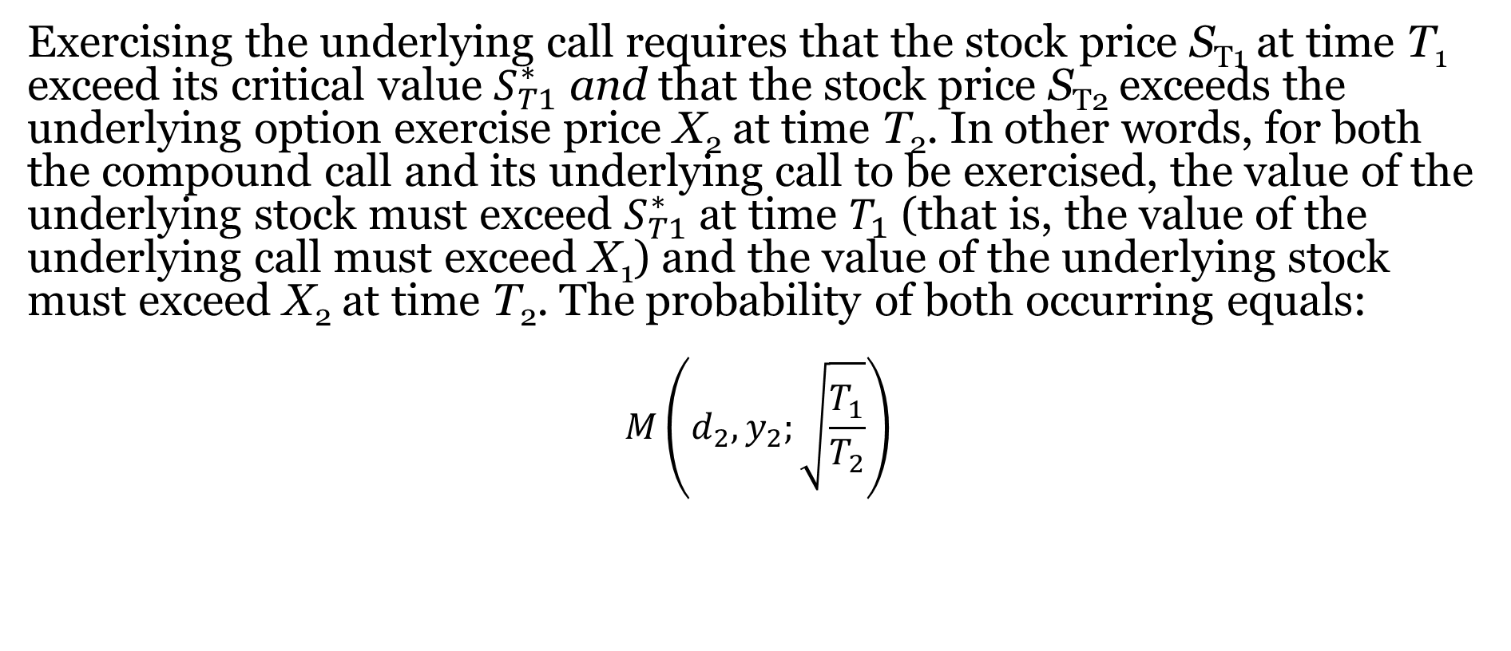
Estimating Exercise Probabilities (Continued)
Exercising the underlying call requires that the stock price S_{T1} at time T₁ exceed its critical value $S_{T1}^{∗}$ and that the stock price S_{T2} exceeds the underlying option exercise price X₂ at time T₂. In other words, for both the compound call and its underlying call to be exercised, the value of the underlying stock must exceed $S_{T1}^{∗}$ at time $T_{1}$ (that is, the value of the underlying call must exceed X₁) and the value of the underlying stock must exceed X₂ at time T₂. The probability of both occurring equals:
$$M\left(d_{2},y_{2};\sqrt{\frac{T_{1}}{T_{2}}}\right)$$

Slide 55
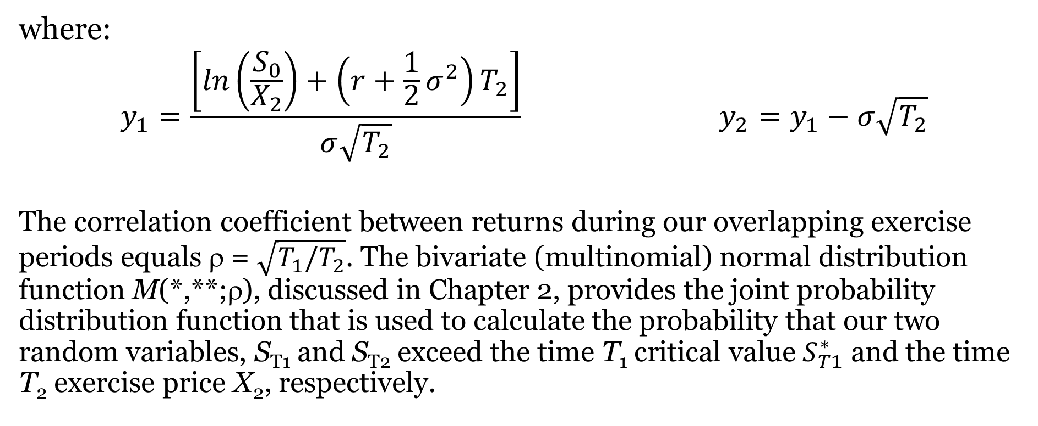
Estimating Exercise Probabilities (Continued)
where:
$$y_{1}=\frac{\left[ln\left(\frac{S_{0}}{X_{2}}\right)+\left(r+\frac{1}{2}σ^{2}\right)T_{2}\right]}{σ\sqrt{T_{2}}} y_{2}=y_{1}−σ\sqrt{T_{2}}$$
The correlation coefficient between returns during our overlapping exercise periods equals ρ = $\sqrt{T_{1}/T_{2}}$. The bivariate (multinomial) normal distribution function M(*,**;ρ), discussed in Chapter 2, provides the joint probability distribution function that is used to calculate the probability that our two random variables, S_{T1} and S_{T2} exceed the time T₁ critical value $S_{T1}^{∗}$ and the time T₂ exercise price X₂, respectively.

Slide 56
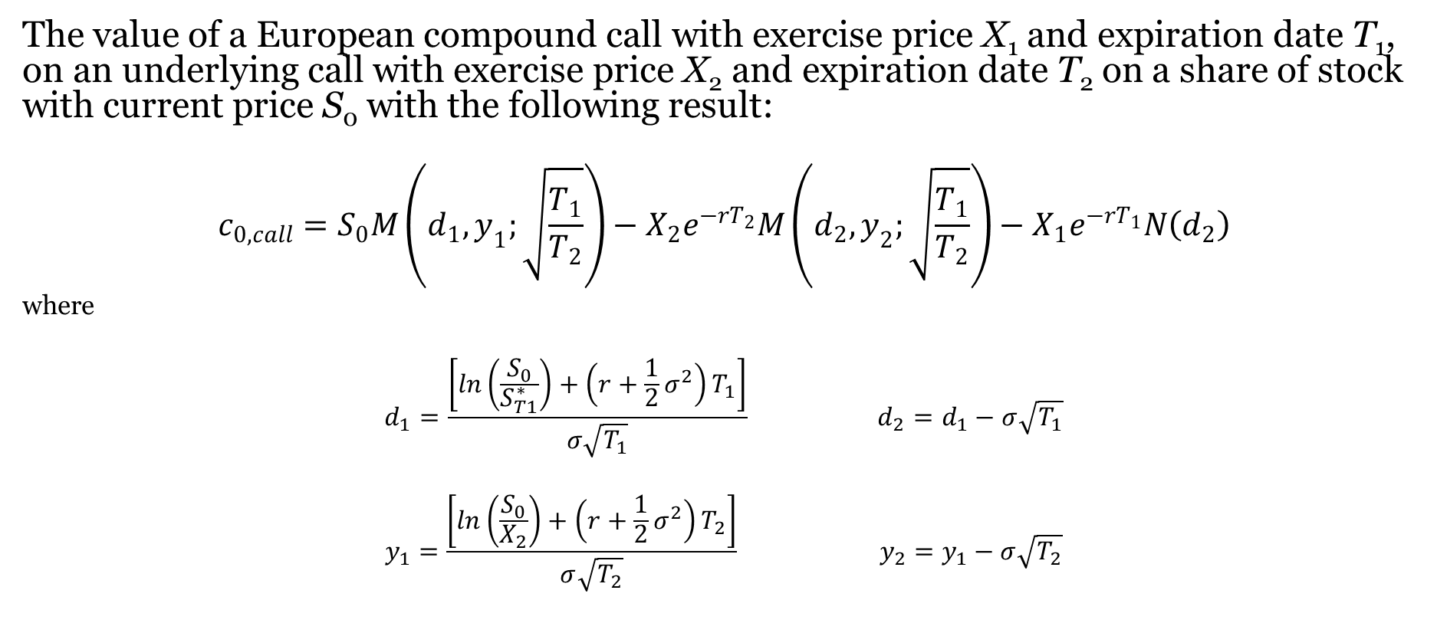
Valuing The Compound Call
The value of a European compound call with exercise price X₁ and expiration date T₁, on an underlying call with exercise price X₂ and expiration date T₂ on a share of stock with current price S₀ with the following result:
$$c_{0,call}=S_{0}M\left(d_{1},y_{1};\sqrt{\frac{T_{1}}{T_{2}}}\right)−X_{2}e^{−rT_{2}}M\left(d_{2},y_{2};\sqrt{\frac{T_{1}}{T_{2}}}\right)−X_{1}e^{−rT_{1}}N\left(d_{2}\right)$$
where
$$d_{1}=\frac{\left[ln\left(\frac{S_{0}}{S_{T1}^{∗}}\right)+\left(r+\frac{1}{2}σ^{2}\right)T_{1}\right]}{σ\sqrt{T_{1}}} d_{2}=d_{1}−σ\sqrt{T_{1}}$$
$$y_{1}=\frac{\left[ln\left(\frac{S_{0}}{X_{2}}\right)+\left(r+\frac{1}{2}σ^{2}\right)T_{2}\right]}{σ\sqrt{T_{2}}} y_{2}=y_{1}−σ\sqrt{T_{2}}$$

Slide 57
Illustration: Valuing The Compound Call
Consider a compound call with exercise price X₁ = 3, expiring in three months (T₁ = .25) on an equity call, with exercise price X₂ = 45, expiring in 6 months (T₂ = .5). The stock currently sells for S₀ = 50 and has a return volatility equal to 𝜎 = .4. Thus, the compound call gives its owner the right to buy an underlying call in three months for $3, which will confer the right to buy the underlying stock in six months for $45. The riskless return rate equals r = .03. What is the value of this compound call?

Slide 58
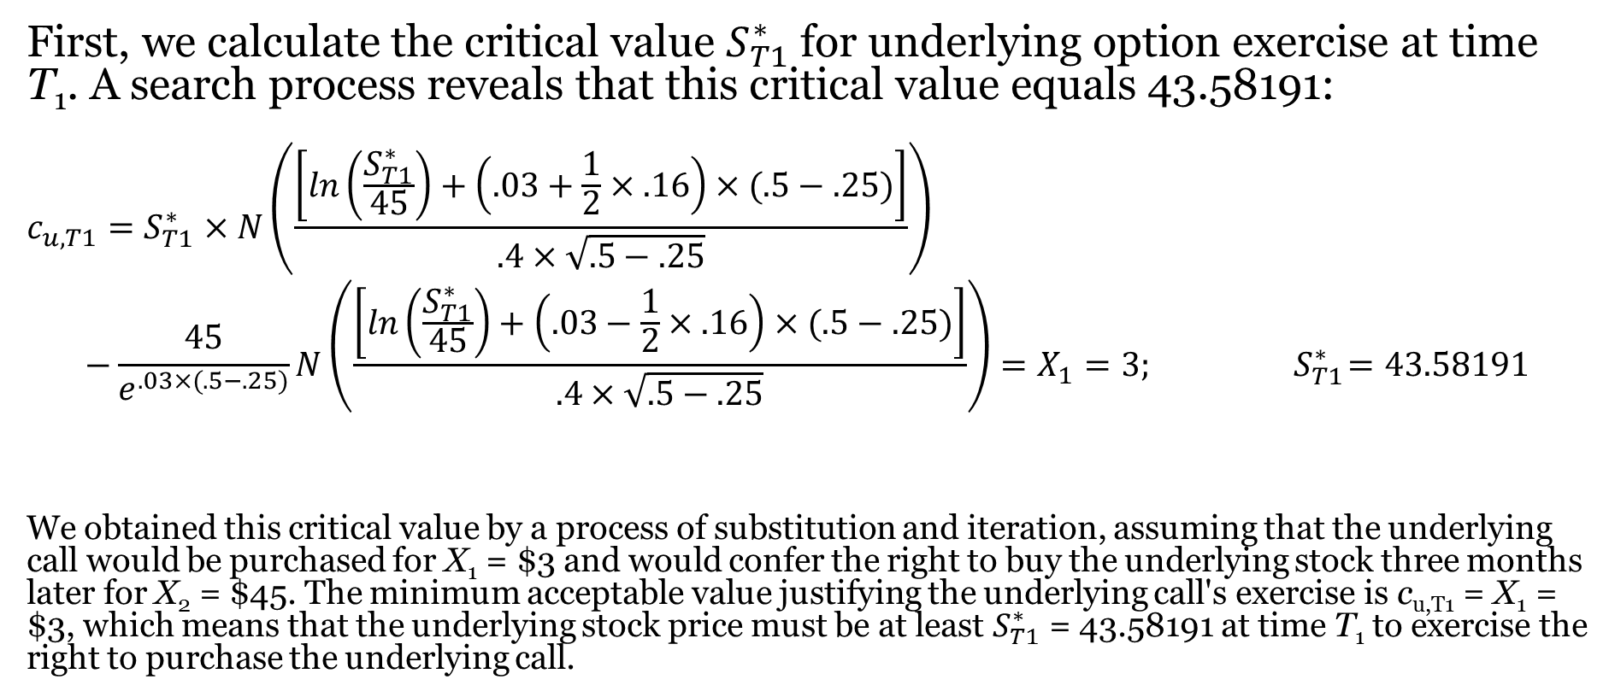
Illustration: Valuing the Compound Call (Continued)
First, we calculate the critical value $S_{T1}^{∗}$ for underlying option exercise at time T₁. A search process reveals that this critical value equals 43.58191:
$$c_{u,T1}=S_{T1}^{∗}×N\left(\frac{\left[ln\left(\frac{S_{T1}^{∗}}{45}\right)+\left(.03+\frac{1}{2}×.16\right)×(.5−.25)\right]}{.4×\sqrt{.5−.25}}\right)$$
$$−\frac{45}{e^{.03×(.5−.25)}}N\left(\frac{\left[ln\left(\frac{S_{T1}^{∗}}{45}\right)+\left(.03−\frac{1}{2}×.16\right)×(.5−.25)\right]}{.4×\sqrt{.5−.25}}\right)=X_{1}=3; { S}_{T1}^{∗}=43.58191$$
We obtained this critical value by a process of substitution and iteration, assuming that the underlying call would be purchased for X₁ = $3 and would confer the right to buy the underlying stock three months later for X₂ = $45. The minimum acceptable value justifying the underlying call's exercise is c_{u,T1} = X₁ = $3, which means that the underlying stock price must be at least $S_{T1}^{∗}$ = 43.58191 at time T₁ to exercise the right to purchase the underlying call.

Slide 59
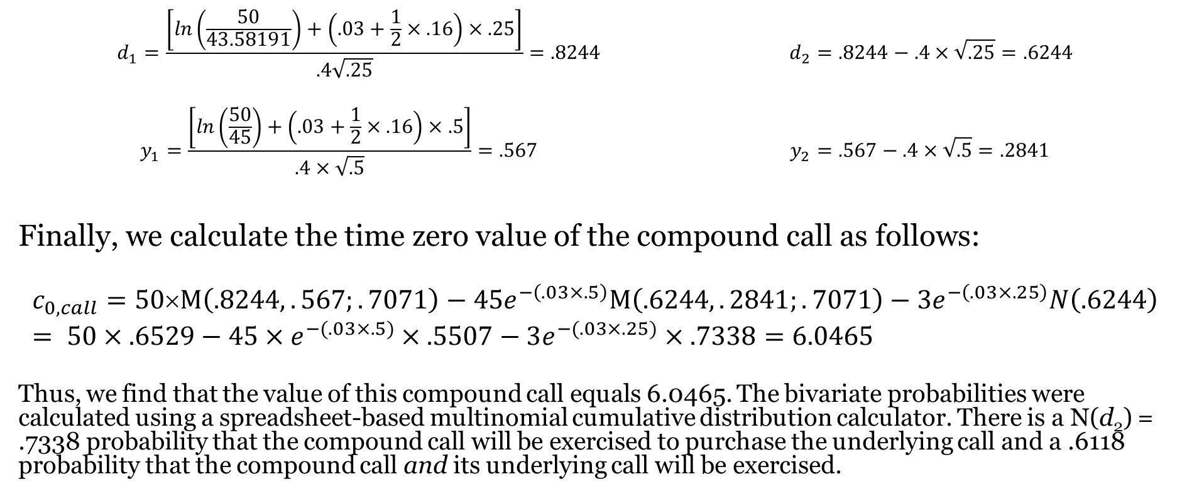
Illustration: Valuing the Compound Call (Continued)
$$d_{1}=\frac{\left[ln\left(\frac{50}{43.58191}\right)+\left(.03+\frac{1}{2}×.16\right)×.25\right]}{.4\sqrt{.25}}=.8244 d_{2}=.8244−.4×\sqrt{.25}=.6244$$
$$y_{1}=\frac{\left[ln\left(\frac{50}{45}\right)+\left(.03+\frac{1}{2}×.16\right)×.5\right]}{.4×\sqrt{.5}}=.567 y_{2}=.567−.4×\sqrt{.5}=.2841$$
Finally, we calculate the time zero value of the compound call as follows:
$$c_{0,call}=50×M\left(.8244,.567;.7071\right)−45e^{−\left(.03×.5\right)}M\left(.6244,.2841;.7071\right)−3e^{−\left(.03×.25\right)}N\left(.6244\right)= 50×.6529−45×e^{−(.03×.5)}×.5507−3e^{−(.03×.25)}×.7338=6.0465$$
Thus, we find that the value of this compound call equals 6.0465. The bivariate probabilities were calculated using a spreadsheet-based multinomial cumulative distribution calculator. There is a N(d₂) = .7338 probability that the compound call will be exercised to purchase the underlying call and a .6118 probability that the compound call and its underlying call will be exercised.

Slide 60
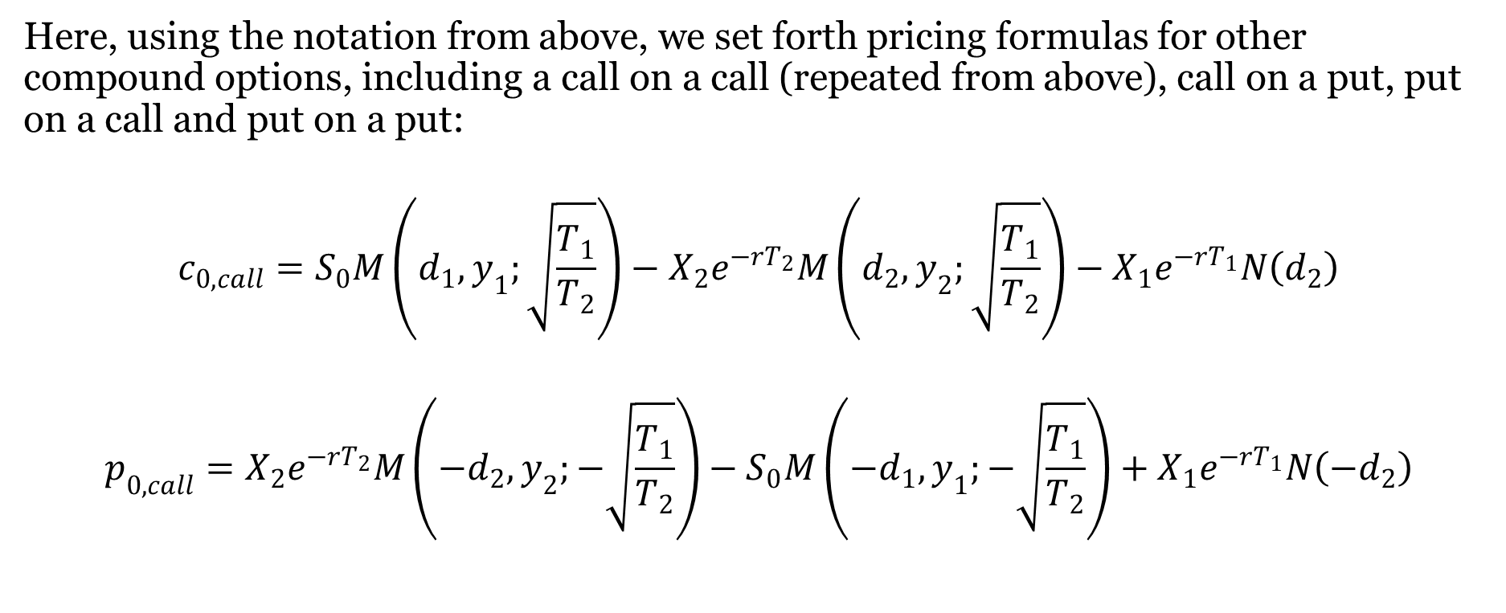
Put-Call Parity For Compound Options
Here, using the notation from above, we set forth pricing formulas for other compound options, including a call on a call (repeated from above), call on a put, put on a call and put on a put:
$$c_{0,call}=S_{0}M\left(d_{1},y_{1};\sqrt{\frac{T_{1}}{T_{2}}}\right)−X_{2}e^{−rT_{2}}M\left(d_{2},y_{2};\sqrt{\frac{T_{1}}{T_{2}}}\right)−X_{1}e^{−rT_{1}}N\left(d_{2}\right)$$
$$p_{0,call}=X_{2}e^{−rT_{2}}M\left({−d}_{2},y_{2};−\sqrt{\frac{T_{1}}{T_{2}}}\right)−S_{0}M\left(−d_{1},y_{1};−\sqrt{\frac{T_{1}}{T_{2}}}\right)+X_{1}e^{−rT_{1}}N\left({−d}_{2}\right)$$

Slide 61
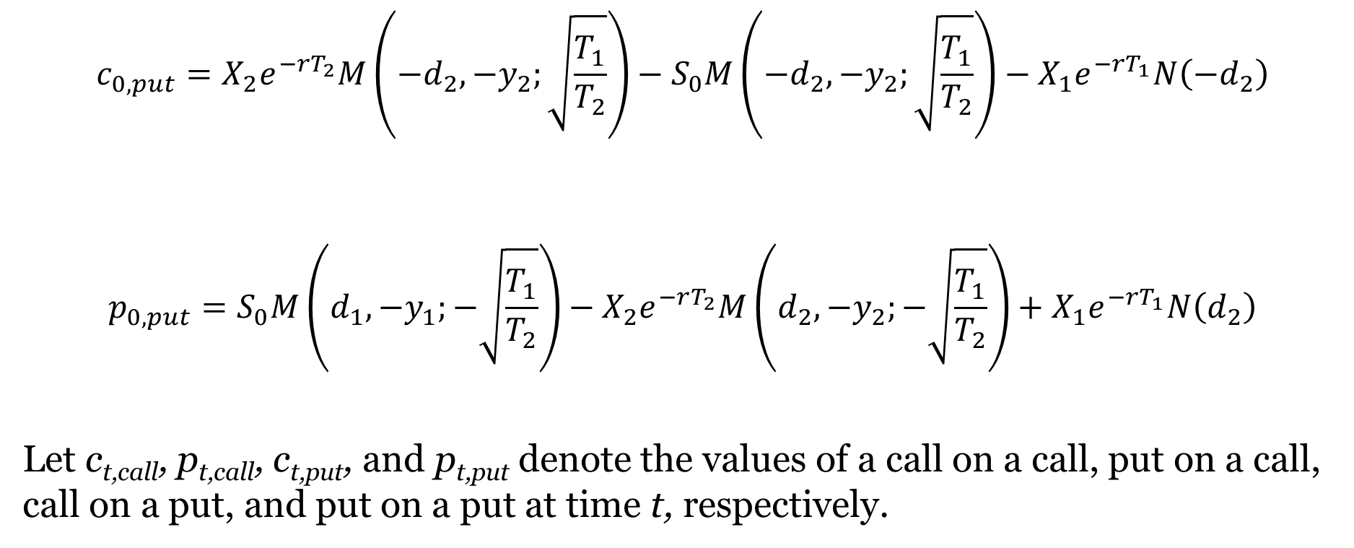
Put-Call Parity For Compound Options (Continued)
$$c_{0,put}=X_{2}e^{−rT_{2}}M\left({−d}_{2},{−y}_{2};\sqrt{\frac{T_{1}}{T_{2}}}\right)−S_{0}M\left(−d_{2},{−y}_{2};\sqrt{\frac{T_{1}}{T_{2}}}\right)−X_{1}e^{−rT_{1}}N\left({−d}_{2}\right)$$
$$p_{0,put}=S_{0}M\left(d_{1},{−y}_{1};−\sqrt{\frac{T_{1}}{T_{2}}}\right)−X_{2}e^{−rT_{2}}M\left(d_{2},{−y}_{2};−\sqrt{\frac{T_{1}}{T_{2}}}\right)+X_{1}e^{−rT_{1}}N\left(d_{2}\right)$$
Let c_{t,call}, p_{t,call}, c_{t,put}, and p_{t,put} denote the values of a call on a call, put on a call, call on a put, and put on a put at time t, respectively.

Slide 62

Put-Call Parity For Compound Options (Continued)
Present Value:
$$c_{0,call}{ − p}_{0,call} {={ c}_{0,put} − p}_{0,put}+{ S}_{0}−X_{2}e^{−rT_{2}}$$
Time T₁ Value:
MAX[c_{u,T1} -X₁,0] - MAX[X₁ - c_{u,T1},0] = MAX[p_{u,T1} -X₁,0]-MAX[X₁ - p_{u,T1},0]$+ S_{0}−X_{2}e^{−rT_{2}}$
c_{u,T1} -X₁ = p_{u,T1} -X₁ $+ S_{0}−X_{2}e^{−rT_{2}}$
Where c_{t,call}, p_{t,call}, c_{t,put}, and p_{t,put} denote the values of a call on a call, put on a call, call on a put, and put on a put at time t, respectively.

Slide 63
The Black-Scholes Model And Dividend Adjustments
Lumpy Dividend Adjustments
Merton’s Continuous Leakage Formula

Slide 64
Lumpy Dividend Adjustments
The European Known Dividend Model
Modeling American Calls
Black's Pseudo-American Call Model
The Roll-Geske-Whaley Compound Option Formula

Slide 65
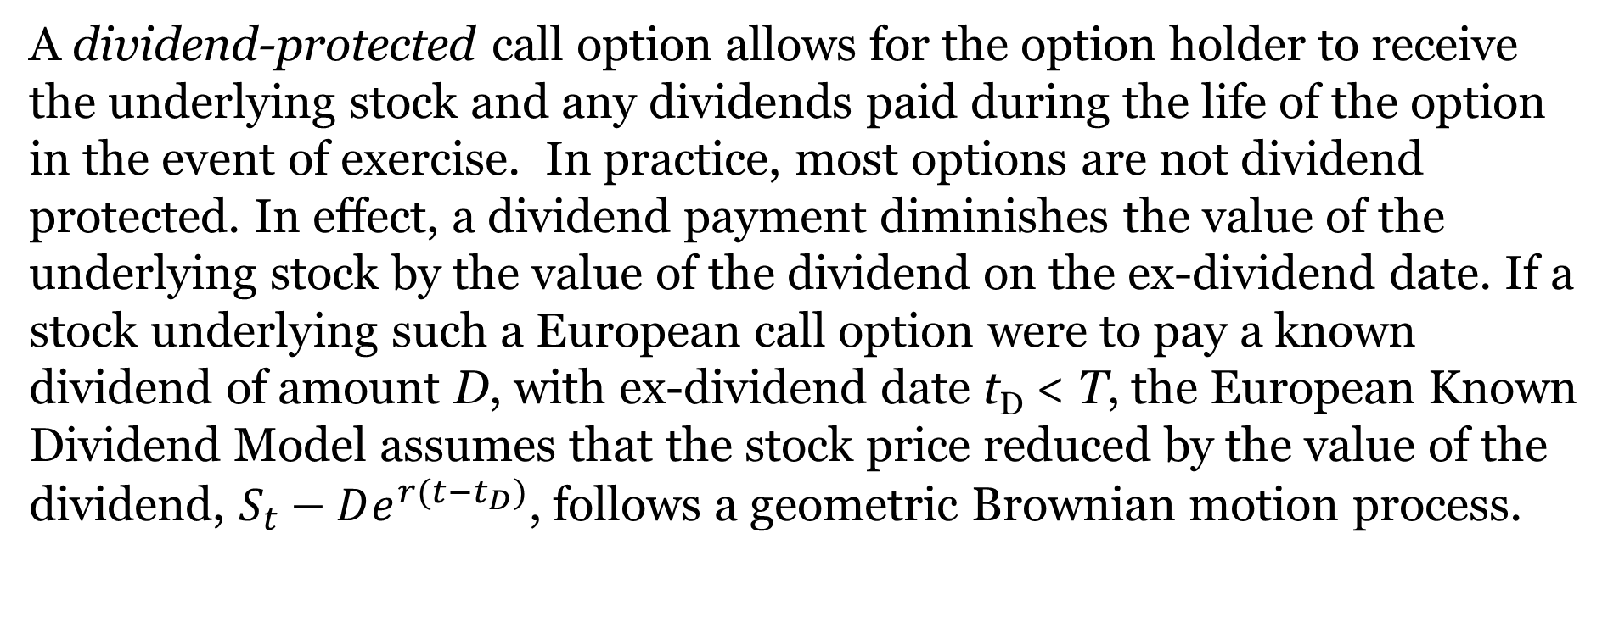
The European Known Dividend Model
A dividend-protected call option allows for the option holder to receive the underlying stock and any dividends paid during the life of the option in the event of exercise. In practice, most options are not dividend protected. In effect, a dividend payment diminishes the value of the underlying stock by the value of the dividend on the ex-dividend date. If a stock underlying such a European call option were to pay a known dividend of amount D, with ex-dividend date t_{D} < T, the European Known Dividend Model assumes that the stock price reduced by the value of the dividend, $S_{t}−De^{r(t−t_{D})}$, follows a geometric Brownian motion process.

Slide 66

The European Known Dividend Model (Continued)
The boundary condition is $c_{T}=MAX\left(S_{T}−e^{r(t−t_{D})}−X,0\right).$
The European Known Dividend Model can be used to evaluate the option as follows:

Slide 67
Modeling American Calls
Exercising American Calls Early in the Absence of Dividends:
The investor can choose between two portfolios A and B where Portfolio A consists of one call that is not exercised before expiry and the present value of X dollars Xe^{-rT} retained from not exercising the call. If the call is exercised before expiry, the portfolio, labeled as Portfolio B, will consist of one share of stock, which is purchased with the exercise money X. The last two columns of this table give expiration date portfolio values, depending on the underlying stock price S_{T} relative to the call exercise price X. Since the sum value of the call and exercise money is always either equal to or greater than the value of the stock on the expiration date (V_{AT} ≥ V_{BT}), the call should never be exercised early. That is, Portfolio A is always preferred to Portfolio B.

Slide 68
Modeling American Calls (Continued)
Exercising American Calls Early in the Presence of Dividends:
The premature exercise of an American call might occur when its underlying stock pays a dividend, where t_{D} (t_{D} ≤ T) is the time of the premature exercise. We will demonstrate shortly that this premature exercise will occur only on the ex-dividend date, and only when the dividend amount is sufficiently high relative to some critical ex-dividend date stock price S_{tD}*.

Slide 69
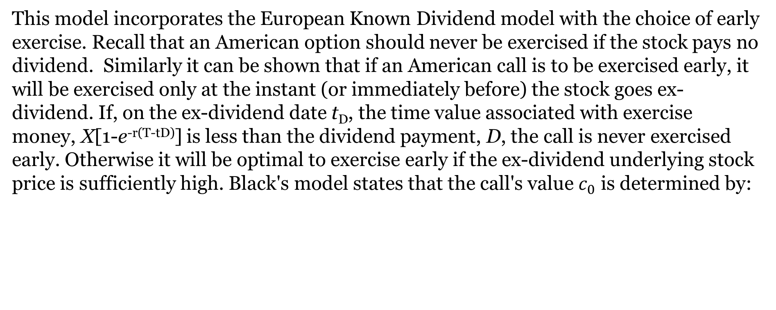
Black's Pseudo-American Call Model
This model incorporates the European Known Dividend model with the choice of early exercise. Recall that an American option should never be exercised if the stock pays no dividend. Similarly it can be shown that if an American call is to be exercised early, it will be exercised only at the instant (or immediately before) the stock goes ex-dividend. If, on the ex-dividend date t_{D}, the time value associated with exercise money, X[1-e^{-r(T-tD)}] is less than the dividend payment, D, the call is never exercised early. Otherwise it will be optimal to exercise early if the ex-dividend underlying stock price is sufficiently high. Black's model states that the call's value $c_{0}$ is determined by:
where $c_{0}^{∗}$ is the call's value assuming it is exercised immediately before the stock’s ex-dividend date and $c_{0}^{∗∗}$ is the call's value assuming the option is held until it expires.

Slide 70
The Roll-Geske-Whaley Compound Option Formula
The Roll-Geske-Whaley model requires that we first we find that minimum stock price (S_{tD}*) at the ex-dividend date (t_{D}) that will lead to early exercise of the option. That is, on the ex-dividend date, given a known dividend payment D, there is some minimum time t_{D} stock price S_{tD}* at which early exercise (on the ex-dividend date) is optimal. At this minimum price, or at a higher price, paying the exercise price and receiving the stock along with the dividend is worth more than retaining the call. Thus, it makes sense to exercise the call. All values of S_{tD} exceeding this price S_{tD}* will lead to early option exercise. This minimum price is found by solving the following for S_{tD}*:

Slide 71
The Roll-Geske-Whaley Compound Option Formula (Continued)
When dividends are zero, the call will never be exercised early. If dividends are small, the underlying stock price S_{tD}* at time t_{D} will need to be very large to justify early exercise of the call. Thus, for any dividend amount D > 0, there is some minimum stock price S_{tD}* on the ex-dividend date that would lead to early exercise of the American call.
M$\left(d(∗), y(∗); \sqrt{\frac{t_{D}}{T}}\right)$ is a cumulative multivariate (bivariate) normal distribution, where $\sqrt{\frac{t_{D}}{T}}$ is the correlation coefficient between random variables S_{tD} and S_{T}, assuming that stock returns are independent over non-overlapping periods of time.

Slide 72
The Roll-Geske-Whaley Compound Option Formula (Continued)

Slide 73
Illustration: Calculating The Value Of An American Call On Dividend-Paying Stock
Suppose that we wish to calculate the value of a 6-month X = $45 American call on a share of stock that is currently selling for $50. The stock is expected to go ex-dividend on a $5 payment in three months, and not again until after the option expires. The standard deviation of returns on the underlying stock is .4 and the riskless return rate is 3%. What is the call worth today assuming:
The European Known Dividend model?
Black’s Pseudo-American Call model?
the Roll-Geske-Whaley model?

Slide 74
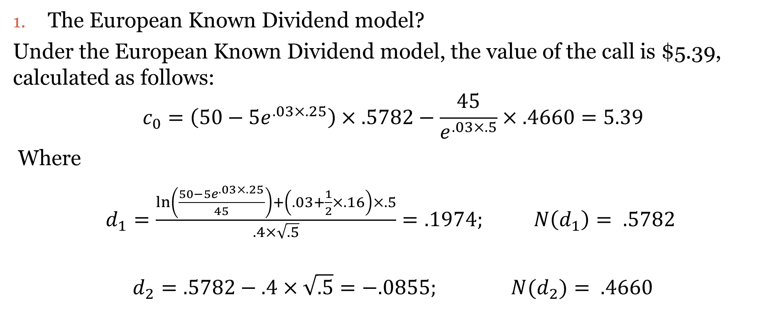
Illustration: Calculating the Value Of An American Call On Dividend-Paying Stock (Continued)
The European Known Dividend model?
Under the European Known Dividend model, the value of the call is $5.39, calculated as follows:
$$c_{0}=\left(50−5e^{.03×.25}\right)×.5782−\frac{45}{e^{.03×.5}}×.4660=5.39$$
Where
$d_{1}=\frac{\ln\left(\frac{50−5e^{.03×.25}}{45}\right)+\left(.03+\frac{1}{2}×.16\right)×.5}{.4×\sqrt{.5}}=.1974; N\left(d_{1}\right)= .5782$
$$d_{2}=.5782−.4×\sqrt{.5}{=−.0855; N(d}_{2})= .4660$$

Slide 75
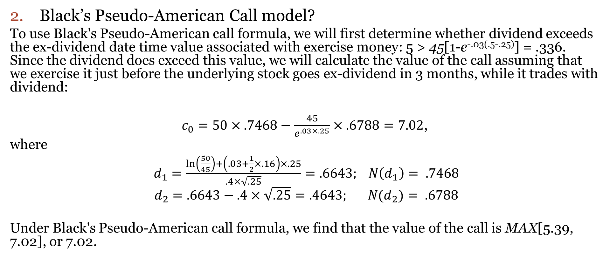
Illustration: Calculating the Value Of An American Call On Dividend-Paying Stock (Continued)
2. Black’s Pseudo-American Call model?
To use Black's Pseudo-American call formula, we will first determine whether dividend exceeds the ex-dividend date time value associated with exercise money: 5 > 45[1-e^{-.03(.5-.25)}] = .336. Since the dividend does exceed this value, we will calculate the value of the call assuming that we exercise it just before the underlying stock goes ex-dividend in 3 months, while it trades with dividend:
$c_{0}=50×.7468−\frac{45}{e^{.03×.25}}×.6788=7.02$,
where
$d_{1}=\frac{\ln\left(\frac{50}{45}\right)+\left(.03+\frac{1}{2}×.16\right)×.25}{.4×\sqrt{.25}}=.6643; N\left(d_{1}\right)= .7468$
$d_{2}=.6643−.4×\sqrt{.25}{=.4643; N(d}_{2})= .6788$
Under Black's Pseudo-American call formula, we find that the value of the call is MAX[5.39, 7.02], or 7.02.

Slide 76
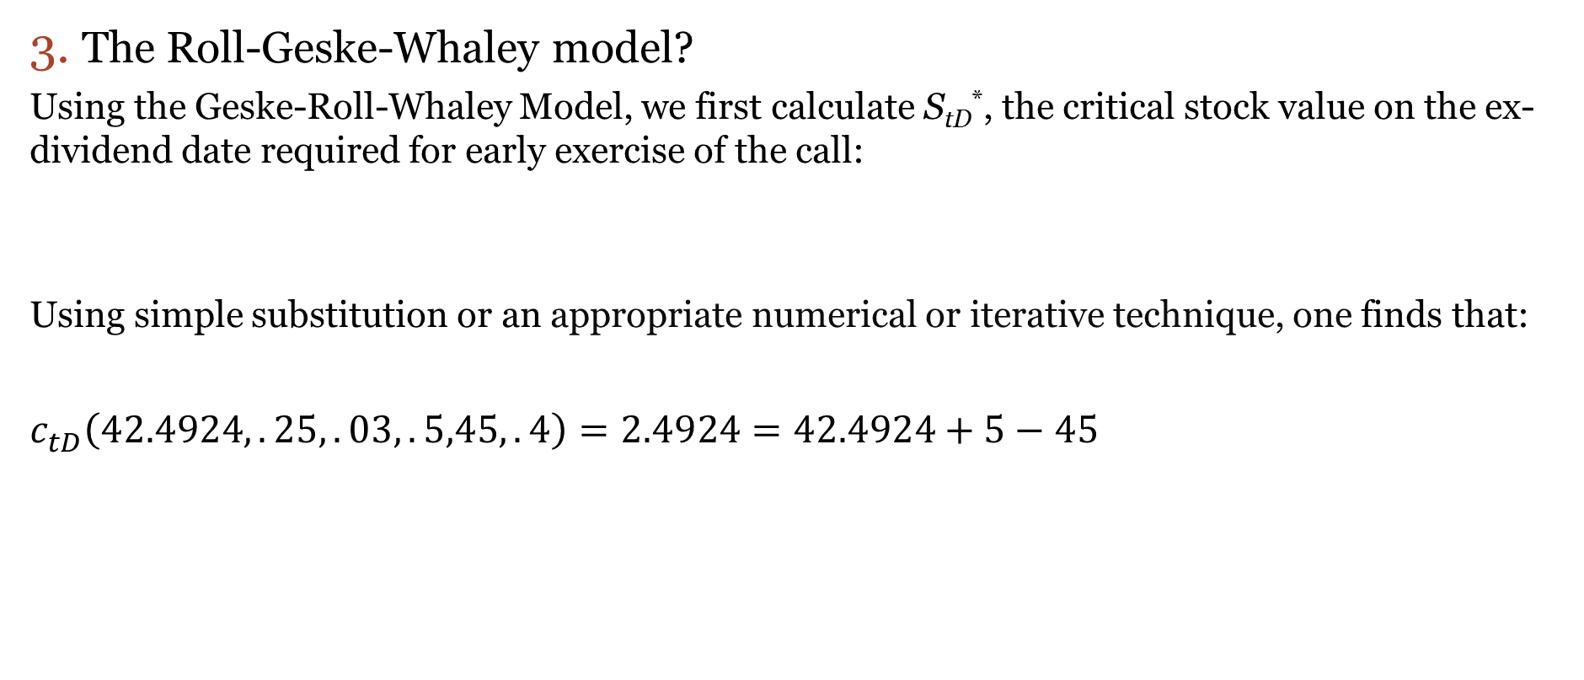
Illustration: Calculating the Value Of An American Call On Dividend-Paying Stock (Continued)
3. The Roll-Geske-Whaley model?
Using the Geske-Roll-Whaley Model, we first calculate S_{tD}*, the critical stock value on the ex-dividend date required for early exercise of the call:
Using simple substitution or an appropriate numerical or iterative technique, one finds that:
$c_{tD}^{ }\left(42.4924,.25,.03,.5,45,.4\right)=2.4924=42.4924+5−45$
$$c_{tD}^{ }(S_{tD}^{∗},.25,.03,.5,45,.4)=S_{tD}^{∗}+5−45$$
This means that if the stock is selling for S_{tD}* = $42.4924 in 3 months (t_{D} = .25), the call on the stock trading ex-dividend will have the same value as the stock, plus declared dividend minus the exercise money. Thus, as long as the ex-dividend value of the stock plus the dividend minus exercise money exceeds the ex-dividend call value, the call will be exercised early.

Slide 77
Illustration: Calculating the Value Of An American Call On Dividend-Paying Stock (Continued)
3. The Roll-Geske-Whaley model? (continued)
The value of the American call is found to be 6.96, as follows:
Where

Slide 78
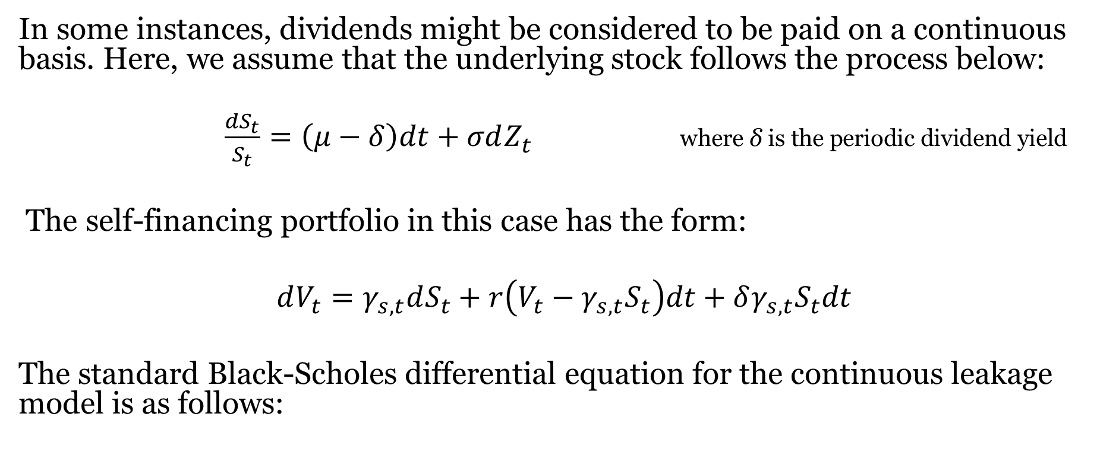
Merton’s Continuous Leakage Formula
In some instances, dividends might be considered to be paid on a continuous basis. Here, we assume that the underlying stock follows the process below:
$\frac{{dS}_{t}}{S_{t}}=\left(μ−δ\right)dt+σdZ_{t}$ $\text{where} \text{δ} \text{is} \text{the} \text{periodic} \text{dividend} \text{yield}$
The self-financing portfolio in this case has the form:
$$dV_{t}=γ_{s,t}dS_{t}+r\left(V_{t}−γ_{s,t}S_{t}\right)dt+δγ_{s,t}S_{t}dt$$
The standard Black-Scholes differential equation for the continuous leakage model is as follows:

Slide 79
Merton’s Continuous Leakage Formula (Continued)
Its particular solution, subject to the boundary condition c_{T} = MAX[0, S_{T} - X] for a European call, is given as follows:
where
and for a European put :
p₀ = c₀ + Xe^{-rT} - S₀e^{-δT}

Slide 80
Illustration: Continuous Dividend Leakage
Return to our earlier example where an investor is considering six-month options on a stock that is currently priced at $75. The exercise price of the call and put are $80 and the current riskless rate of return is 10% per annum. The variance of annual returns on the underlying stock is 16%. However, this stock will pay a continuous annual dividend at a rate of 2%. What are the values of these call and put options on this stock?
With N(d₁) = .522 and N(d₂) = .41
p₀ = 7.56 + 80(.9512) - 75e^{-.02×.5} = 9.41

Slide 81
Beyond Plain Vanilla Options On Stock
Exchange Options: Provide for the exchange of one asset for another
Currency Options: A specific type of exchange option that provides for the exchange of one currency for another

Slide 82
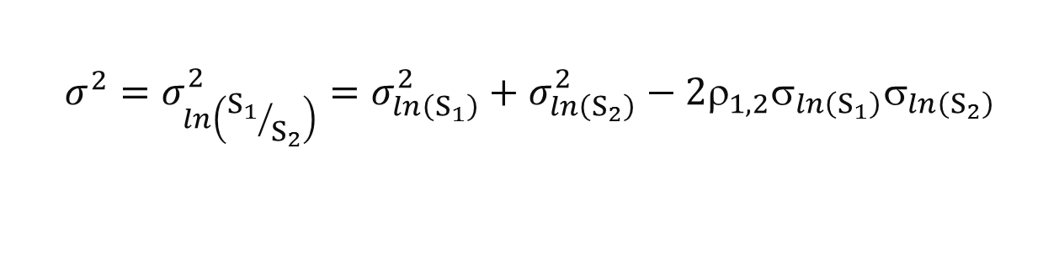

Exchange Options
Suppose that the prices S₁ and S₂ of two assets follow geometric Brownian motion processes with σ₁ and σ₂ as standard deviations of logarithms of price relatives (or returns) for each of the two securities:
And the variance of logarithms of price relatives of the two assets relative to one another is σ²:
where E[dZ₁ × dZ₂] = ρ_{1,2}dt, where ρ_{1,2} is the correlation coefficient between logarithms of price relatives ln(S₁/S₂) between the two securities.
$$\frac{{dS}_{1}}{S_{1}}= μ_{1}dt+σ_{1}{dZ}_{1} \frac{{dS}_{2}}{S_{2}}= μ_{2}dt+σ_{2}{dZ}_{2}$$
$$σ^{2}=σ_{\ln\left({S_{1}}/{S_{2}}\right)}^{2}=σ_{\ln\left(S_{1}\right)}^{2}+σ_{\ln\left(S_{2}\right)}^{2}−2ρ_{1,2}σ_{\ln\left(S_{1}\right)}σ_{\ln\left(S_{2}\right)}$$

Slide 83
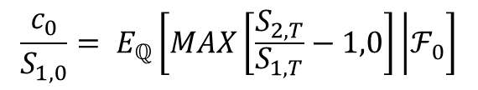
Changing The Numeraire For Pricing The Exchange Call
Using our notation from Section 7.2.3, the exchange option is valued in risk-neutral probability space as:
We can change our numeraire to stock 1. Now, the exchange option can be valued in a Black-Scholes environment with stock 1 as the numeraire:
where
$$\frac{c_{0}}{S_{1,0}}= E_{ℚ}\left[MAX\left[\frac{S_{2,T}}{S_{1,T}}−1,0\right] | ℱ_{0}\right]$$

Slide 84
Exchange Option Illustration
The Predator Company has announced its intent to acquire the Prey Company through an exchange offer.
This offer expires in 90 days (T = .25 years).
Shares of stock in the two companies follow geometric Brownian motion processes with a variance of σ²_{ln(S1)} = .16 for Predator (Predator is company 1) and σ²_{ln(S2)} = .36 for Prey, and zero correlation ρ_{1,2} = 0 between the two.
Predator Company stock is currently selling for $40 and Prey shares are selling for $50.
The current riskless return rate is .05.
What is the value of the exchange option associated with this tender offer?

Slide 85
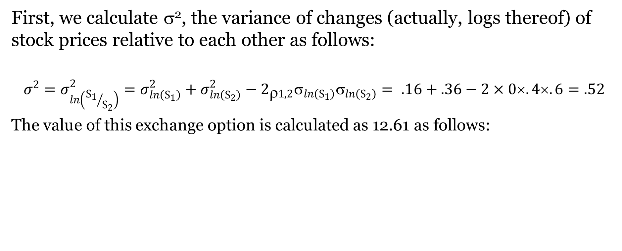
Exchange Option Illustration (Continued)
First, we calculate σ², the variance of changes (actually, logs thereof) of stock prices relative to each other as follows:
$$σ^{2}=σ_{\ln\left({S_{1}}/{S_{2}}\right)}^{2}=σ_{\ln\left(S_{1}\right)}^{2}+σ_{\ln\left(S_{2}\right)}^{2}−2_{ρ1,2}σ_{\ln\left(S_{1}\right)}σ_{\ln\left(S_{2}\right)}= .16+.36−2×0×.4×.6=.52$$
The value of this exchange option is calculated as 12.61 as follows:

Slide 86
Currency Options
Interest rates may differ between the foreign and domestic countries.
We quote two interest rates r(f) and r(d), one each for the foreign and domestic currencies.
The standard differential equation for currency options is as follows:
where s is the exchange rate, r(d) is the domestic riskless rate (the rate for the currency that will be given up if the option is exercised), r(f) is the foreign riskless rate (the rate for the currency which may be purchased).

Slide 87
Currency Options (Continued)
The solution to above differential equation, subject to the boundary condition is given as follows:
where

Slide 88
Currency Option Illustration
Consider the following example where call options are traded on Brazilian real (BRL). One U.S. dollar is currently worth 2 Brazilian real (s₀ = .5). We wish to evaluate a 2-year European call and put on BRL with exercise prices equal to X = .45. U.S. and Brazilian interest rates are .03 and .08, respectively. The annual standard deviation of exchange rates is .15.
We calculate d₁ = .1313 and d₂ = -.0808; N(d₁) and N(d₂) are .5522 and .4678, respectively. Thus the call is valued at c₀ = .037 and the put is valued at p₀ = .035.

